Slide 1
Intro to MIS - MGS351
Salesforce Introduction

Slide 2
Salesforce Introduction
Salesforce Lectures
Salesforce Platform Overview
Microsoft Access and Salesforce
Salesforce Terminology
Understanding Salesforce Accounts
Logging in to Salesforce

Slide 3
Salesforce Lectures
Lectures recorded previously
Ignore any references to exam, project and homework dates
There will be review/reinforcement of some concepts (eg. database terms)

Slide 4
Salesforce Platform Overview
Customizable Customer Relationships Management (CRM) platform
Accessed using a web browser - no Mac issues!
Skills are in high demand
Training through Trailhead is free

Slide 5
Microsoft Access and Salesforce
MS Access
  Tables
  Queries
  Forms
  Reports
  Macros and Modules
  Relationships
Salesforce
  Objects
  List Views
  Page Layouts
  Reports
  Automation
  Schema Builder

Slide 6
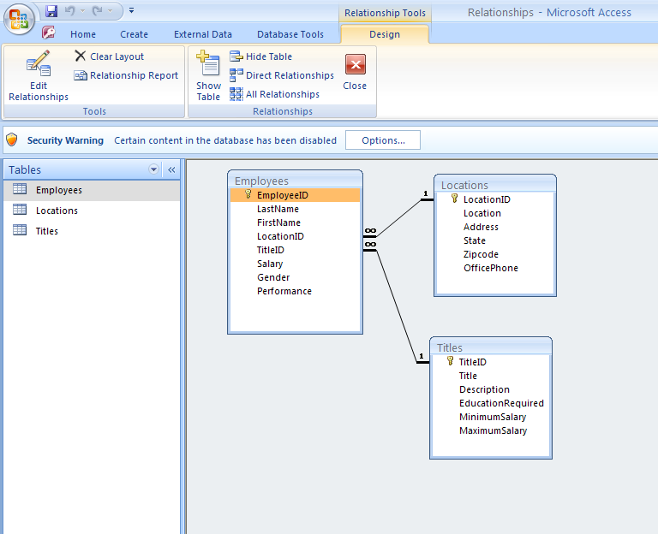

Slide 7
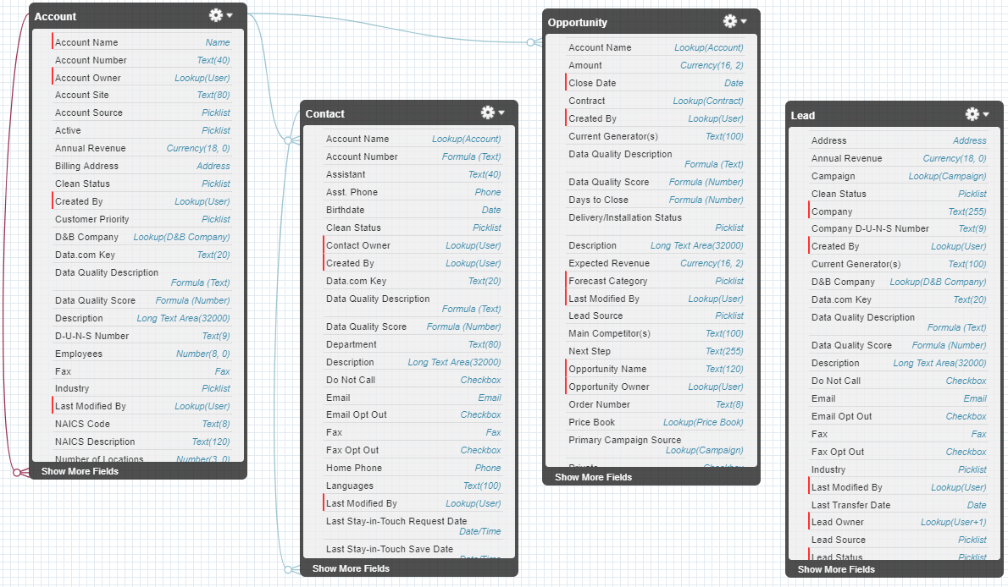
Salesforce Schema Builder

Slide 8
Salesforce Terminology
Org
App - Standard and Custom
  AppExchange marketplace provides third party apps you can install in your Org
Your group project is a Custom App that resides in your Development Org
Your homework is completed in Trailhead playgrounds
Notes:
https://help.salesforce.com/articleView?id=glossary.htm
Org: An org is an abbreviation of organization as it pertains to a deployment of Salesforce with a defined set of licensed users. An org is the virtual space provided to an individual customer of Salesforce. Your org includes all of your data and applications, and is separate from all other orgs.
App: Short for “application.” A collection of components such as tabs, reports, dashboards, and Visualforce pages that address a specific business need. Salesforce provides standard apps such as Sales and Service. You can customize the standard apps to match the way you work. In addition, you can package an app and upload it to the AppExchange along with related components such as custom fields, custom tabs, and custom objects.
Salesforce provides standard apps such as Sales and Service.
You can also build your own on-demand apps by grouping items into new custom apps. A custom app consists of a label, a description, and an ordered list of items, which often includes tabs. You can also add custom logos and branding to your custom apps.
Objects are tables in a database.
Opportunities are leads that are qualified to buy.
When a lead is converted, an account and contact are also created in Salesforce. An account is a company you’re doing business with, and a contact is someone who works at that account.

Slide 9
Understanding Salesforce Accounts
Development Org (Dev Org) Account
  Shared username and password used for group project
  Example: A1G1@mgs351S20.com
Individual Salesforce Account
  Used to complete homework in Trailhead
  Assigned to you in recitation
  Example: djmurray@mgs351s20.com

Slide 10
Understanding Salesforce Accounts
Trailhead Playground Account(s)
  A playground is a temporary org where you complete training/homework
  A playground username and password is created by Salesforce automatically when the playground is created Example: djmurray@brave-raccoon-8j5k04.com
  Do not create a new playground unless the assignment instructs you to do so

Slide 11




Homework 6 | 4500 Trailhead Points
Homework 6 Trailmix
  Trailhead Playground Management
  Data Modeling
  Lightning Experience Customization

Slide 12
Logging in to Salesforce
Use Chrome and always login using an incognito browser window!
Make sure you have no incognito windows open that are logged in to Salesforce or Trailhead
Logging in to the same browser session with different accounts does not work

Slide 13
Logging in to Salesforce - Homework
Trailhead for homework
  https://trailhead.salesforce.com
  Login using Salesforce account option
  Sign up for this during recitation
  Use individual account emailed to you
  Check homework hints!

Slide 14
Logging in to Salesforce - Project
Development Org for group project
  https://login.salesforce.com
  Use shared group account provided to you during recitation. Everyone in the group uses the same account.
  DO NOT USE YOUR UB EMAIL ACCOUNT WHEN SIGNING UP

