Slide 1
Intro to MIS - MGS351
Create Professional Quality
Output with Reports
Chapter 5

Slide 2
Chapter Overview
Reports Overview
Tabular, Summary and Matrix
Building Reports
Report Folders, Types and Filters
Report Examples
Dashboards

Slide 3
Reports
Used to format and present the database data in a professional, logical and useful manner.
The reports (output) for a system dictate what data must be stored in the database.

Slide 4
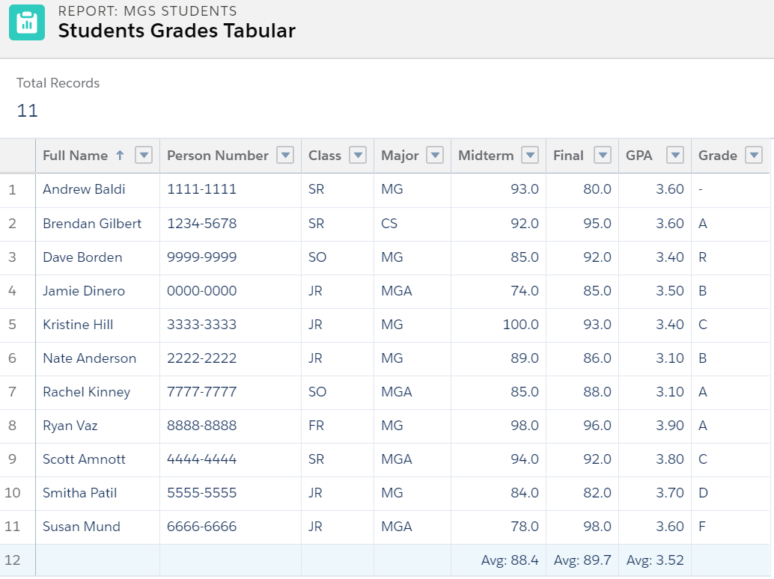
Reports - Tabular

Slide 5
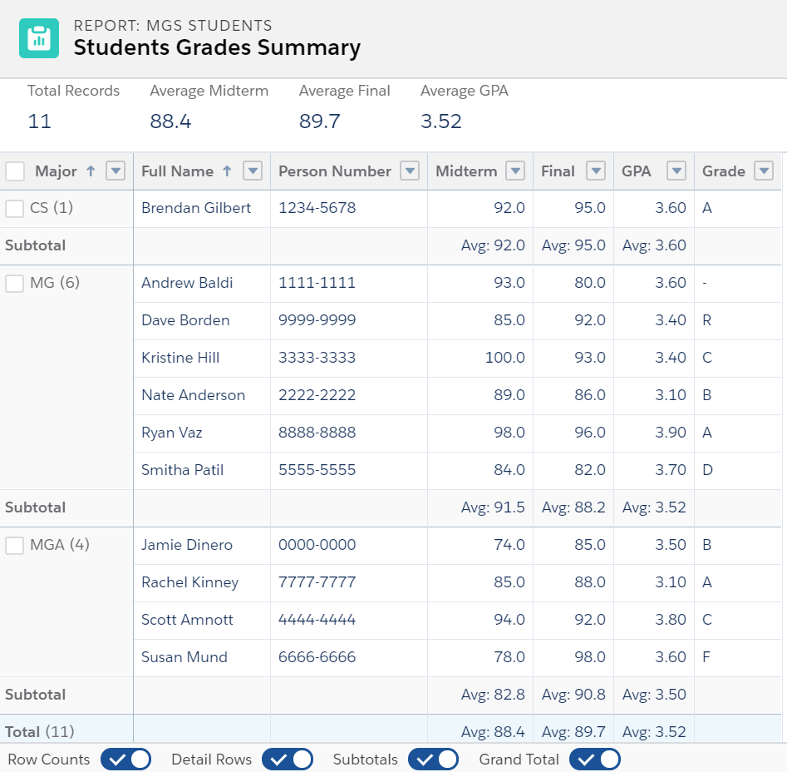
Reports - Summary

Slide 6
Reports - Summary Options

Slide 7
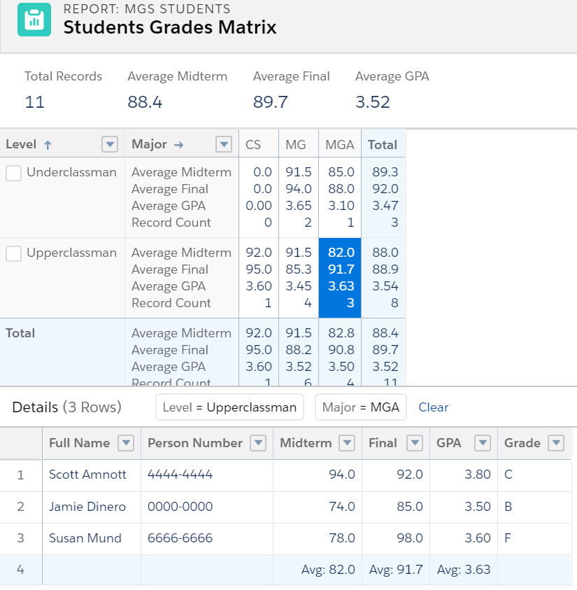
Reports - Matrix

Slide 8
Building Reports
Report Folders
Where reports are stored
Report Types
Where reports get their source data from
Report Filters
Options to limit what records are returned
Report Builder
Drag and drop interface to create reports

Slide 9
Report Folders
Reports are stored and organized in folders
Folders determine who can view, edit and manage the report
Public, Hidden or Shared settings

Slide 10
Report Type
A “template” that determines which fields and records are available for use when creating a report
Based on the relationships between a primary object and its related objects
Standard and Custom

Slide 11
Report Filters
Standard Filter
Show Me and Date Field
Field Filter
Filter Logic
AND, OR, NOT
Cross Filter
WITH or WITHOUT conditions

Slide 12
Report Examples using the
Report Builder

Slide 13
Dashboards
Dashboards are visual displays of key metrics and trends for records
Each dashboard component has a source report (1:1 mapping)
Secure dashboards with viewing options

Slide 14
Homework 7 | 4175 Trailhead Points
Homework 7 Trailmix
Formulas & Validations
Reports & Dashboards for Lightning Exp.
Quick Start: Reports & Dashboards
Filter Report Data
Quick Start: Process Builder

