Slide 1
Intro to MIS - MGS351
Obtain Valuable Information
Using Queries
Chapter 4

Slide 2
Chapter Overview
Queries
List Views
Formula Fields
Mathematical Operators and Functions (+,-,*,/)
Text Operators (Concatenation)
Logical Operators and Functions (IF)
Salesforce Object Query Language

Slide 3
Queries
Allow you to ask questions (queries) about data in the database.
Accomplished through the use of:
List Views
Limit fields displayed
Sort and filter results
Apply filter logic
Salesforce Object Query Language

Slide 4
List View Examples

Slide 5
Who is in MGS351 sorted by person number?

Slide 6
Who are Juniors in MGS351?

Slide 7
Who are Fr, So, and Jr students in MGS351?

Slide 8
Who doesn’t have a grade yet?

Slide 9
Who has a last name beginning with the letter M?

Slide 10
Who has a GPA greater than 3.5?

Slide 11
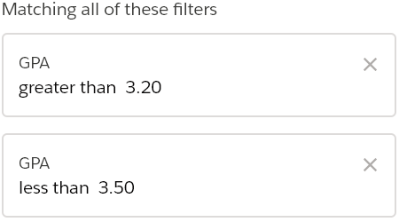
Who has a GPA between 3.2 and 3.5?

Slide 12
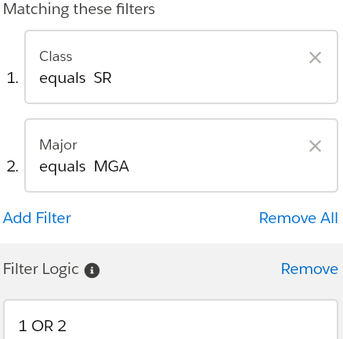
Who is a Senior OR Accounting major?

Slide 13
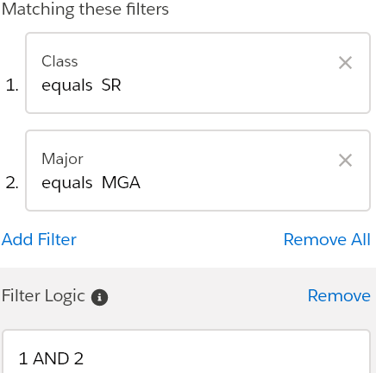
Who is a Senior AND Accounting major?

Slide 14
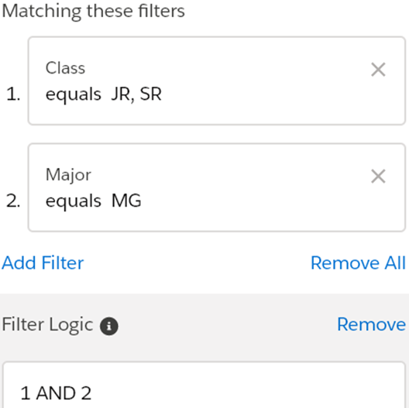
Who is a Jr or Sr and a Mgmt (MG) major?

Slide 15
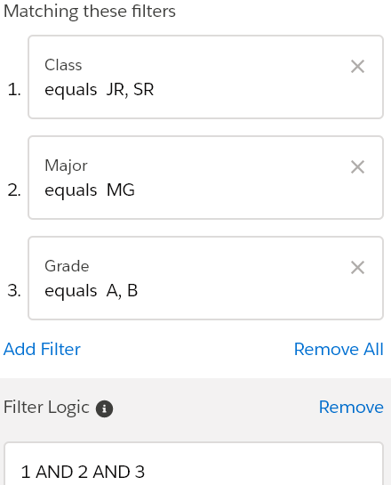
Who is a Jr or Sr and a (MG) major with a grade of A or B?

Slide 16
Who is a not a Freshman?

Slide 17
Formula Fields
Can perform simple calculations and complex operations to display calculated results.
Number of days since last sales contact
Profit margin calculation
Volume discount calculation
Account rating
Math, Text, Logical, Date, Summary and Advanced Functions

Slide 18
Formula Field - Math Examples
Add, Subtract, Multiply and Divide
Exponents
Order of Operations using ( )
MIN, MAX, SQRT, ABS, MOD
ROUND

Slide 19
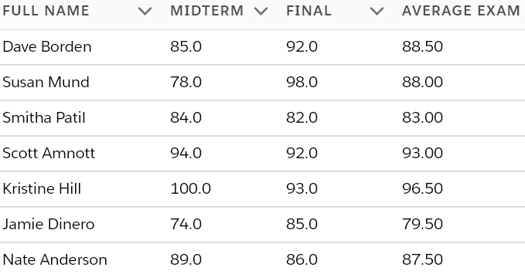
Math Calculation - Average Exam
( Midterm__c + Final__c ) / 2

Slide 20
Formula Field - Text Examples
Concatenate (&)
LEN
LEFT, MID, RIGHT
LOWER, UPPER
VALUE, TEXT
BEGINS, CONTAINS
FIND, SUBSTITUTE
TRIM

Slide 21
Concatenation
Used to combine multiple fields together or to add extra formatting in a formula field.
The ampersand sign & connects multiple fields and strings of text.
Fields are referenced by their field name and text strings are enclosed in double quotes.

Slide 22
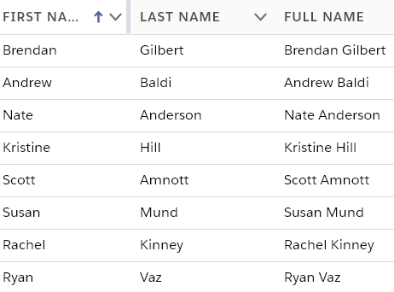
Concatenation - Full Name
First_Name__c & " " & Last_Name__c

Slide 23
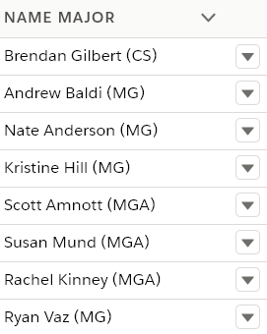
Concatenation - Name Major
Full_Name__c & " (" & Major__c & ")"

Slide 24
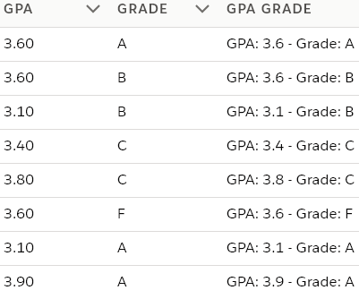
Concatenation - GPA Grade
"GPA: " & TEXT(GPA__c) & " - Grade: " & Grade__c
Space
Space

Slide 25
Formula Field - Logical Examples
=, ==, !=, <>, <, >, <=, >=, &&, ||
IF
AND, OR , NOT
ISBLANK, ISNULL, ISNUMBER
CASE

Slide 26
IF Expression
Use to conditionally evaluate data, and dynamically generate output based on it.
IF(logical_test, output_if_true, output_if_false)
In other words, a formula field can be created to display “Graduating” for seniors and “Continuing” for all other students.
IF(Class is equal to SR, display Graduating, otherwise display Continuing)

Slide 27
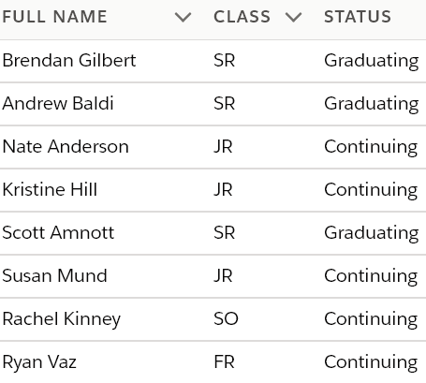
IF Expression - Status
IF(Class__c = "SR", "Graduating", "Continuing")

Slide 28
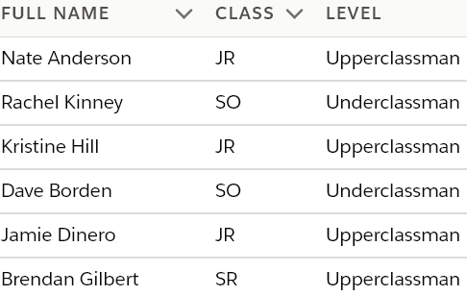
IF Expression - Level
Display “Underclassman” for FR and SO students and “Upperclassman” for JR and SR students
IF(OR (Class__c ="FR", Class__c ="SO"), "Underclassman", "Upperclassman")

Slide 29
Nested IF Expression - Performance
Display the performance rating for each student based on their course grade.
Satisfactory [A, A-, B+, B, B-, C+, C]
Marginal [C-, D]
Unsatisfactory [F]
IF(Grade__c = "F", "Unsatisfactory", IF(OR (Grade__c ="D", Grade__c = "C-"), "Marginal", "Satisfactory"))

Slide 30
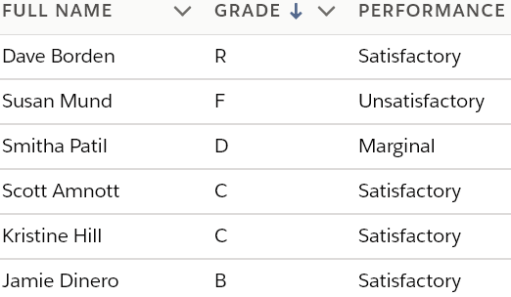
Nested IF Expression - Performance
IF(Grade__c = "F", "Unsatisfactory", IF(OR (Grade__c ="D", Grade__c = "C-"), "Marginal", "Satisfactory"))

Slide 31
Challenge Problems
Who has a last name exactly six characters long?
Sort a list view by Class order - Freshman, Sophomore, Junior, Senior

Slide 32
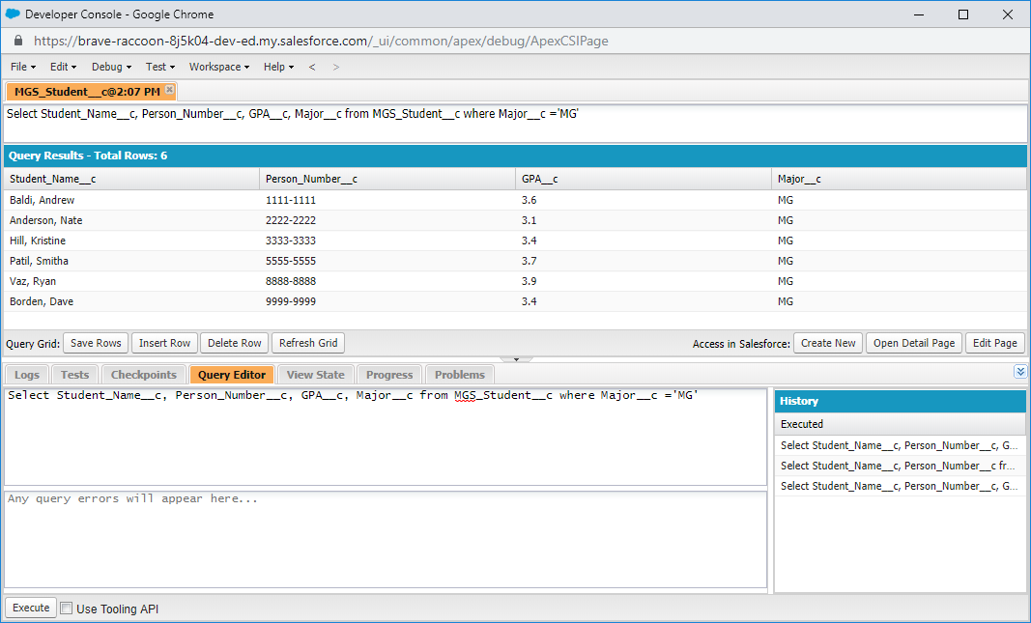
Salesforce Object Query Language - SOQL

