Slide 1
Intro to MIS - MGS351
Simplify Data Entry with Page Layouts
Chapter 3

Slide 2
Chapter Overview
Page Layouts
Details, Related, Compact Layout
Page Layout Editor
Page Layout Demo
Roll Up Summary Fields
Page Layouts and Profiles
Record Types

Slide 3
Page Layouts
Used for entering / displaying data or for presenting information in a logical manner.
Controls the fields, sections, related lists and buttons that appear when users view or edit a record.
Can modify the object’s default page layout or create a new one.

Slide 4
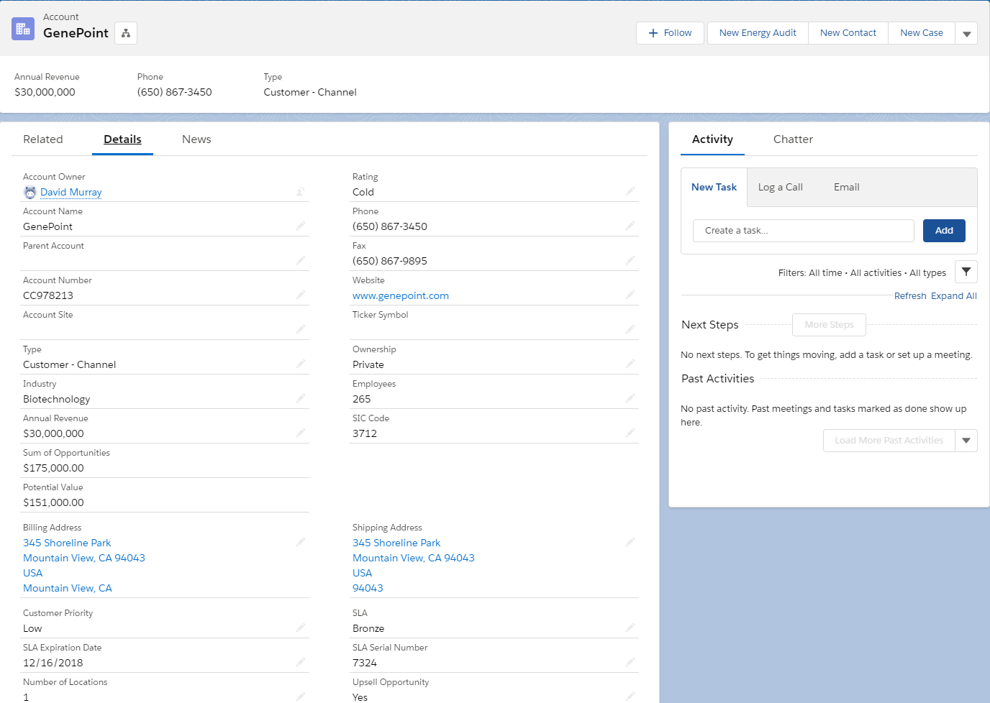
Page Layout Example - Details Tab

Slide 5
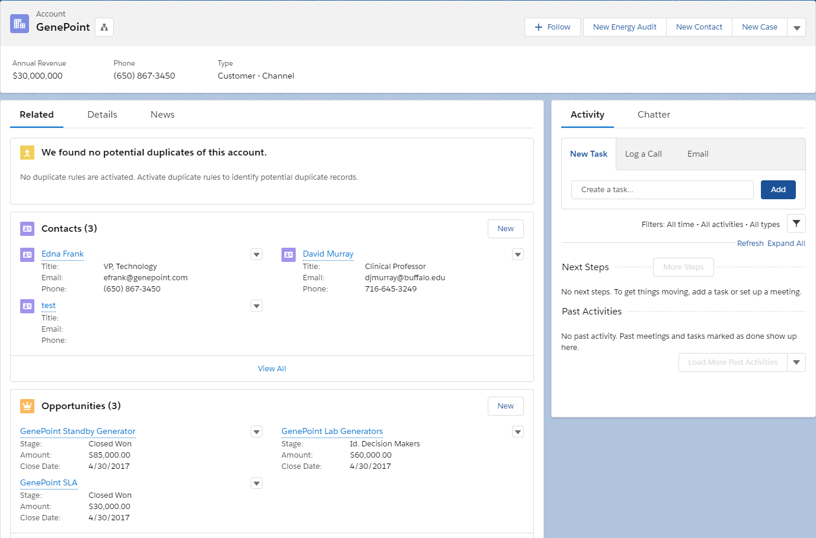
Page Layout Example - Related Tab

Slide 6
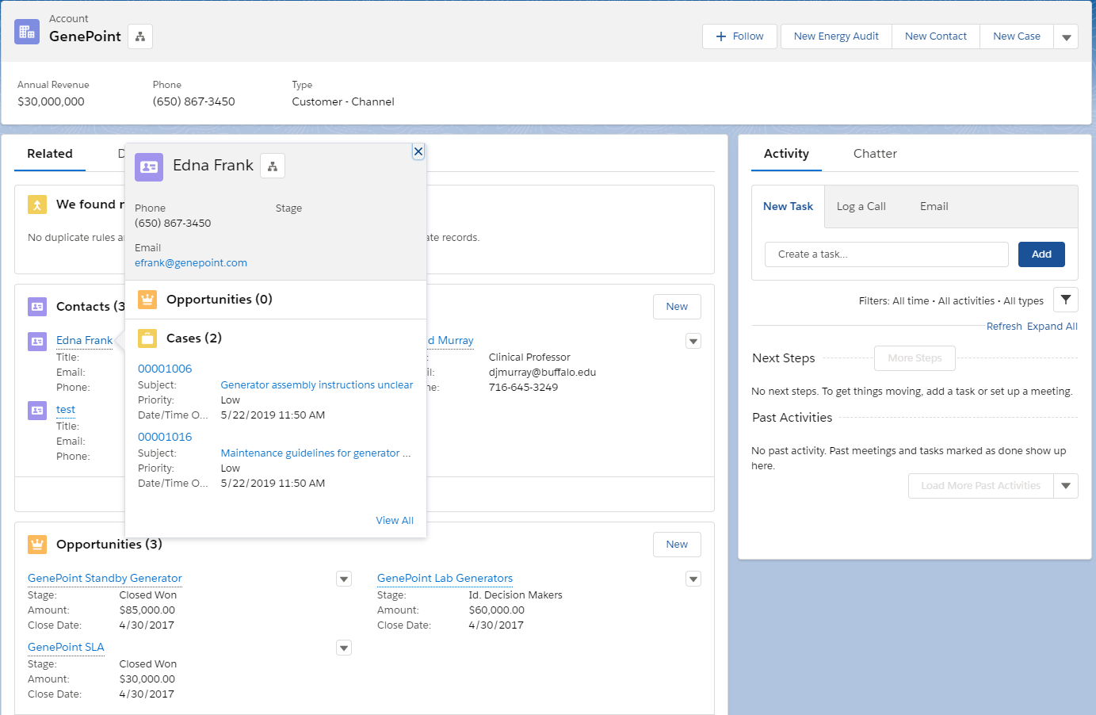
Page Layout Example - Compact Layouts
Notes:
Compact layouts control which fields your users see in the highlights panel at the top of a record. They also control the fields that appear in the expanded lookup card you see when you hover over a link in record details.

Slide 7
Page Layout Editor
Control which fields, lists of related records, and custom links users see
Customize the order that the fields appear in the page details
Set fields as visible, read only, or required
Control which standard and custom buttons appear on records and related lists
Control which quick actions appear on the page

Slide 8
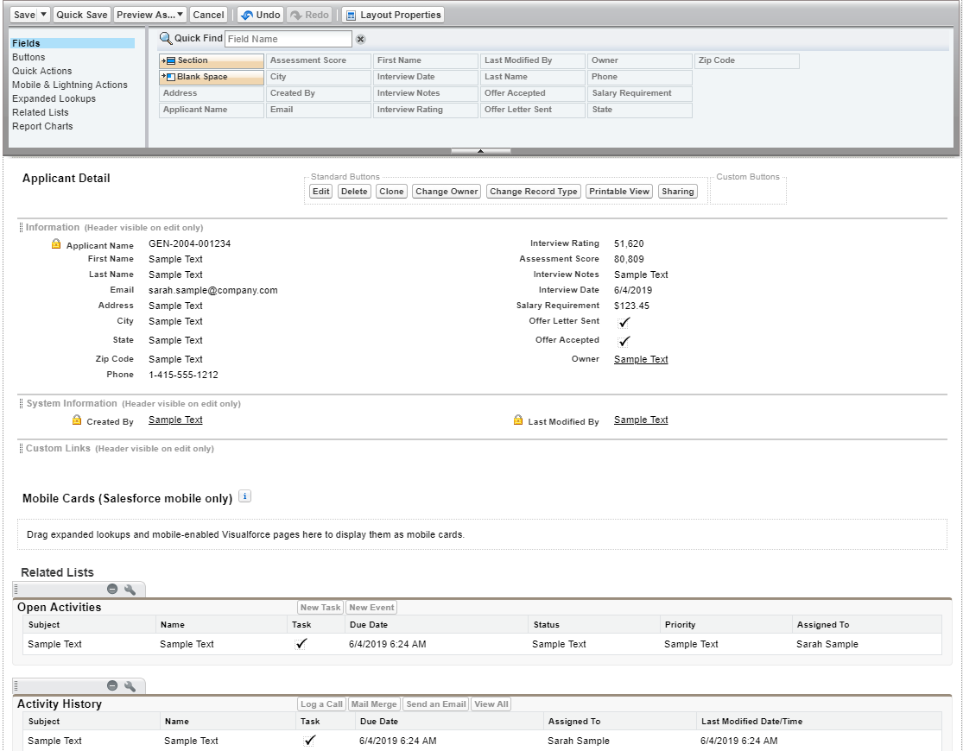
Page Layout Editor

Slide 9
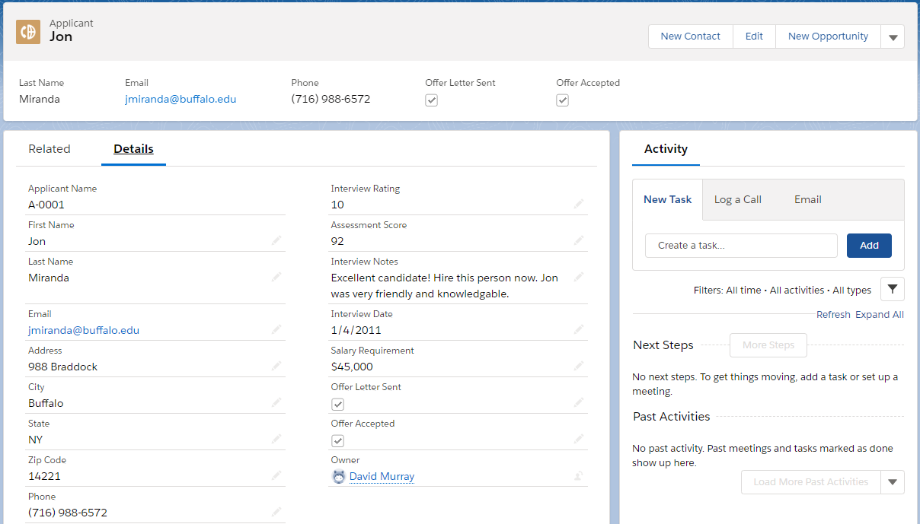
Page Layout Example

Slide 10
Page Layout Demo

Slide 11
Roll Up Summary Fields
Calculate values from a set of related records (related list)
Always based on master-detail relationships
Count, Sum, Min and Max

Slide 12
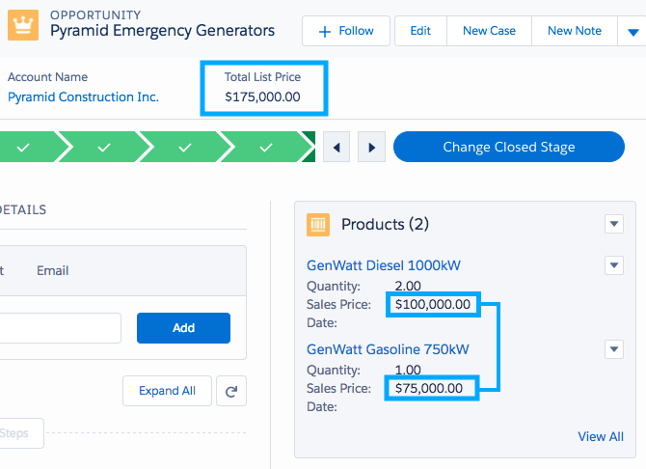
Roll Up Summary Field - Sum

Slide 13
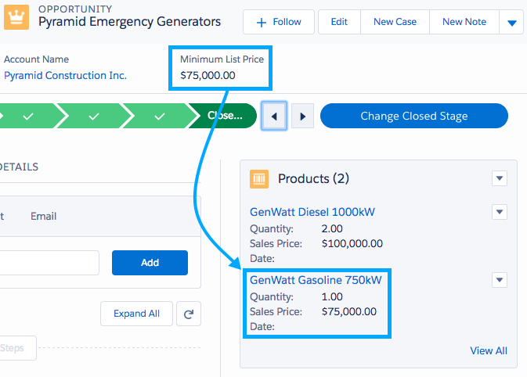
Roll Up Summary Field - Min

Slide 14
Page Layouts and Profiles
Can create multiple Page Layouts customized to different department’s needs.
Can assign Page Layouts to different user profiles.
Manager, Employee, Staff
Sales, Service, Marketing

Slide 15
Record Types
Additional fine grained customization based on user profile.
Determines the page layout and picklist values users will see.
Only shows users exactly what they need.

