Slide 1
Intro to MIS - MGS351
Design and Create Objects
to Store Data
Chapter 2

Slide 2
Chapter Overview
Databases and Decision Making
Designing Database Tables
Primary Keys
Creating Objects in Salesforce
Field Data Types and Properties

Slide 3
Databases and Decision Making
Input
(Data)
Process
Output
(Information)
Input in Page Layouts Handled by Queries Output to Reports
Stored in Objects and List Views Supports Decision Making
GIGO – Garbage In, Garbage Out

Slide 4
Designing Database Tables
Database design is critically important to the success of an information system.
Your tables are the foundation of the entire database.

Slide 5
Designing Database Tables
Include the necessary data
Determined by reporting needs
Store data in its smallest parts
Split last and first names
Avoid storing calculated data (GPA)
What about age versus birthdate?
Avoid data redundancy

Slide 6
Primary Keys
A field or combination of fields that uniquely identifies records in a table.
Use an existing field
Use a combination of fields (concatenated key)
Create a new field using the Auto Number data type

Slide 7
Objects (Tables)
Store the data in a database – similar to a spreadsheet, but more organized. Contains records (rows) and fields (columns).
Standard Objects - Contacts, Leads Opportunities, Accounts and many more
Custom Objects
Object Manager configures objects.

Slide 8
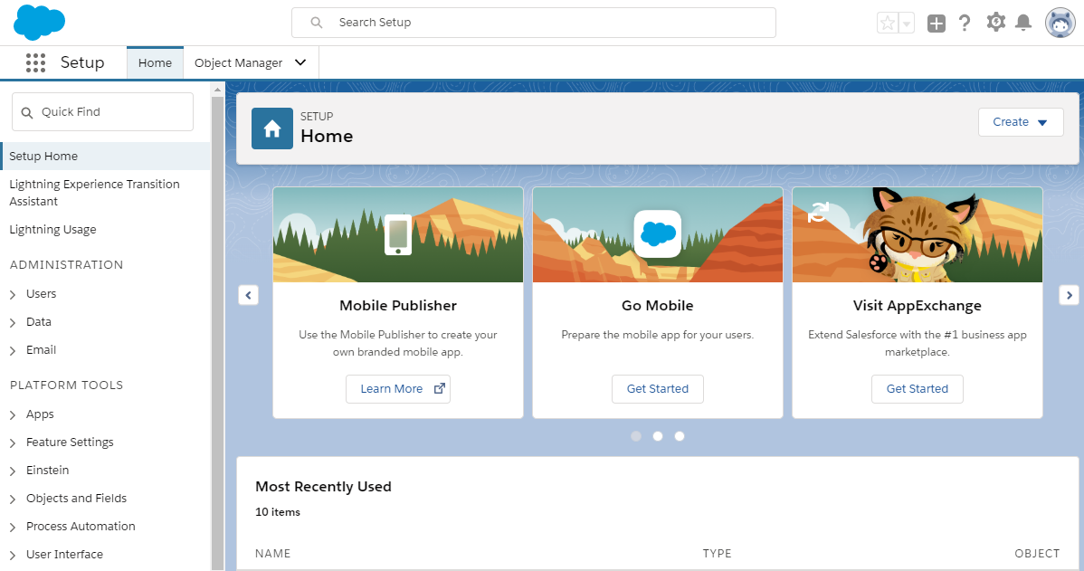
Salesforce Setup Menu - Object Manager

Slide 9
Custom Objects
API name always includes “__c” suffix
Broker object has Broker__c API name
Contains three default fields
Created By
Last Modified By
Owner

Slide 10
Field Data Types
Auto Number
Formula
Checkbox
Currency
Date
Date / Time
Email
Geolocation
Number
Percent
Phone
Picklist (multi)
Text
Textarea (long/rich)
Time
URL

Slide 11
Field Data Types (cont.)
Lookup Relationship
Master-Detail Relationship
External Lookup Relationship

Slide 12
Field Properties
Field Label
Length
Description
Help Text
Validation Rule
Required
Unique
Default Value
These help to prevent GIGO

Slide 13
Questions & Requested Updates from HR Users
Bad data appears in AssessmentScore
Need email address of every applicant
Want option to store 9 digit zip code
Need to track the HR employee assigned to each candidate
Data entry and editing is not user-friendly

