Slide 1
Intro to MIS - MGS351
Overview of Salesforce
Chapter 1

Slide 2
Chapter Overview
Salesforce Introduction
App Launcher and Setup Menu
Microsoft Access and Salesforce
Salesforce Terminology
  Org, Apps, Objects, List Views, Page Layouts, Reports and Automation
Salesforce Accounts

Slide 3
Salesforce
Salesforce is a cloud-based (SaaS and PaaS) customer relationship management (CRM) platform designed to help you sell, service, market, analyze, connect with customers, and more.
Accessed using a web browser - no Mac issues!
Customizable through clicks, not code!
Skills are in high demand and training through Trailhead is free
Notes:
CRM technology allows you to manage relationships with your customers and prospects and track data related to all of your interactions. It also helps teams collaborate, both internally and externally, gather insights from social media, track important metrics, and communicate via email, phone, social, and other channels.
- Software as a Service (SaaS) is a delivery model where a software application is hosted as a service and provided to customers via the Internet. The SaaS vendor takes responsibility for the daily maintenance, operation, and support of the application and each customer's data. The service alleviates the need for customers to install, configure, and maintain applications with their own hardware, software, and related IT resources.
- Platform as a Service (PaaS) is an environment where developers use programming tools offered by a service provider to create applications and deploy them in a cloud. The application is hosted as a service and provided to customers via the Internet. The PaaS vendor takes responsibility for the daily maintenance, operation, and support of the deployed application and each customer's data. The service alleviates the need for programmers to install, configure, and maintain the applications on their own hardware, software, and related IT resources.
Cloud based means available through a web browser, tablet or mobile device.
Contains built-in capabilities and ability to customize.

Slide 4
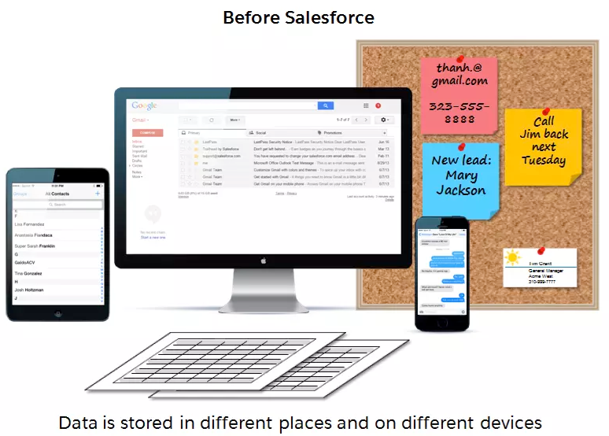
Without CRM

Slide 5
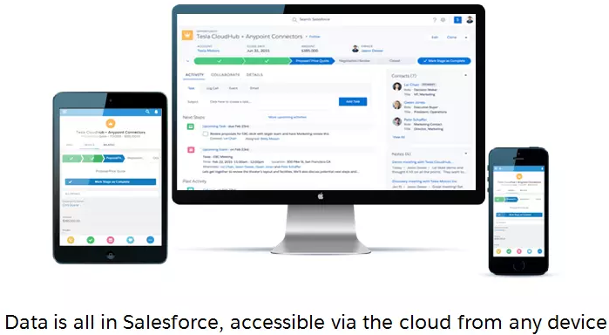
With CRM

Slide 6

Salesforce Example
Access via login.salesforce.com
or through Trailhead

Slide 7
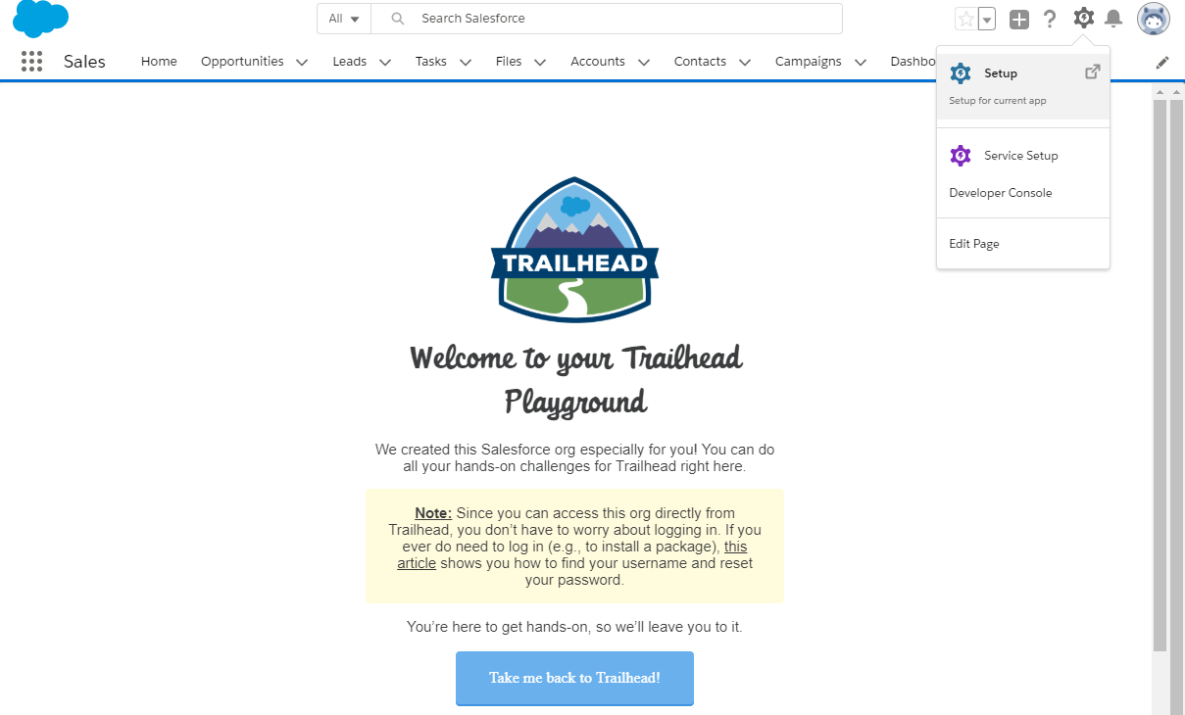

Salesforce App Launcher & Setup Menu
Standard Sales App Navigation
App Launcher for users
Setup Menu for setting things up behind the scenes

Slide 8
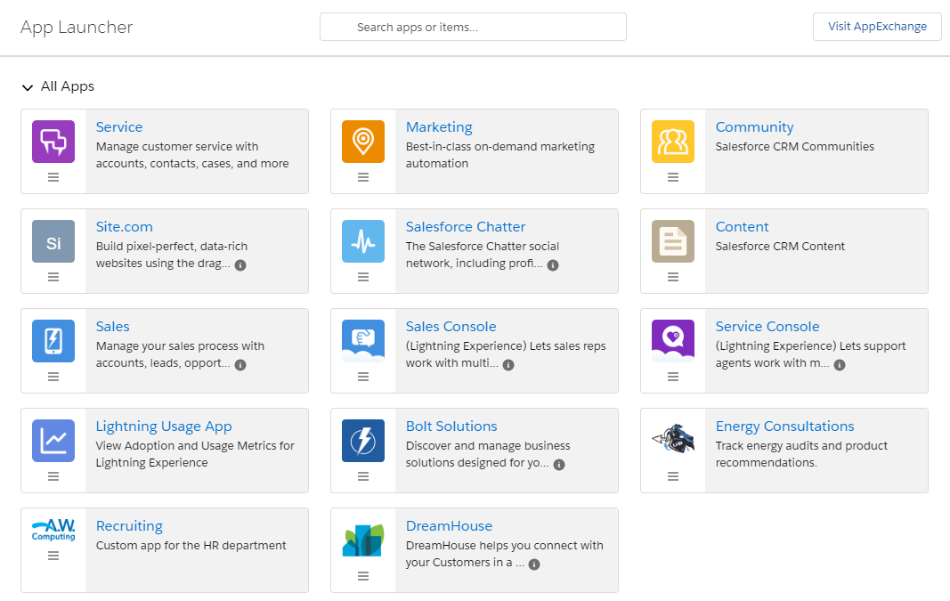
Salesforce App Launcher

Slide 9
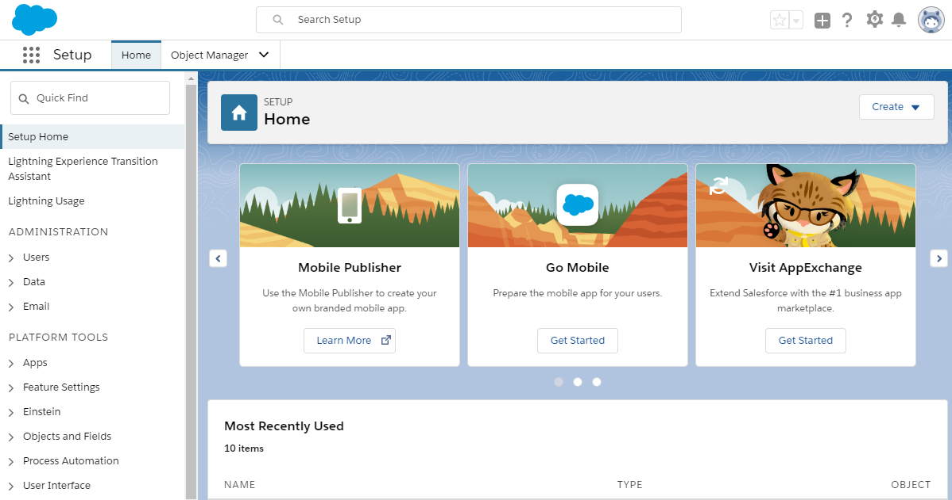
Salesforce Setup Menu

Slide 10
Microsoft Access and Salesforce
MS Access
  Tables
  Queries
  Forms
  Reports
  Macros and Modules
  Relationships
Salesforce
  Objects
  List Views
  Page Layouts
  Reports
  Automation
  Schema Builder

Slide 11
Salesforce Terminology
Org
App - Standard and Custom
  AppExchange marketplace provides third party apps you can install in your Org
Your group project is a Custom App that resides in your Development Org
Your homework is completed in Trailhead playgrounds
Notes:
https://help.salesforce.com/articleView?id=glossary.htm
Org: An org is an abbreviation of organization as it pertains to a deployment of Salesforce with a defined set of licensed users. An org is the virtual space provided to an individual customer of Salesforce. Your org includes all of your data and applications, and is separate from all other orgs.
App: Short for “application.” A collection of components such as tabs, reports, dashboards, and Visualforce pages that address a specific business need. Salesforce provides standard apps such as Sales and Service. You can customize the standard apps to match the way you work. In addition, you can package an app and upload it to the AppExchange along with related components such as custom fields, custom tabs, and custom objects.
Salesforce provides standard apps such as Sales and Service.
You can also build your own on-demand apps by grouping items into new custom apps. A custom app consists of a label, a description, and an ordered list of items, which often includes tabs. You can also add custom logos and branding to your custom apps.

Slide 12
Objects (Tables)
Stores the data in a database
  Standard Objects - Contacts, Leads Opportunities, Accounts and many more
  Custom Objects - names end with “__c”
Object Manager configures fields
  Data type, field label, length, field name, description, help text, validation rule, required, unique, default value, etc.
Notes:
Objects are tables in a database.
Opportunities are leads that are qualified to buy.
When a lead is converted, an account and contact are also created in Salesforce. An account is a company you’re doing business with, and a contact is someone who works at that account.

Slide 13
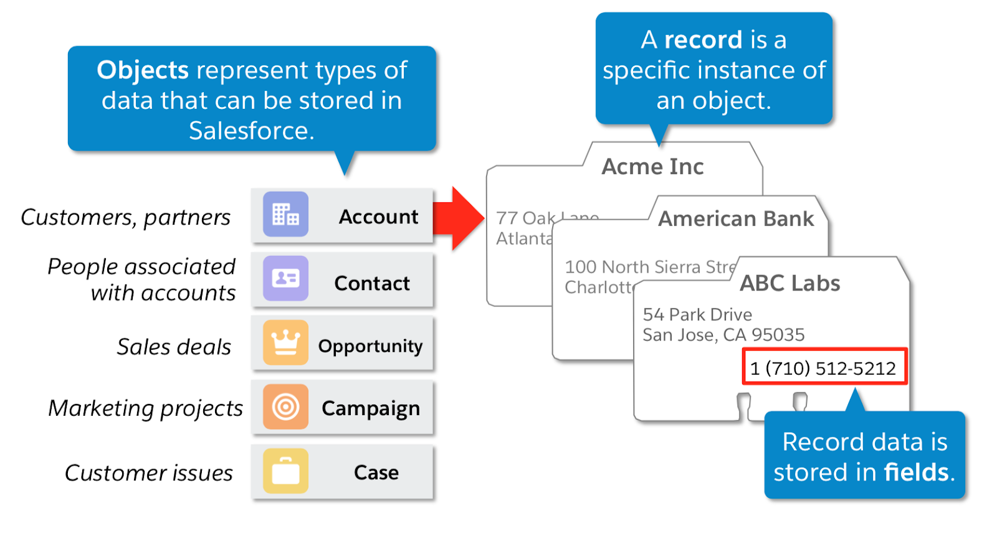
Objects (Tables)
Notes:
An object allows you to store information in your Salesforce organization. The object is the overall definition of the type of information you are storing. For example, the case object allow you to store information regarding customer inquiries. For each object, your organization will have multiple records that store the information about specific instances of that type of data.

Slide 14
List Views (Queries)
Returns filtered results and allows you to ask questions (queries) about data in the database to extract information.
  When have customers placed orders?
  What products in inventory haven’t sold well?
  Who is the most productive employee?
Notes:
List View: Displays items (for example, accounts or contacts) based on specific criteria. Salesforce provides some predefined views.

Slide 15
Page Layouts (Forms)
Used for entering data, displaying data or for presenting information in a logical manner.
Notes:
Page layout is the organization of fields, custom links, and related lists on a record detail or edit page. Use page layouts primarily for organizing pages for your users.

Slide 16
Reports and Dashboards
Used to format, summarize and present the data in a professional, logical and useful manner.
Dashboards are single reports containing many reports.
Reports (output) in a system dictate what data must be stored in the database.
Notes:
A dashboard is a visual display of key metrics and trends for records in your org. The relationship between a dashboard component and report is 1:1; for each dashboard component, there is a single source report.

Slide 17
Automation: Workflow / Process Builder / Flow Builder (Macros and Modules)
Automation that can perform advanced operations, making Salesforce more powerful and user-friendly.
Often used to automate actions within Salesforce.
  Workflow and Process Builder - EOL 12/31/2025
  Flow Builder

Slide 18
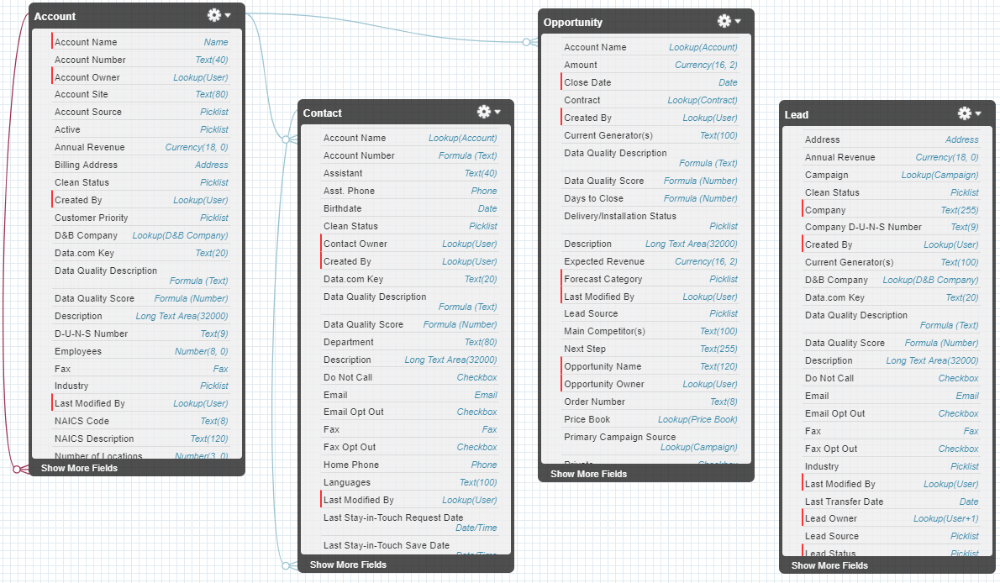
Schema Builder (Relationships)

Slide 19






Homework 6 | 8800 Trailhead Points
Homework 6 Trailmix
  Trailhead Playground Management
  Data Modeling
  Lightning Experience Customization
  Formulas & Validations
  Reports & Dashboards for Lightning Exp.
  Quick Start: Reports & Dashboards

Slide 20
Understanding Salesforce Accounts
Development Org (Dev Org) Account
  Shared username and password used for group project
  Example: A1G1@mgs351F24.com
Individual Salesforce Account
  Used to complete homework in Trailhead
  Assigned to you in recitation
  Example: djmurray@mgs351F24.com

Slide 21
Understanding Salesforce Accounts
Trailhead Playground Account(s)
  A playground is a temporary org where you complete training/homework
  A playground username and password is created by Salesforce automatically when the playground is created Example: djmurray@brave-raccoon-8j5k04.com
  Do not create a new playground unless the assignment instructs you to do so

Slide 22
Logging in to Salesforce
Use Chrome and always login using an incognito browser window!
Make sure you have no incognito windows open that are logged in to Salesforce or Trailhead
Logging in to the same browser session with different accounts does not work

Slide 23
Logging in to Salesforce - Homework
Trailhead for homework
  https://trailhead.salesforce.com
  Login using Salesforce account option
  Sign up for this during recitation
  Use individual account emailed to you
  Check homework hints!

Slide 24
Logging in to Salesforce - Project
Development Org for group project
  https://login.salesforce.com
  Use shared group account provided to you during recitation. Everyone in the group uses the same account.
  DO NOT USE YOUR UB EMAIL ACCOUNT WHEN SIGNING UP

