Slide 1
Homework 3 Hints

Slide 2
General Tips: Homework #3
Take your time on this homework
  This is the longest and most difficult homework
Make sure that you read everything in all the steps. Don’t just skim the instructions. This is how mistakes are made and time is lost.

Slide 3
FUNCTIONS FOR HW #3:
=Avg([Field])
  Used to average number values in a specific field references
=Count([Field])
  Used to count number of field entries
OR you can:
  Click on a specific control field (in designview)
  Then Click on the button and select the appropriate function you want to appear

Slide 4
Chapter 4 Guided Exercise:
Step 5: Create & Explain new queries
  CREATE ribbon
  QUERY DESIGN button
Step 6: a few ways to add fields to queries
Step 7: how to delete fields in queries

Slide 5
Chapter 4 GE
Step 8: How to “Run” (execute) queries
  When you Run a query, a table pops up with all of the results that you require in the criteria and fields.
  You can go back to design view to edit a query

Slide 6

Chapter 4 Guided Exercise:
Step 9: Make sure you don’t forget to delete the comma. This is an alternative way to edit queries
Steps 12:
  “Return” drop-down list:
  On the design ribbon at top of page
Step 16: What are the four different class codes?
Step 17: In the criteria row, right underneath the row with the checkbox, enter in jr. then press enter or tab. What happens?

Slide 7
Chapter 4 Guided Exercise:
Step 19: Enter in SR in the row underneath the “jr”. This will make the query return jr or SR students.
Step 20: underneath the GPA criteria, input >=3.5 (See the screenshot on page 38).
  Make sure you read all of 20, it will teach you about how Access interprets the query information.

Slide 8
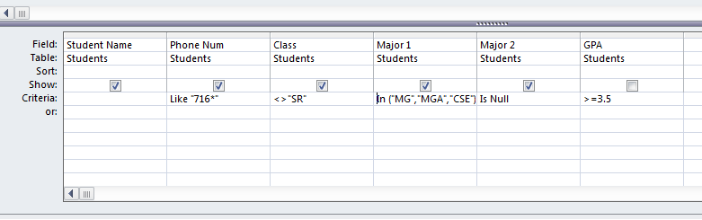
Chapter 4 Guided Exercise:
At the end of Steps 24 – 29:
Pay attention to the row labels and where you are inserting text

Slide 9
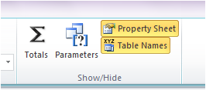
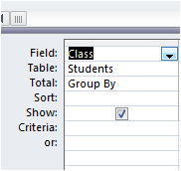
Chapter 4 Guided Exercise:
Step 23:
  Tells you what you will be doing for steps 24-30
Step 32: Totaling a column
  Design ribbon
  TOTAL button (SIGMA SYMBOL)
Step 32: Sorting and Grouping
  “Total” row
  “Group By” dropdown

Slide 10
Chapter 4 GE
Steps 33-36
  Use Group by drop downs
Steps 39-40
  Brackets [ ] around query criteria cause pop ups when queries are initially ran.

Slide 11
Chapter 4 Guided Exercise:
Step 43: Expression Creation
  Concatenation
    Expression1 & Expression2
    Strings (words, sentences, etc.) NEED double quotes
    Expressions ([XXX]) do NOT
  “Building”
    Open query
    DESIGN view
    Right click on CRITERIA
    Select BUILD
Enter this expression where you are asked to do so in step 43
  [Students]![Student Name] & " (" & [Students]![Major 1] & ")"

Slide 12
Chapter 4 Guided Exercise:
Step 46: “IF” functions
  Basic
    IF (X) THEN (Y,Z)
      Y will appear IF X is TRUE
      Z will appear IF X is FALSE
  Enter this If statement in first:
  IIf([Students]![GPA]>=3.75,"Summa Cum Laude",”Not high honors”)
  Nested
    (IF (A) THEN (B), IF (C) THEN (D,E))
      B will appear IF A is TRUE
      D will appear IF C is TRUE
      E will appear if C is FALSE
  Enter this If statement in later (the same spot):
  IIf([Students]![GPA]>=3.75,"Summa Cum Laude",(IIf([Students]![GPA]>=3.5,"Magna Cum Laude","Cum Laude")))

Slide 13
Chapter 4 GE
Please Run the Queries to make sure the proper outputs occur (in respect to the logic statements & criteria you enter in design view)

Slide 14

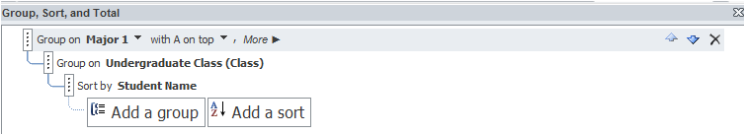
Chapter 5 GE
Step 4 & 5:
  This is just viewing a report and how to view in print preview (to print a report).
    You will use this for your final project
Step 6 - 16:
  Used to set up a Report GROUP & / OR SORT
  This is where you make changes:
  Make sure you are grouping and sorting in ORDER of what the text indicates and with the proper fields

Slide 15
Chapter 5 GE
Step 17-24:
  Formatting.
  Step 22: Refer to chapter 3 form formatting, for any confusion.
Step 25-28
  All a part of the Report Wizard process
  Make sure you group and sort properly
  Don’t forget to include average GPA
Step 29:
  Add a LABEL with your name to the REPORT FOOTER (if the footer is not expanded or dropped down, you can do so).

Slide 16
Chapter 5 GE & AE
Please check in REPORT View that all of your report editing and creating is showing up properly.
  Helps you check formatting
  Helps you double check that your functions are working properly
  Helps re-assure that you can complete the tasks

Slide 17
Chapter 5 Applied Exercise:
Step 1:
  Use the Report Wizard to create a report. Select “Top Performing Management Upperclassmen” query from the Tables/Queries drop down list
  Choose the fields: Student Name, Person Number, Class and GPA
  Do not group the report. Then, sort the report by GPA in descending order. Hit Next, Next and Finish

Slide 18
Chapter 5 Applied Exercise:
Step 1:
  Be sure to SORT GPA properly
  Now go to the Layout View and choose format and then choose conditional formatting
  There, you will choose GPA for the formatting rules
  Make the rule “field value is greater than or equal to 3.9”
    Make the formatting bold red font

Slide 19
Chapter 5 Applied Exercise:
Step 2:
Go to the create tab and choose query design
Choose the students table
  Include: Student Name, Phone Num, Class, Major 1 and GPA
Add the following 3 criteria:
  In brackets [], ask for the code for major (ex CSE)
  In the GPA criteria, type in >2.8
  In the Phone Num criteria, type in 716*
    Can refer to Chapter 4 GE: #’s 20, 22, 25, 27

Slide 20
Chapter 5 Applied Exercise:
Step 3:
  Use the Report Wizard to create a report. Select “Local Students” query from the Tables/Queries drop down list
  Choose all the fields
  Group the report by class, by double clicking “class”
  Sort the report by student name. Hit next, next, then finish
  Follow the rest of the directions in the book for formatting

Slide 21
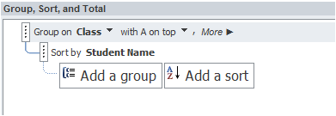
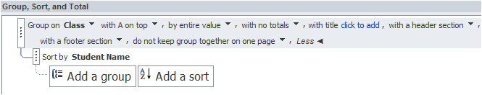
CH 5 AE
Step #3
  This is a step you need to be careful with selecting the correct headers/footers to add/delete:
    TEXT BOXES & LABELS
      KNOW THE DIFFERENCE!
  If you cannot find the header/footer, it may be hidden please go to “More” under “Group on…”
  and select:

Slide 22
Chapter 5 Applied Exercise:
Step 4 (adding expressions):
Go to the create tab and choose query design
Choose the students table
  Include: Student Name, Phone Num, Class, Major 1, Grade and GPA

Slide 23
Chapter 5 Applied Exercise:
Step 4 continued:
  An expression that concatenates the GPA and Grade. Called GradeSummary.
    For reference, refer to Chapter 4 step #43
  To indicate where data is taken from:
    [table/query name]![table/query field]
  To indicate each additional part to the code:
    & (separates fields from text)
  To indicate text to be shown:
    “text inserted”

Slide 24
Chapter 5 Applied Exercise:
Step 4 continued
  An expression to display Freshman, Sophmore, Junior or Senior instead of FR, SO, JR, SR. Call is LongClass. You need to use the nested Ifs. (See step 46 in Chapter 4.)
  How nested IIF function works:
    Expression: IIF([expression]<>= “statement”, “text to be displayed if true”,IIF(if false: new expression to be evaluated, “text to be displayed if true”,IIF(if false: new expresssion to be evaluated,“text to be displayed if true”,“text to be displayed if false”)))
      “ Expression: ” can be changed to Long class
      [expression] – this is where you place the table then field to reference
      Ex: If "class field from student table” = “FR”, then display “Freshman”

Slide 25
Chapter 5 Applied Exercise:
  Step 4 continued
    An expression to show, 1,2,3 and 4 to correspond to FR, SO, JR, SR. Call it SortClass.
      Use IIF statements
      For reference: Chapter 4 GE, #46
    Think about both nested IIF this way:
    If the class field from the students table= “FR”, then display “1”, if not evaluate: if ="SO”, if yes display "2”, if not evaluate if =“JR”, if yes display “3”, if not display “4” because it must = SR
  See previous slide very similar logic/ format

Slide 26
CH 5 AE
Step #4
  Remember to change “Expr1:” to the proper field names indicated in the textbook.
    “Expr1:” is located BEFORE your concatenated code/IIF statements in the “Field” row in Query DESIGN view.
    Chapter 4 GE: #45
  BRACKETS “[ ]” should only enclose table/field names in IIF functions!
  Keep track of your parenthesis (every open parenthesis must have a closed one)
  Keep track of you commas, you must use commas in IIF statements.
  In SORTCLASS Query try to sort “SortClass” Field Ascending

Slide 27
Chapter 5 Applied Exercise:
Step 5:
  Use the Report Wizard to create a report. Select “Class Sort” query from the Tables/Queries drop down list
  Choose the fields: Student Name, Major 1, LongClass, SortClass and GradeSummary.
  Group the report by SortClass, then LongClass by double clicking “SortClass” then “LongClass”

Slide 28
Chapter #5 AE
Step #5
  Sort the report by Student Name.
  Add a calculated control/textbox that displays the total number of students in each class and the overall total number of students on the report. (See Step 10 in Chapter 5) (See FUNCTIONS FOR HW #3 SLIDE)
    PAY ATTENTION TO THE FOOTERS THESE CONTROLS ARE PLACED IN!
  Hit next, next, then finish
  Follow the rest of the directions in the book for formatting

Slide 29
Chapter 5 AE
Step #5:
  Please remember to re-locate the longclass control(the box with functions, not the label) to the sortclass header IN DESIGN VIEW
  Sortclass should not be visible.
    go to the property sheet, then set the “visible” property to NO).
    You can Hide/Delete Headers & Footers the same way
      click on the header/footer, go to the property sheet, and set the “visible” property to NO

Slide 30
Keep In Mind
Please pay attention to REPORT formatting!
Please LABEL/NAME all QUERIES AND REPORTS according to the book (do not make up names and delete any extra ones that you messed up)

Slide 31
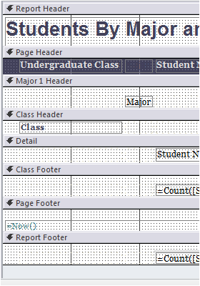
Keep in Mind:
Please pay attention to The different sections of FOOTERS and HEADERS.
  When you have a grouped/sorted report you will have multiple footers/headers
  Where you put your functions will effect the values that are computed.

