Slide 1
Homework 2 Hints

Slide 2
General Tips
Remember what FORM view you are in!
Design, form, and layout view
TABLE views include:
Design and Datasheet view

Slide 3
Chapter 3 Guided Exercise Questions
Make sure you add your name to the header of a form when prompted.
When asked to add to the header/footer
Add a label (DO NOT replace the FORM TITLE!)
Remember to add the correct date (and date length/format) to the header/ footer when prompted.

Slide 4
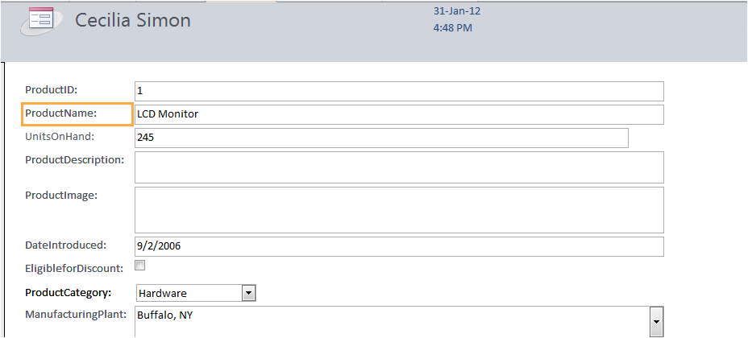
Chapter 3 Guided Exercise
Step 4
Make sure to add a record for your TA.
Step 5
“command buttons” are the buttons at the bottom of the form
A “control” is the field name in a form and the input box next to it:

Slide 5
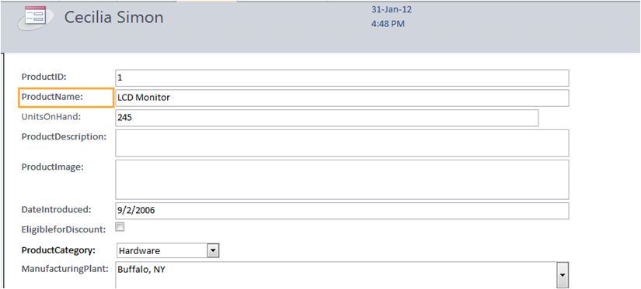
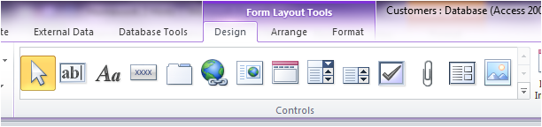
Chapter 3 GE
Step 8:
Unbound control =label
Bound control=textbox
Unbound controls= labels
Bound controls are created by choosing text box button (this automatically comes with a label too!)

Slide 6
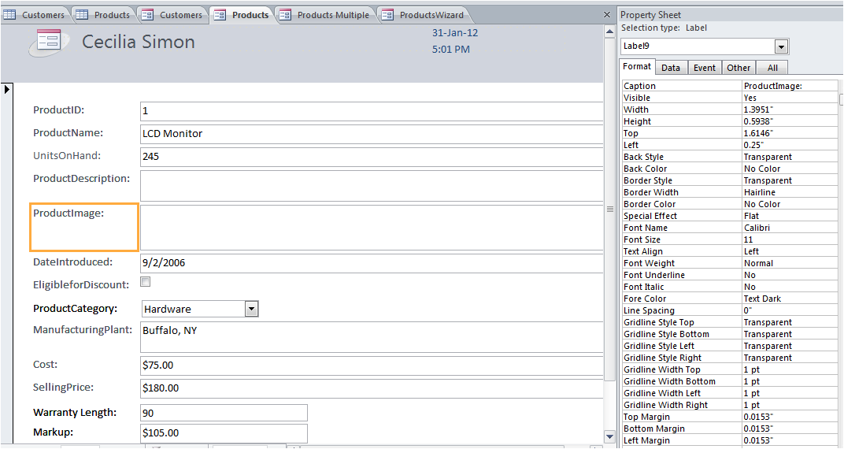
Chapter 3 GE
Step 10:
This is a property sheet, Remember this!!
You can also access it by right clicking on a form and selecting “properties”!

Slide 7
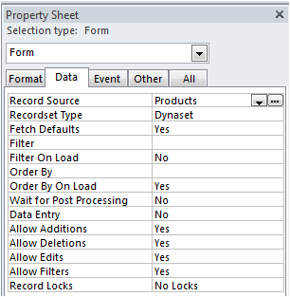
Chapter 3 GE
Step 10
This is used to modify settings for a form AND a form’s controls
If you click on a form’s control the settings for that control will pop up on the property sheet.
Record Source
Where the Form grabs it’s data from
(Which table or query)
Step #2 in AE

Slide 8
Chapter 3 GE
Step 11
Reference in Step 3 of Applied exercise
Step 12
“Control Sources” in the Property Table are referencing a “CONTROL” from the “Record Source” Table/ Query.
“#Name” occurs when “Record Source” and “Control source” do not have matching field references.

Slide 9
Chapter 3 GE
Step 13
Check formatting
Controls should line up
form (in form view) is not cut off or only displaying half of the page.
Controls are named properly and details are correct
Ex. Spaces exist between words (WarrentyLength vs. Warrenty Length)
No “#NAME” exists
This step also highlights some shortcuts (a little confusing at first)

Slide 10
Chapter 3 GE
Step 14
Formatting Text boxes & controls
Watch alignment
Step 15: Conditional Formatting
Use for AE Step #7
Red background will show up in textbox with values less than 100 inputted in them.
Step 17:
Date and time format just adjust HOW date and time are DISPLAYED on the form.

Slide 11
Chapter 3 GE
Step 18
More formatting: Specifically LAYOUT of the form
Step 20
Go through this CAREFULLY
MAKE SURE YOUR TAB ORDER GOES CONSECUTIVELY DOWN THE PAGE
Used in AE Step #14

Slide 12
Chapter 3 GE
Step #22: Calculated Controls!
Added to Text boxes
Must include brackets “[ ]” around every individual field/ control used in the calculation
Takes # values from [field] in table/form that corresponds to that same record in the table and can add, subtract, etc. These values.
Used in AE Step #6
Ex. =[Price]-[cost]
This would go in the text box of a “Profit” control
It would calculate profit for that Product/Item based on that specific Product’s Price and Cost
Remember to use correct format property (currency vs. number vs text), like in EXCEL
Remember to re-name the LABEL next to this text box.

Slide 13
Chapter 3 GE
Step #23
Switch form back to Single Form.
Step #12 in GE
Step #24
Reference for Step #11 in AE
If still struggling to find button control, it is the rectangle with 4 “x’s” inside
If your wizard does not start when adding the command button, go to Form Design, Click the drop down in the Controls section, and make sure that “Use Control Wizards” is selected.
Step #26
Be sure your formatting is okay after adding the new control (textbox)

Slide 14
Chapter #3 GE
Step # 27
How to create a new form and connect data easily from tables to the forms***
Step # 27
Make sure you make BOTH (2):
Products Multiple & Products Wizard forms!

Slide 15
Chapter #3 Applied Exercises
Step #2
See GE Step #10
Step #3
See GE Step #11
Step #4
Check for “NAME#” in any text boxes in “Form View”
This error occurs because of step #2 of the AE
Use Step #12 to fix this
You will reference a field in the Customer’s Query instead of the Customer’s Table now**

Slide 16
Chapter 3 AE
Step 4
See Guided Exercise Step 12 for guidance!!!
In Design View, click on the control that is no longer referencing properly (e.g. phone, zip, etc.)
Open the property sheet and click on the All tab. Look for the Control Source property.
Change the Control Source property to reference the appropriate field in the Customers Query.
Step #5
Reference Step #26 in GE

Slide 17
Chapter 3 Applied Step 6
See Guided Exercise Step 22 for guidance!!!
In Design View, you are going to use the text box button to add a calculated control to the detail section.
Open the property sheet for the new text box and find the control source property.
You need to enter a formula that will multiply Discount and TotalPurchases.
Switch to Form View and CHECK that the control is calculating properly!!!
Switch back to Design View and open the property sheet for your calculated control once again. Find the Format property and switch it to Currency.
Edit the label for your control to be Total Discount.

Slide 18
Chapter #3 AE
Step #7
Reference GE Step #15
Step #8
Use “Date()” function
See Step #22 in GE

Slide 19
Chapter 3 Applied Step 9
See Guided Exercise Step 16 for guidance!!!
In Design View, delete the Fname and Lname controls, in the form.
Select the Design ribbon and click on the Add Existing Fields button. The field list should contain all the fields from the Customers Query.
Look in the list for the Name field (e.g. the one that displays the Fname and Lname in a single field)
Be sure to drag it from the field list and drop it where the controls you deleted used to be.

Slide 20
Chapter #3 AE
Step #10
See CHAPTER #2 GE Steps #17-22
Step #11
Step # 24 Chap #3 GE
Step #12
LABEL, NOT TEXTBOX

Slide 21
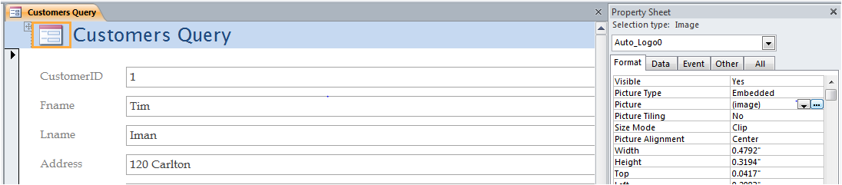
Chapter #3 AE
Step #13
See “picture” under Property Sheet
In layout or design view
Upload a picture from your computer
Make sure a picture actually is seen by the user in form view

Slide 22

CH 3 AE
If you are having trouble getting the drop down in the AE to work:
Go to Customers Table in design view
Select Lookup wizard for field & set correct dropdown settings (some students do not do this first... But still get a working drop down… there is more than one way to get the drop down to work)
Go back to Customers Form and Delete the existing Customer Type control
Insert a COMBO BOX (as pictured) in design
view
Go through wizard and take drop down from customer’s query and the field “customer type”.
Check in form view to see that is worked.

Slide 23
Drop down issues cont.
If you are still having trouble:
Go to design view
Open Property Sheet and click on the “Data” tab
Make sure the control source is customer type

Slide 24
Aesthetics
Check your entire assignment for control alignment, proper label names, etc.
Make sure forms and controls are not cut off/short.

Slide 25
Tab Order
AFTER YOUR ENTIRE HOMEWORK IS DONE:
CHECK TO MAKE SURE THE TABBING THROUGHOUT ALL YOUR FORMS IS CORRECT!!!
E.g. Manually tab through all your forms and make sure there are no unusual jumps and the order is correct (e.g. top to bottom, left to right)
This is THE most common reason students lose points on this homework!
If you make any additional changes to your homework after you do this, RECHECK THE TAB ORDER.
See Guided Exercise Step 20 for guidance on tab order.

