Slide 1
Intro to MIS - MGS351
Information Systems Development
Chapter 10

Slide 2
Overview
Organizational Change
System Development Methodologies
Systems Development Life Cycle (SDLC)
Rapid Application Development (Prototyping)
Agile Methodology
Lean Methodology
Outsourcing

Slide 3
Organizational Change
Automation: Speeding up performance
Rationalization of procedures: Streamlining of operating procedures
Business process reengineering: Radical design of business processes
Paradigm shift: Radical reconceptualization

Slide 4
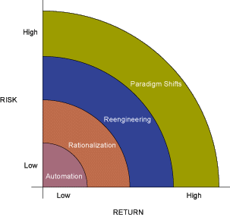
Organizational Change

Slide 5
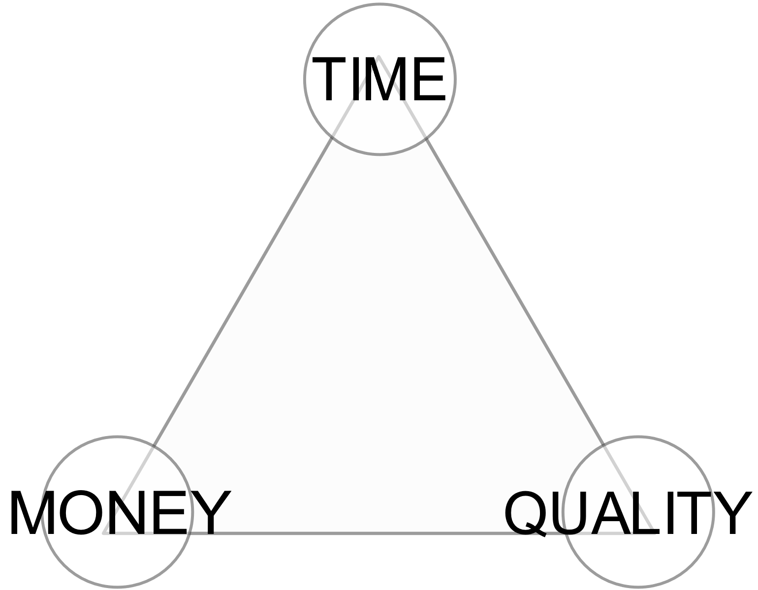
Why Systems Fail
20% of systems succeed, 80% fail.
Reasons systems fail:
Unclear or missing requirements
Skipping SDLC phases
Failure to manage project scope (scope creep and feature creep)
Failure to manage project plan
Changing technology
Inadequate testing and/or poor implementation
Not planning for the future

Slide 6
Information Systems Planning
Organization Mission
Business Assessment
IS Planning Process
Organization Strategic Plan
Current Information Technology Architecture
IS Strategic Plan
New information Technology Architecture
IS Operational Plan
IS Development Projects

Slide 7
Systems Development Life Cycle (SDLC)
SDLC - the development method used by most organizations today for large, complex systems
Waterfall Approach - a sequence of steps in the SDLC with cycles returned to previous stops
Systems Analysts - IS professionals who specialize in analyzing and designing information systems
Programmers - IS professionals who modify existing computer programs or write new computer programs to satisfy user requirements
Technical Specialists - experts in a certain type of technology, such as databases or telecommunications

Slide 8
SDLC
(1) Systems Investigation
An eight-stage systems development life cycle (SDLC)
(2) Systems Analysis
(3) Systems Design
(4) Programming
(5) Testing
(6) Implementation
(7) Production
(8) Maintenance
Go Back to a previous Stage or Stop

Slide 9
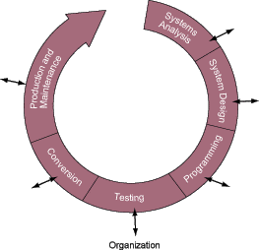
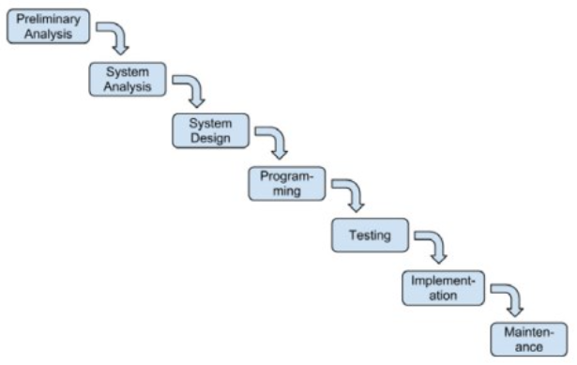
SDLC

Slide 10
Preliminary Analysis
Define the system to be developed.
Set the project scope.
Develop the project plan including tasks, resources, and timeframes.

Slide 11
Preliminary Analysis
Project scope document - a written definition of the project scope and is usually no longer than a paragraph.
Project plan - defines the what, when, and who questions of system development including all activities to be performed, the individuals, or resources, who will perform the activities, and the time required to complete each activity.

Slide 12
Preliminary Analysis
Project milestones - represent key dates for which you need a certain group of activities performed.
Project manager - an individual who is an expert in project planning and management, defines and develops the project plan and tracks the plan to ensure all key project milestones are completed on time.

Slide 13
Preliminary Analysis
Feasibility Study determines the probability of success of proposed system’s development project and assesses the project’s
Technical feasibility
Economic feasibility
Behavioral feasibility

Slide 14
System Analysis
Involves the examination of the business problem the organization plans to solve with information systems.
Requires end users and IT specialists to work together to gather, understand, and document the business requirements for the proposed system. Joint Application Development (JAD) is often used to accomplish this.

Slide 15
System Analysis
Requirements definition document – prioritizes the business requirements and places them in a formal comprehensive document. Requires a “sign off” (approval) by the knowledge workers.
May also include:
Strengths and weaknesses of the existing system
Functions that the new systems must have to solve the business problem
User information requirements for the new systems

Slide 16
System Design
Develop a technical blueprint of how the proposed system will work and define the technical architecture.
Technical design
System outputs, inputs, and user interfaces
Hardware, software, databases, telecommunications, personnel, and procedures
How these components are integrated

Slide 17
Programming
The translation of the design specifications into computer code which becomes the actual system.
Also, build the technical architecture, databases and programs.

Slide 18
Testing
Checks to see if the computer code will produce the expected and desired results under certain conditions
Syntax errors - misspelled word or a misplaced comma
Logic errors - permit the program to run, but result in incorrect output
Unit testing, system testing, acceptance testing, test plan

Slide 19
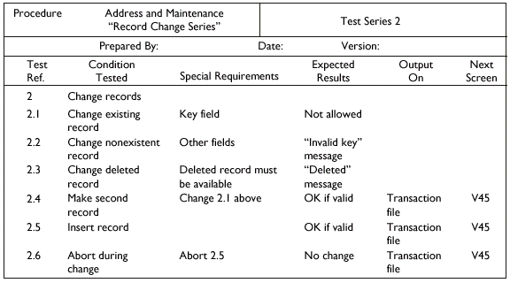
Test Plan

Slide 20
Implementation
The process of converting from the old system to the new system. Four implementation strategies:
Parallel
Direct cutover
Pilot
Phased
User documentation and training help to facilitate the conversion process

Slide 21
Maintenance
Monitor and support the new system to ensure it continues to meet the business goals.
Help desk to support the system users.
Provide an environment to support system changes.
Debugging the program
Updating the system to accommodate changes in business conditions
Add new functionality to the system

Slide 22
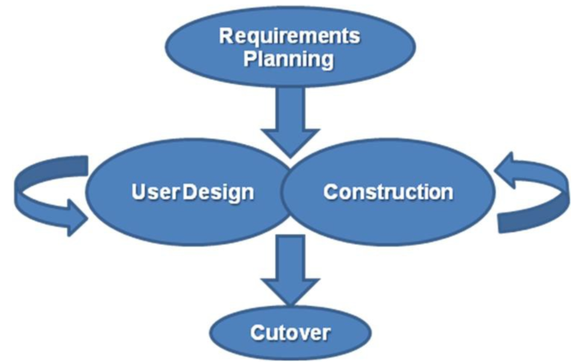
Rapid Application Development / Prototyping

Slide 23
Rapid Application Development / Prototyping
Process of building experimental system quickly and inexpensively for demonstration and evaluation
Prototype - a model of a proposed product, service, or system.
Proof-of-concept prototype - used to prove the technical feasibility of a proposed system.
Selling prototype - used to convince people of the worth of a proposed system.

Slide 24
Rapid Application Development / Prototyping Advantages
Speeds up the development approach
Gives the users the opportunity to clarify their information requirements
Encourages active knowledge worker participation
Helps resolve discrepancies among knowledge workers
Gives users a feel for the final system.
Helps determine technical feasibility
Helps sell the idea of a proposed system

Slide 25
Rapid Application Development / Prototyping Disadvantages
Replaces the systematic analysis and design stages of the SDLC - quality may be sacrificed
Can result in an excess of iterations
Leads people to believe the final system will follow shortly
Gives no indication of performance under operational conditions
Leads the project team to forgo proper testing and documentation

Slide 26
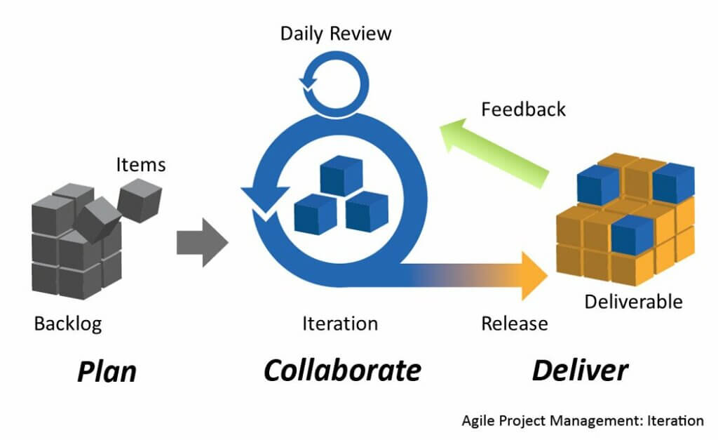
Agile Methodology
Notes:
Small cross-functional teams that include development team members and users;
Daily status meetings to discuss the current state of the project;
Short time-frame increments (from days to one or two weeks) for each change to be completed
Working project at the end of each iteration which demonstrates progress to the stakeholders.

Slide 27
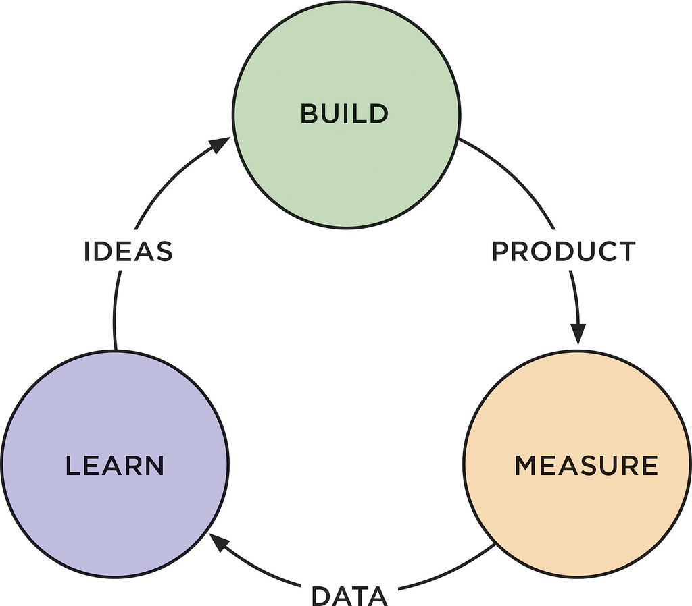
Lean Methodology - MVP
Notes:
The Lean Startup by Eric Reis
MVP - Minimum Viable Product
Software usage stats and user feedback collected for each iteration

Slide 28
Summary of Methodologies

Slide 29
Outsourcing
Outsourcing - the delegation of specific work to a third party for a specified length of time, at a specified cost, and at a specified level of service.

Slide 30
Outsourcing Advantages
Focus on unique core competencies
Exploit the intellect of another organization
Better predict future costs
Acquire leading-edge technology
Reduce costs
Improve performance accountability
Economies of scale

Slide 31
Outsourcing Disadvantages
Reduces technical know-how for future innovation
Reduces degree of control
Increases vulnerability of strategic information
Increases dependency on other organizations
Contract problems

