Slide 1
Intro to MIS - MGS351
Information Systems Security
Chapter 6

Slide 2
Overview
Ethics and Intellectual Property
Data Breaches
Cybersecurity Mindset
CIA Triad
Cybersecurity Threats
Cybersecurity Best Practices

Slide 3
Introduction
To handle information in a responsible way you must understand:
  The importance of ethics in the ownership and use of information.
  The importance to people of personal privacy and the ways in which it can be compromised.
  The value of information to an organization.
  Threats to information and how to protect against them (security).

Slide 4
Ethics
Ethics - the principles and standards that guide our behavior toward other people.
  Your basic ethical structure, which you developed as you grew up.
  The set of practical circumstances involved in the decision that you’re trying to make.
    Consequences, Society’s opinion, Likelihood of effect, Time to consequences, Relatedness and Reach of result

Slide 5
Making Ethical Decisions
“We can afford to lose money - even a lot of money. But we can’t afford to lose reputation - even a shred of reputation. We must continue to measure every act against not only what is legal but also what we would be happy to have written about on the front page of a national newspaper in an article written by an unfriendly but intelligent reporter.”
“Your attitude on such matters, expressed by behavior as well as words, will be the most important factor in how the culture of your business develops. Culture, more than rule books, determines how an organization behaves.”
- Warren Buffett

Slide 6
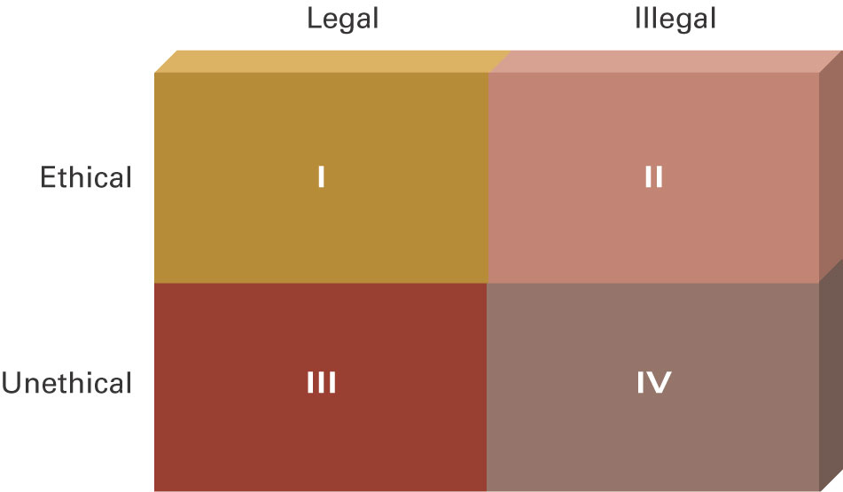
Ethical Guidelines

Slide 7
Intellectual Property
Intellectual property - intangible creative work that is embodied in physical form.
Copyright - protection afforded an expression of an idea (song, video game, some proprietary documents)
Fair Use Doctrine - says that you may use copyrighted material in certain situations (creation of new work or within certain limits, for teaching purposes)

Slide 8
Intellectual Property
Pirated software - the unauthorized use, duplication, distribution or sale of copyrighted software.
Counterfeit software - software that is manufactured to look like the real thing and sold as such.
Proper software licensing is important

Slide 9
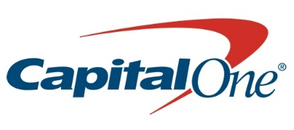

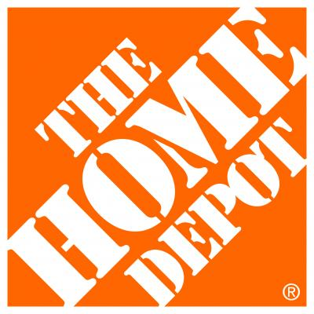











What do these companies have in common?
Notes:
One of several security threats – also ransomware, IoT botnets, etc.

Slide 10
Data Breach Statistics
1,341 |  | 75,056 |  | 4,807,319,974
Breaches YTD 2025 |  | Breaches of All Time |  | Compromised Emails
4,988,381,576 |  | 176,530,501,460 |  | 136,954
Records YTD 2025 |  | Records of All Time |  | Organizations Monitored
Notes:
Source: https://www.cyberriskanalytics.com/#statistics
Why do we have such a problem? Let’s take a look at the who is behind this

Slide 11
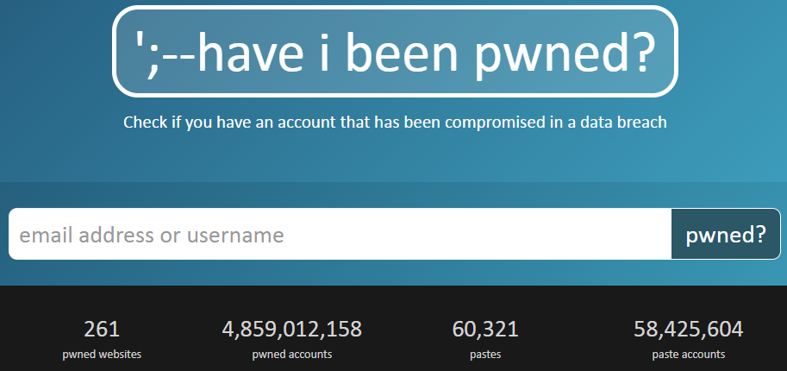
Monitor breaches and credit report
haveibeenpwned.com
www.annualcreditreport.com

Slide 12
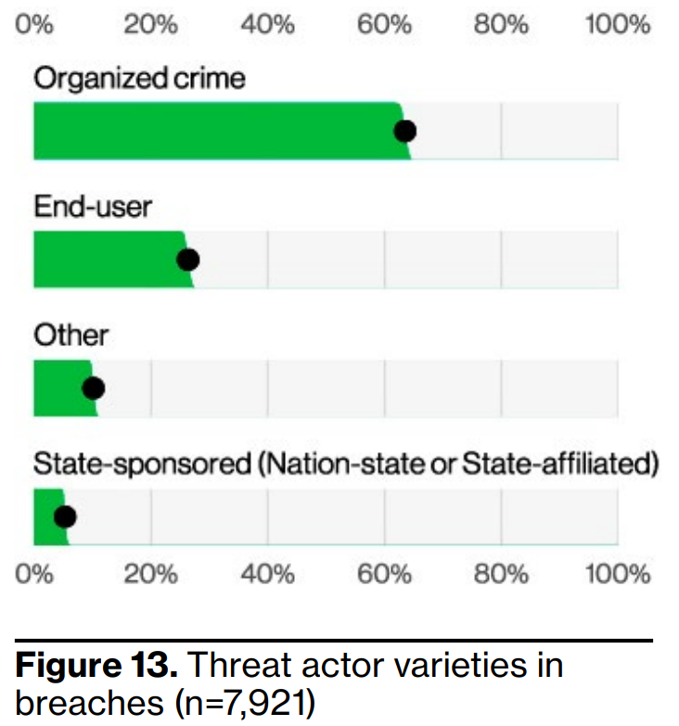
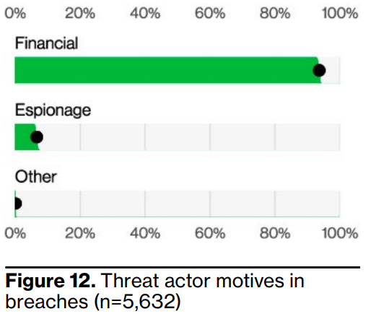
Who and Why: Threat Actors and Motivation
Notes:
Source: Verizon Data Breach Investigations Report 2024
94% Financially Motivated

Slide 13
Who: Threat Actors
Hacktivists
Thieves
Spies / Espionage
Terrorists
Nation States/Cyber-Warfare
Cyber Vigilantes
Use same techniques that have worked for years
Very Organized
International
Corporate
Research
Promotional / Marketing
Communications
Raise Funds
Defacement
Cyber attacks
Large-scale disruption of service which could result in the loss of life
Cyber Stalkers/Bullies
“MAD” keeps this in check for the time being
Loosely Affiliated Groups
A form of Political Activism
Seen primarily with social networking and text messaging
Sometimes conducted by “Insiders”
Crimes range from theft to hacking to distribution of illicit materials
APTs

Slide 14
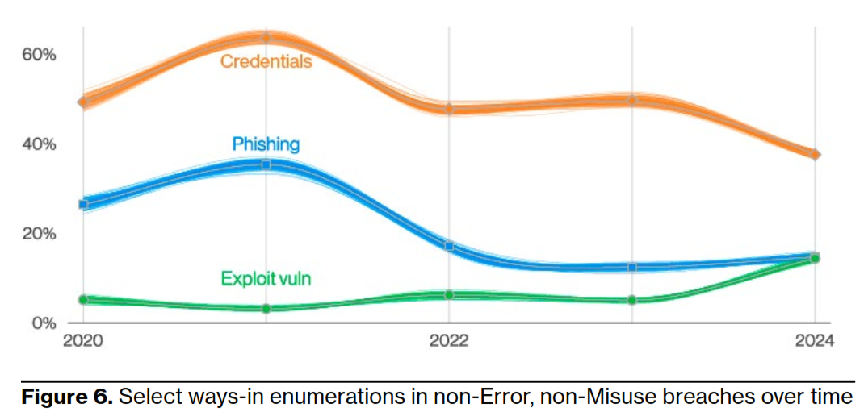
How: Data Breach Initial Steps
Notes:
Source: Verizon Data Breach Investigations Report 2024
Summary of initial steps into breaches

Slide 15
Having a Proper Cybersecurity Mindset
There is no such thing as 100% security
People are the weakest link in security
Risks can be diminished with:
  Common Sense
  A Little Knowledge
  Preventative Measures

Slide 16
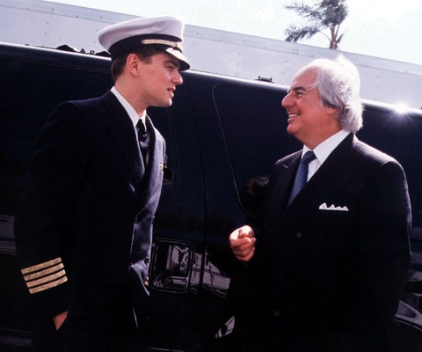
“Every system, every technology, every document has a flaw somewhere.”
- Frank Abagnale

Slide 17
How secure are passwords?

Slide 18
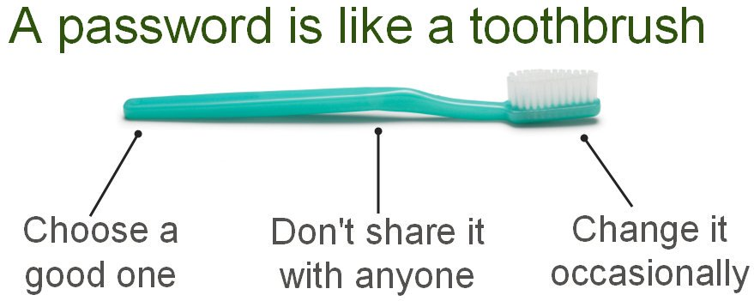
How secure are passwords?
https://www.security.org/how-secure-is-my-password/

Slide 19
Password Recommendations
Enable Multi-factor Authentication
>16 characters, mixed case, symbols, alphanumeric
Create long and memorable passwords with a passphrase
Use different passwords as much as possible - especially for critical accounts
Consider using a password manager
Notes:
The researchers used clusters of graphics cards to crack eight-character passwords in less than two hours.
But when the researchers applied that same processing power to 12-character passwords, they found it would take 17,134 years to make them snap.
"The length of your password in some cases can dictate the vulnerability," said Joshua Davis, a research scientist at the Georgia Tech Research Institute.
It's hard to say what will happen in the future, but for now, 12-character passwords should be the standard, said Richard Boyd, a senior research scientist who also worked on the project.
The researchers recommend 12-character passwords -- as opposed to those with 11 or, say, 13 characters -- because that number strikes a balance between "convenience and security."
They assumed a sophisticated hacker might be able to try 1 trillion password combinations per second. In that scenario, it takes 180 years to crack an 11-character password, but there's a big jump when you add just one more character -- 17,134 years

Slide 20
Having a Proper Cybersecurity Mindset
There is no such thing as 100% security
People are the weakest link in security
Risks can be diminished with:
  Common Sense
  A Little Knowledge
  Preventative Measures

Slide 21
Social Engineering
“You could spend a fortune purchasing technology and services, and your network infrastructure could still remain vulnerable to old-fashioned manipulation.”
- Kevin Mitnick

Slide 22
Receipt for your payment
Dear International Rebates, This email confirms that you, have paid info@blogistics.com $520.00 USD using your credit card. If you haven't authorized this charge, press cancel payment and get a full refund. Charge will appear on your credit card statement as 'blogistics' payment sent to info@blogistics.com Cancel Payment

Slide 23
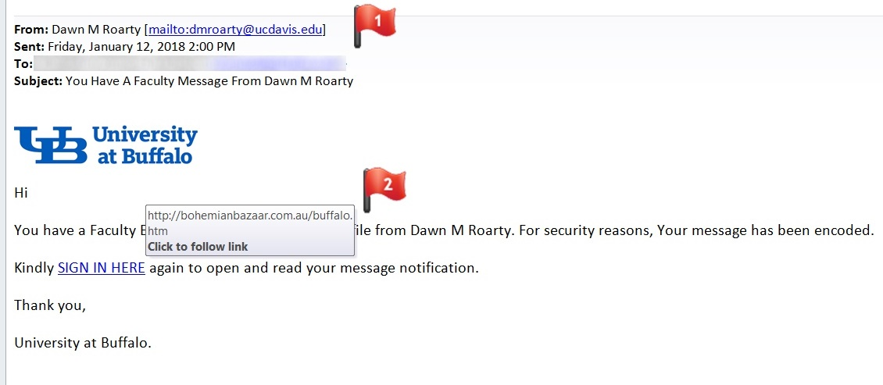
Faculty Message Phishing

Slide 24
Phishing & Spear Phishing
Goals of phishing emails
  Recipient responds with personal information
  Recipient clicks on a link
  Recipient opens an attached file
  Recipient performs some action (wire transfer)

Slide 25
Protect yourself from Phishing
Be on the alert for email spoofing
Stay calm and use common sense
Be suspicious if asked for personal information
Don’t click any links in the email message!
Don’t open any file attachments!
Call the person or company to verify. Use a known good contact phone number.

Slide 26
We wouldn’t be fooled. Right?
But could we be bribed?

Slide 27
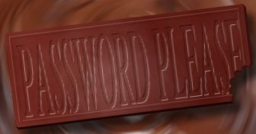
Candy Bar for Your Password?
70% of respondents reveal their password in exchange for a bar of chocolate
34% of respondents offered their password when asked without even needing to be bribed!

Slide 28
Having a Proper Cybersecurity Mindset
There is no such thing as 100% security
People are the weakest link in security
Risks can be diminished with:
  Common Sense
  A Little Knowledge
  Preventative Measures

Slide 29
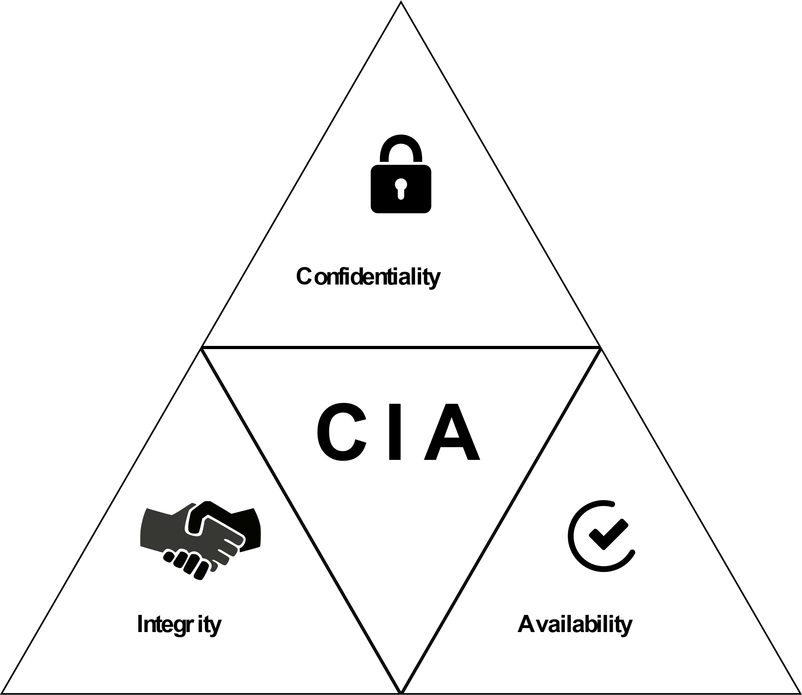
Information Security Triad - CIA

Slide 30
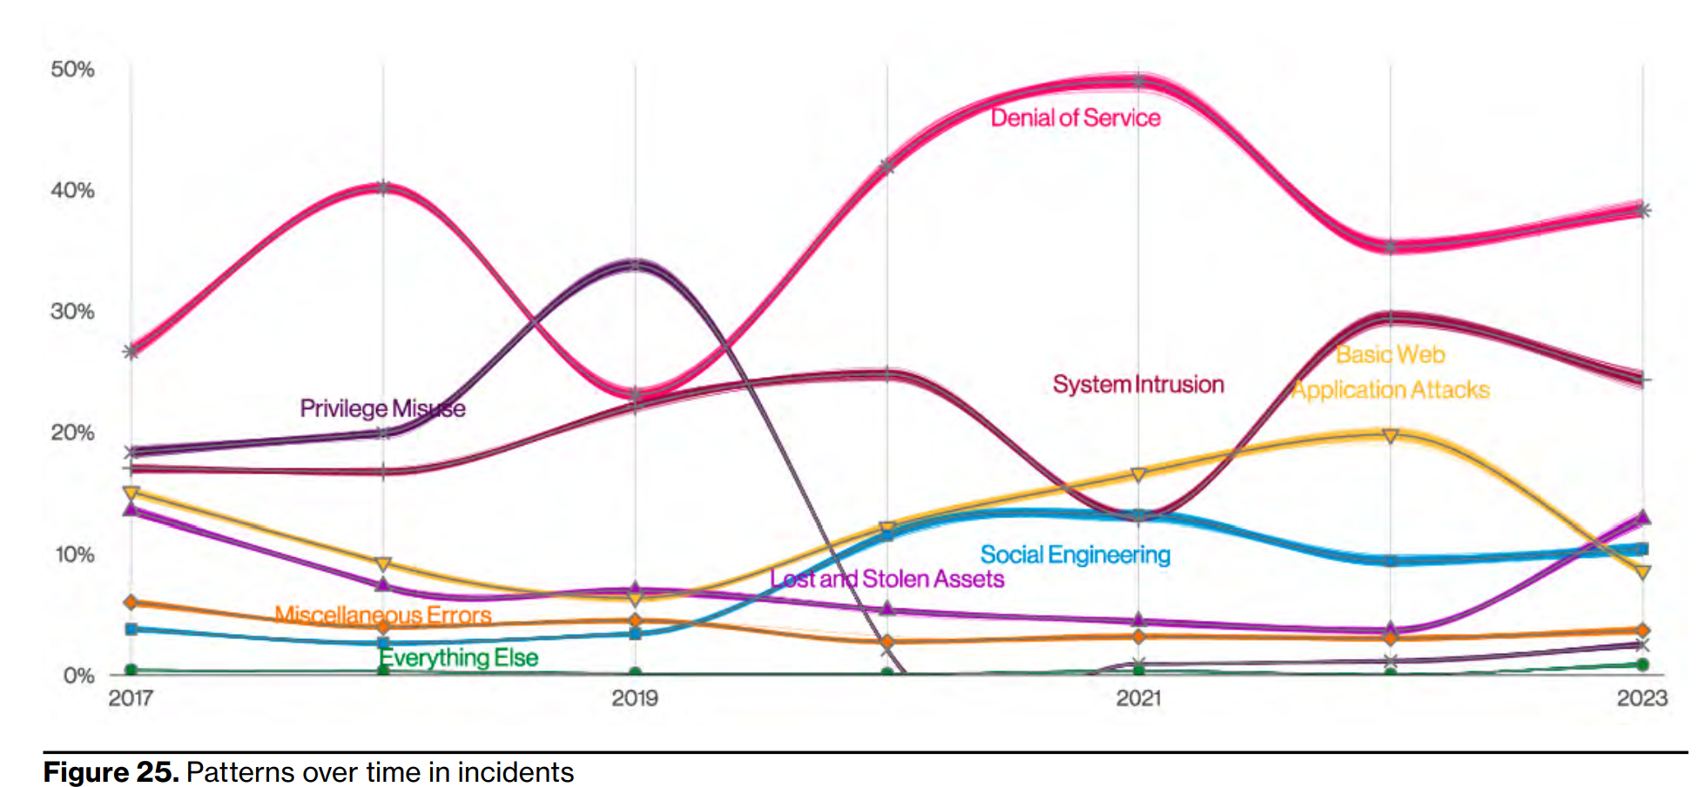
Incident Classification Trends
Notes:
Source: Verizon Data Breach Investigations Report 2023

Slide 31
Cybersecurity Threats
Computer virus - software that is written with malicious intent to cause annoyance or damage.
Worm - a type of virus that spreads itself, not just from file to file, but from computer to computer via e-mail and other Internet traffic.
Distributed Denial-of-service attack (DDoS) - floods a Web site with so many requests for service that it slows down or crashes.

Slide 32
Cybersecurity Threats
Key logger - software, when installed on a computer, records every keystroke and mouse click.
Spyware - software hidden in “free” software and tracks your online movements, mines the information stored on your computer, or uses your computer’s CPU and storage without your permission.
Trojan-horse software - software you don’t want, hidden inside software you do want.

Slide 33
Cybersecurity Threats
Ransomware - malicious software that encrypts computer files and prevents access to them until a cryptocurrency ransom is paid. These crippling attacks often spread to entire networks of computers.
Social Engineering - tricking a user into performing an activity (e.g. clicking link) or sharing information.

Slide 34
Cybersecurity Best Practices
Authentication
  Something you know - password
  Something you have - MFA
  Something you are - Biometric
Authorization / Access Control
  Read, Write, Add, Delete Permissions
  ACL versus Role Based Access Control
Updates (patching) and Antivirus
Intrusion Detection Systems
Data Encryption
Backups
Security Awareness Training & Education

Slide 35
Backup Important Data
Backups are the one solution that can address nearly ALL cybersecurity problems
Consider local backups and offsite (cloud) backups
Best backup solutions run automatically
Consider incremental versus full backup

Slide 36
Additional Security Precautions
Physical security - locks, cabinets, etc.
Firewall - hardware and/or software that protects computers from intruders.
Intrusion-detection software - looks for people on the network who shouldn’t be there or who are acting suspiciously.
Security auditing software - checks out your computer or network for potential weaknesses.

Slide 37
Additional Security Precautions
Encryption - scrambles the contents of a file so that you can’t read it without having the right decryption key.
Public key encryption (PKE) - an encryption system that uses two keys: a public key that everyone can have and a private key for only the recipient.

Slide 38
Cryptography
The study of secret (crypto-) writing (-graphy)
Encryption: Method for scrambling or concealing a message. Process of transforming plain text message into ciphertext (unreadable) message.
Decryption: process of transforming ciphertext message back to plain text message.
Cipher: any method used to encrypt a message
Key: random and secret value placed with the cipher to encrypt or decrypt messages.

Slide 39
The letter “a” encrypted using PGP (Pretty Good Privacy)
-----BEGIN PGP MESSAGE-----
Version: PGP 8.1 - not licensed for commercial use: www.pgp.com
qANQR1DBwU4D6wFAfd5jppEQB/9Pn621c49E/o8NjtkhTOFOgDSUeepk51pdYNTD
oog7I9brllfOybQffvgAimjJTBVm6F44s4vY+T6CBKaAbbrFOkWBKxKaZmPzpJaS
j4tZyE9CwjAE/1+EymggqIcNvoLUVkHv0nFUMtLmyWk1jvMz/M95g1cxMBtx0JED
95a1wC2fTX1kwtdWLGKZ3iw172QkBMqju3kPpdG3zHO7rrho36ptV6iuN726qjMi
vSOTSQn3ALsoKieO03sFmNyeW3OXXDUUyc3olsZwfINCMUVTt8kH3HxentI2H09N
GEd8fh3plNEGxXAQ2f6sb8DcfAJppPERzhPAMAyfPBCyYQ2PCACyYJb/VI8gsF68
7gneCpukS8HW/ob0JxFzv6iSeXf7NybmoAxIsSUxLUXUW4IOvtQ3VtCSgrKnetGi
96Zw+1hXLUMstWOF5FTCos0MAjMWQtyNHql1L6Dnk+Mz842Tl7iA42mewtpOxcWN
pwFq9UPF74vvPUBF7pnvCejyKCn8I3FezL6luOs07LP1exsLjcUZV75McBOVLrDg
pXqE1ZUGJskIqSIEje8XX+J3XJhDE7T5b1/wg6C/cmPRjuvlxHfbTf5Y039pYb1B
XRRoJX93BGR1NKLxI38LJ5YH0wHTm/2jXdGXzMFiKaPkw01Xskl01LvHBdnN+uzK
w+i8X8Zs0jcBFy5ZiHXsLSYcDaCRexawn0H66dtBDpCG/xsZnqmwMYQT9d2Dsh5i
YOKozWGEFRu53in9swF1
=7Yws
-----END PGP MESSAGE-----

Slide 40
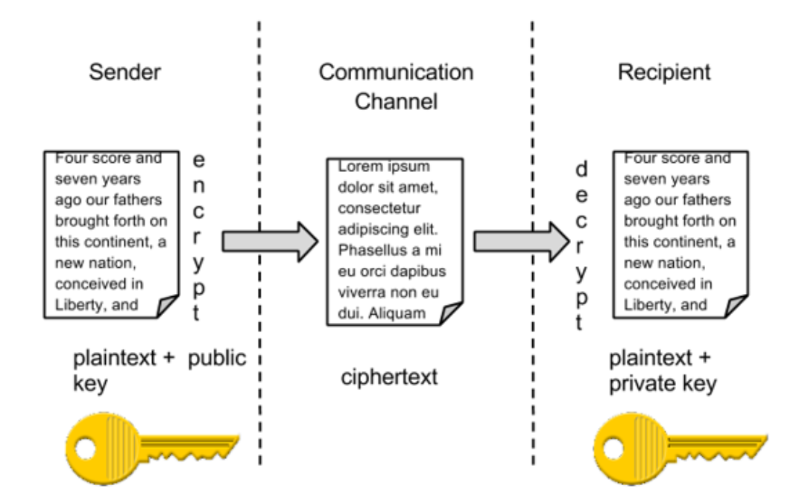
Public Key Encryption

