Slide 1
Intro to MIS - MGS351
Networking and Communication
Chapter 5

Slide 2
Overview
Computer Network Building Blocks
Components, Media and Protocols
What is the Internet?
Overview of various Internet Services
The World Wide Web
How does the Internet work?
Enterprise Impacts

Slide 3
Why Computer Networks?
Two or more computers connected so that they can communicate with each other and share information, software, peripheral devices, and/or processing power.

Slide 4
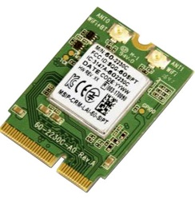
Networking Components
Network interface card (NIC) - an expansion card or integrated device that connects your computer to a network and provides the doorway for information to flow in and out.
These cards can be wireless or wired.

Slide 5
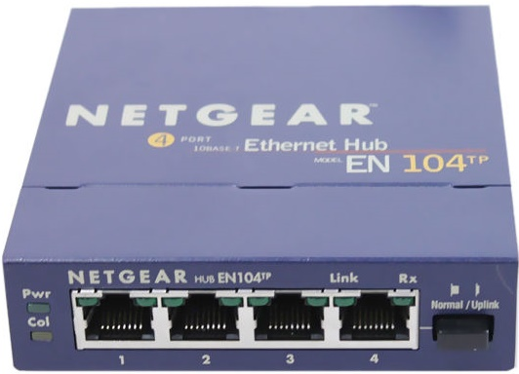
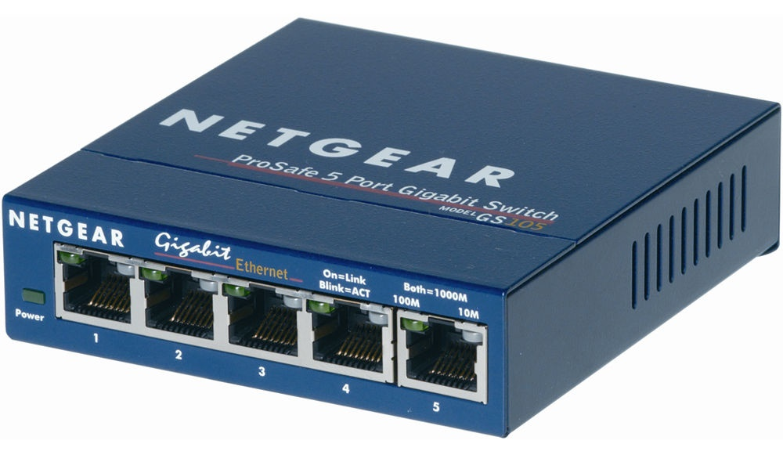
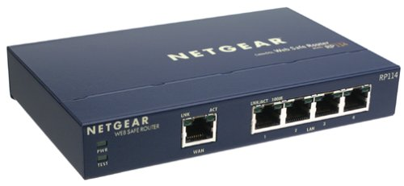
Networking Components

Slide 6
Networking Components
Network hub - a device that connects multiple computers into a network.
Switch - a device that connects multiple computers into a network in which multiple communications links can be in operation simultaneously.
Router - a device that acts as a smart hub connecting computers into a network, and it also separates your network from any other network it’s connected to.

Slide 7
Networking Components

Slide 8
Networking Media
Bounded (wired)
twisted-pair (telephone, Ethernet)
coaxial cable (cable TV)
fiber-optic cable (DWDM)
Unbounded (wireless)
microwave radio (Bluetooth, WiFi)
communication satellites
infrared
high-frequency radios
Notes:
Cat 5, Cat 5e or Cat 6 cable - a better-constructed version of the phone twisted-pair cable.

Slide 9
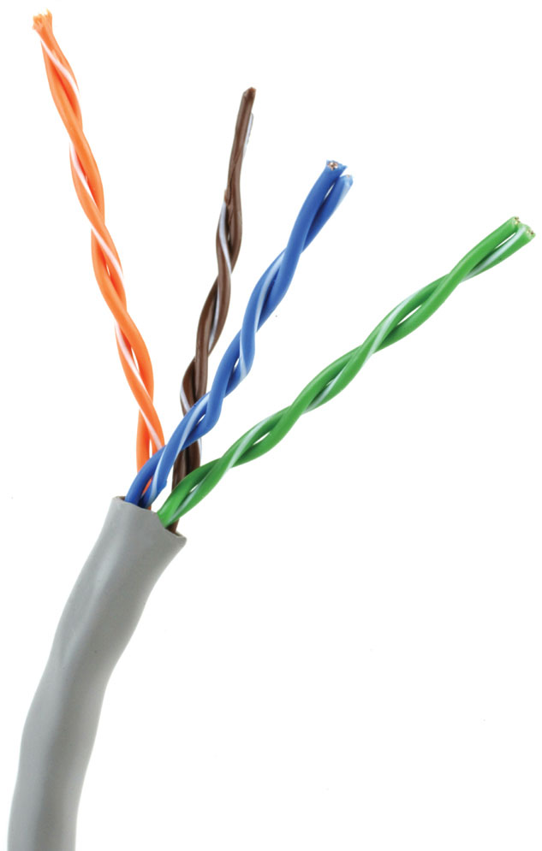
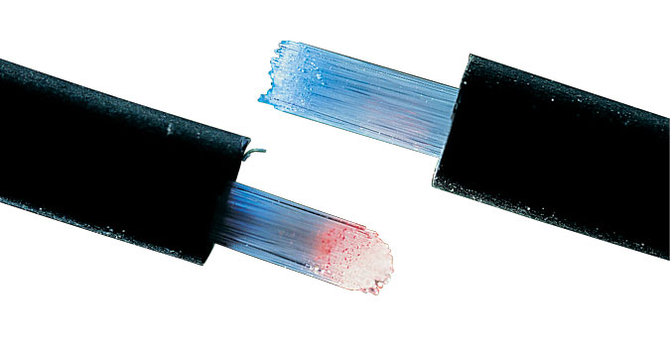
Networking Media
Coaxial Cable
Twisted Pair Cable
Fiber Optic Cable

Slide 10
Networking Protocols
Rules and formats that ensure efficient and error-free electronic communications between different devices/platforms.
TCP/IP, IPv6, WiFi 7
Vary on reliability, speed, capabilities and ease of use

Slide 11
Networking Protocols
A set of characters that mean the same thing to both the sender and the receiver
A set of rules for timing and sequencing messages
A set of methods for detecting and correcting errors

Slide 12
Internet Addresses and Domain Names
IP (Internet protocol) address
128.205.201.56 (IPv4)
2620:cc:8000:1840::80cd:c938 (IPv6)
340 undecillion IPs versus 4.3 billion 340,000,000,000,000,000,000,000,000,000,000,000,000
Domain name - buffalo.edu
Domain Name System (DNS)
Domain name servers
nslookup <hostname> in Windows
host <hostname> in UNIX

Slide 13
Network Classifications
Local area network (LAN) - covers a limited geographic distance, such as an office, building, or a group of buildings in close proximity to each other.
Municipal area network (MAN) - covers a metropolitan area.
Wide area network (WAN) - covers large geographic distances, such as a state, a country, or even the entire world.

Slide 14
The Largest Network
“The Internet is one of the rare, if not unique, instances where ‘hype’ is accompanied by understatement, not overstatement…I don’t think we know what has hit us.”
Nicholas Negroponte, Director, MIT Media Lab

Slide 15
What is the Internet?
Two or more networks joined together (i)
Worldwide group of connected networks that allow public access to information and services (I)
No central governing body
Estimated 5.4 billion users
Roughly 67% of the world population
Notes:
http://www.internetworldstats.com/stats.htm

Slide 16
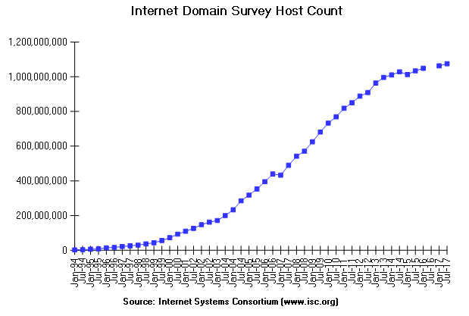
Internet Statistics - Hosts
Notes:
http://www.isc.org/services/survey/

Slide 17
Brief History of the Internet
1969 - Network of four University computers (ARPANET)
1984 - Domain Name System introduced
1986 - NSFnet connects to ARPANET
1988 - Internet WORM affects 6,000 hosts
1991 - Gopher and WWW released
1993 - Mosaic is released
Various organizations help define standards

Slide 18
Internet Services
World Wide Web
E-mail
FTP (Archie)
Telnet and SSH
Chat Rooms (IRC)
Usenet
Gopher (Veronica and Jughead)

Slide 19
World Wide Web
CERN - Where the Web was born
home.cern/science/computing/birth-web
Tim Berners-Lee
Designed for collaborative research
Hyperlinked documents
Defined URL’s, HTML, and HTTP

Slide 20
Anatomy of a Web Page
Uniform Resource Locator (URL)
Hypertext transfer protocol (http://)
Hypertext markup language (HTML)
Hyperlinks

Slide 21
Uniform Resource Locator
Protocol
Directory or Path
Anchor Name
https://mgt2.buffalo.edu/Files/Faculty/MSS/djmurray/mgs351/links.html#ch5
Domain Name
Filename

Slide 22
How does the Internet work?
Clients
Web Servers (www.netcraft.com)
Packets
Routers
Packet Switching (TCP / IP)
Backbone
Network Access Point (NAP)

Slide 23
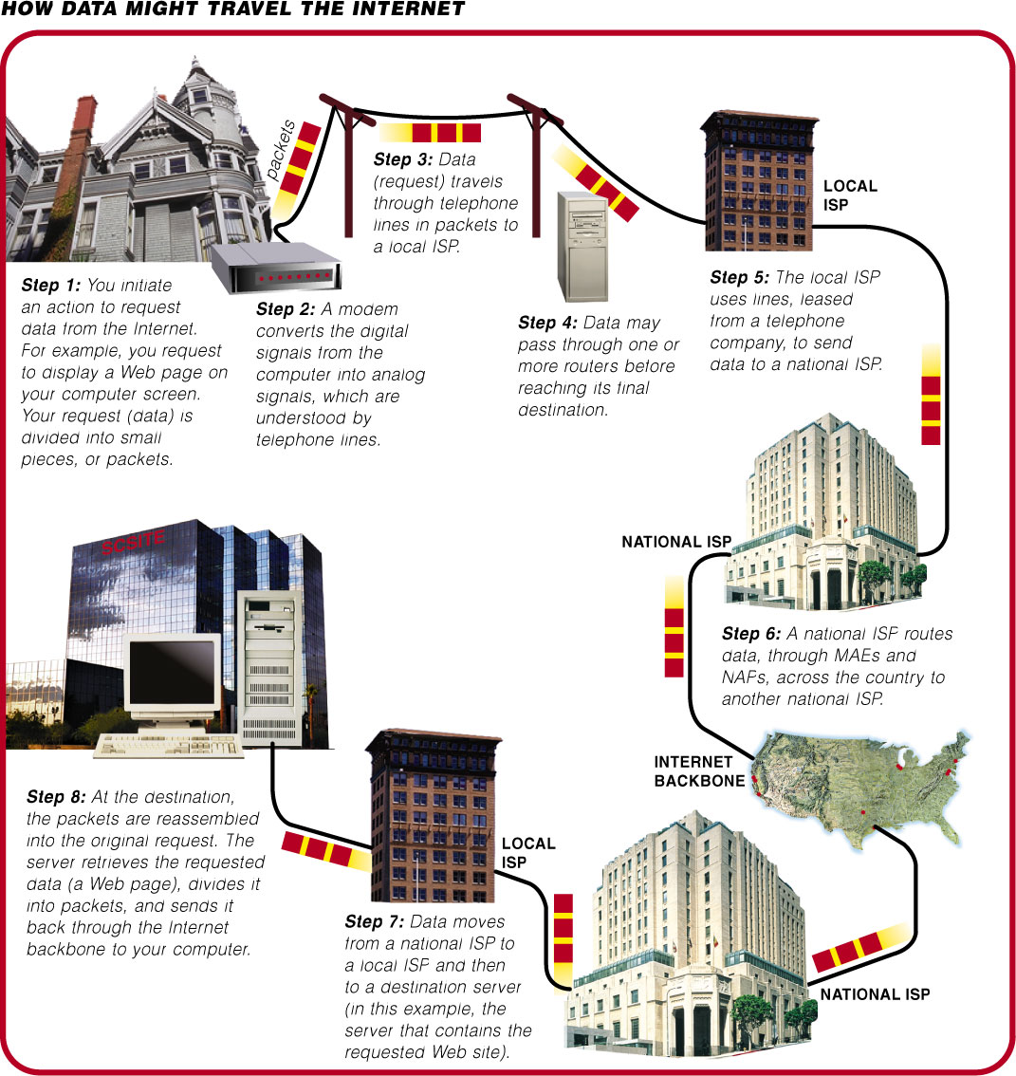

Slide 24
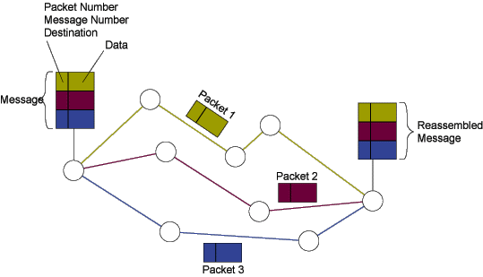
Packet Switching

Slide 25
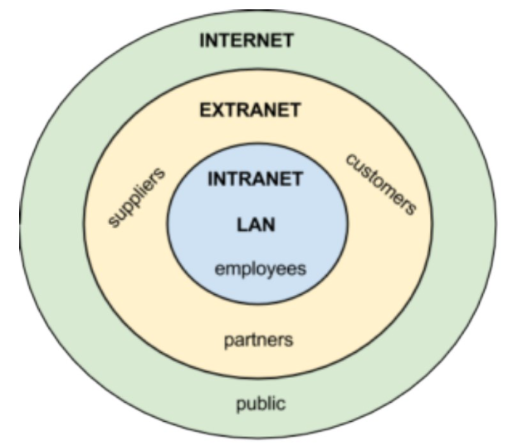
Organizational Networking

Slide 26
Intranets (B2E)
“Private corporate network that uses Internet technology and is designed to meet the needs of employees”

Slide 27
Extranets (B2B)
“Private corporate network designed to meet the needs of external parties such as suppliers, customers, and stockholders”

Slide 28
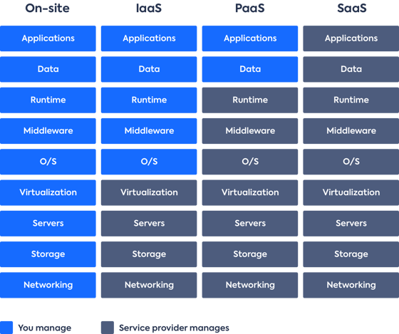
On-site, Infrastructure, Platform and Software as a Service Models
Notes:
IaaS: Amazon Web Services (AWS), MS Azure, Google Compute Engine
PaaS: Amazon Web Services (AWS) Elastic Beanstalk, Force.com (Salesforce), Google App Engine
SaaS: Google Suite, Canva, Salesforce
Questions about vendor lock in, support levels, security/privacy, vendor roadmap

