Slide 1
Intro to MIS - MGS351
Relational Database Design
Chapter 4

Slide 2
Overview
Relational Database Design
Entity Relationship Diagrams
One-to-One (1:1)
One-to-Many (1:N)
Many-to-Many (N:M)
Database Normalization
First, second and third normal form

Slide 3
Relational Databases
Store data in the form of related tables.
Relational design is based on database normalization and can be accomplished with ERD’s.

Slide 4
Relational Database Benefits
Ensures data integrity and referential integrity
Adding, deleting, updating records
Powerful to use

Slide 5
General Database Design Principles
You must become a business expert
Poor relational database design leads to system failure
Proper design accurately reflects the organization’s business rules
Relational database design is both an art and science

Slide 6
Entity Relationship Diagrams
Diagramming tool used to design a relational database – analogous to a “blueprint” for databases. Used by designers to:
Organize relational design on “paper”
Communicate design to end users and business experts for verification

Slide 7
Entity Relationship Diagrams
If designed properly, an ERD will accurately reflect the business rules of the organization. It will become a visual illustration of the organization’s business rules. Therefore, a database is just a reflection of these business rules.

Slide 8
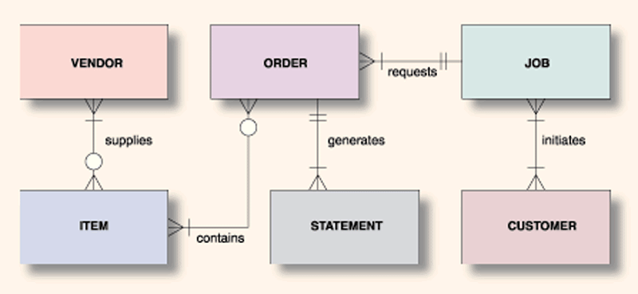
Entity Relationship Diagrams

Slide 9
Entity Relationship Diagrams
Entity - Something general about which data is kept
Attribute - Descriptive value associated with an entity
Key Attribute - Attribute(s) that uniquely identify an entity
Customer entity has name, address, fax number and phone number attributes

Slide 10
Entity Relationship Diagrams
Entities correspond to database tables
Attributes correspond to database fields in a table
Key attributes correspond to primary keys

Slide 11
One-to-One Relationship (1:1)
Student
ID Card
1
Issued
1
Joe
Sally
Tom
Jean
1234-1234
2323-9868
2452-8291
1833-9273

Slide 12
One-to-Many Relationship (1:N)
Student
Library Book
1
Borrows
N
Joe
Sally
Tom
Book A
Book B
Book C
Book D
Book E

Slide 13
Many-to-Many Relationship (M:N)
Student
Course
N
Enrolls
M
Joe
Sally
Tom
Jean
MGS 351
MGA 201
MGQ 301
MGF 301
MGB 301

Slide 14
Multiple Relationships
Faculty
1
Course
Student
N
N
M
Teaches
Enrolls

Slide 15
Multiple Relationships
Jordan
Mike
Murray
MGQ302
Rita
Colleen
MGS351
Sean
Boot
MGF301
Jody
Walt
MGB301
Andrew
Larry
Joe
Barb

Slide 16
ERD Reminders
Consider how time changes the relationship between entities.
Clearly define entities.
Identify all exceptions to the rule…often difficult to find even if you’re the business expert.

Slide 17
Transforming ERD to Tables
Transform entities into tables
Transform attributes into fields
Transform the key attribute into the primary key for the table

Slide 18
Transforming ERD to Tables
Apply these rules to ensure all relationships simplify to 1:N
1:1 - Relationships merge into one table. One entity becomes an attribute of the other
1:N - Add primary key from the “one” entity as a foreign key in the “many” entity
N:M - Add intersection table which includes primary keys from both tables

Slide 19
Transforming ERD to Tables – N:M Detailed Steps
Add intersection table
Flip relationship lines around so “many” side faces the intersection table
Add primary keys from original tables as fields in the intersection table
Assign a name the intersection table
Add other relevant fields to intersection table if necessary

Slide 20
Transforming ERD to Tables – 1:1
Student
ID Card
1
Issued
1
Merge relationships into one table. One entity becomes an attribute of the other.
Student
ID Card

Slide 21
Transforming ERD to Tables – 1:N
Student
Library Book
1
Borrows
N
Person #
Primary Key ➔
Person #
Foreign Key ➔
1:N – Add primary key from the “one” entity as a foreign key in the “many” entity

Slide 22
Transforming ERD to Tables – N:M (Before)
Student
Course
N
Enrolls
M
Person #
Course #
M:N - Add intersection table which includes primary keys from both tables

Slide 23
Transforming ERD to Tables – N:M (After)
Student
Course
Person #
Course #
Step 1: Add intersection table

Slide 24
Transforming ERD to Tables – N:M (After)
Student
Course
1
N
N
1
Person #
Course #
Step 2: Flip relationship lines around so “many” side faces the intersection table

Slide 25
Transforming ERD to Tables – N:M (After)
Student
Course
1
N
N
1
Person #
Course #
Person #
Course #
Step 3: Add primary keys from original tables as foreign key fields in the intersection table

Slide 26
Transforming ERD to Tables – N:M (After)
Student
Registration
Course
1
N
N
1
Person #
Course #
Person #
Course #
Step 4: Assign a name the intersection table

Slide 27
Transforming ERD to Tables – N:M (After)
Student
Registration
Course
1
N
N
1
Grade
Person #
Course #
Person #
Course #
Step 5: Add other relevant fields to intersection table if necessary

Slide 28
Transforming ERD to Tables – N:M (After)
Student
Registration
Course
1
N
N
1
Grade
Person #
Course #
Person #
Course #
What should be used as Primary Key in the intersection table?
Composite Primary Key or Autonumber

Slide 29
Determining Relationships
Customer
Loan
To determine the relationships between two entities, you have to ask the right questions.
1) Can a single Customer have one or many Loans?
2) Can a single Loan be related to one or many Customers?

Slide 30
Determining Relationships
Customer
Loan
1
N
The answers to the two questions depend on the Bank’s business rules. For this example, we’ll say that a Customer can have many loans and a Loan can be related to only one Customer.

Slide 31
Determining Relationships
Customer
Loan
1
N
1) Can a single Loan have one or many Payments?
2) Can a single Payment be applied to one or many Loans?
Payments

Slide 32
Determining Relationships
Customer
Loan
1
N
Again, the answers depend on the Bank’s business rules. For this example, we’ll say that a Loan can have many Payments and a Payment can be applied to many Loans.
M
N
Payments

Slide 33
Database Normalization
Application of a number of rules to the relational model which will simplify the relations.
Avoid common database problems
Make the data as tightly bound as possible
Store the minimum amount of data

Slide 34
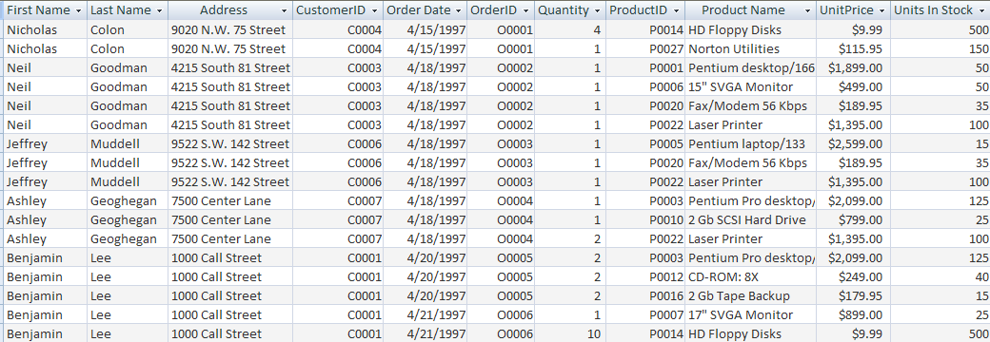
Un-normalized Example

Slide 35
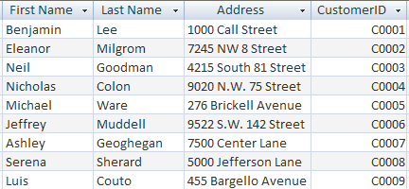
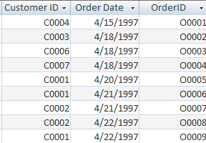
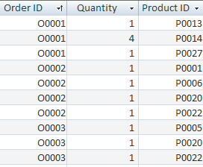
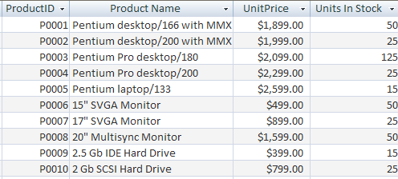
Normalized Example
Customers Orders
Order Details Products

Slide 36
Database Normalization Goal
The fields in a table depend on the key, the whole key, and nothing but the key.

Slide 37
Database Normalization Steps
1NF - Remove repeating groups
2NF - Remove fields dependent only on part of the key field (Applies to concatenated keys)
3NF - Remove fields dependent only on other fields in that table

Slide 38
Un-normalized
Order
Order#, Cust#, CustName, CustAddress,
( Product#, ProductName, Quantity,
ProductPrice), OrderDate

Slide 39
First Normal Form (1NF)
Order
Order#, Cust#, CustName, CustAddress,
OrderDate
Line item
Order#, Product#, ProductName, Quantity,
ProductPrice

Slide 40
Second Normal Form (2NF)
Line item
Order#, Product#, Quantity
Product
Product#, ProductName, ProductPrice

Slide 41
Third Normal Form (3NF)
Order
Order#, Cust#, OrderDate
Customer
Cust#, CustName, CustAddress

