Slide 1
Intro to MIS - MGS351
Obtain Valuable Information
Using Queries
Chapter 4

Slide 2
Chapter Overview
Query Criteria
  Like, In, And, Or, Between, Null, Relational Operators (>,<,>=,<=,=,<>)
Grouping and Sorting
  Avg, Min, Max, Count, Sum
Advanced Query Topics
  Unmatched and Parameter Queries, Concatenation, IIf, Update Queries

Slide 3
Queries
Allow you to ask questions (queries) about data in the database.
  Select, Crosstab, Make Table, Update, Append, Delete
Often used to build reports and forms
Datasheet, Design and SQL view

Slide 4
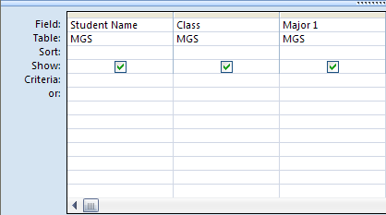
Who is in MGS351?

Slide 5
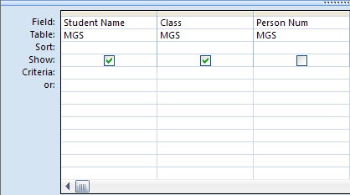
Who is in MGS351 sorted by person number?

Slide 6
Who are Juniors in MGS351?

Slide 7
How many Seniors are in MGS351?

Slide 8
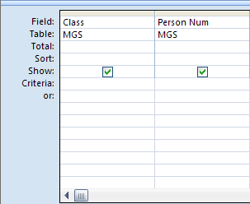
How many Seniors are in MGS351? (Better way)

Slide 9
How many Fr, So, Jr and Sr students are in MGS351?

Slide 10
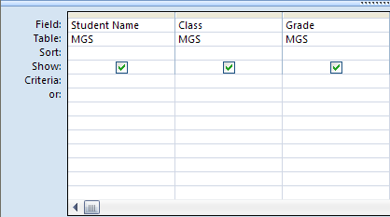
Who has resigned the class?

Slide 11
Who doesn’t have a grade yet?

Slide 12
Who has a last name beginning with the letter M?
* represents anything (many characters) or nothing
? represents any single character

Slide 13
Who has a first name beginning with the letter S?
* represents anything (many characters) or nothing
? represents any single character

Slide 14
Who has a last name six characters long?
* represents anything (many characters) or nothing
? represents any single character

Slide 15
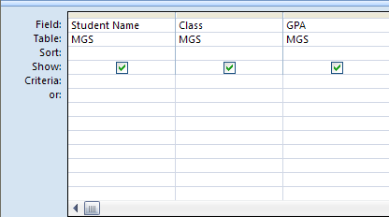
Who has a GPA greater than 3.5?

Slide 16
Who has a GPA between 3.2 and 3.5?

Slide 17
Who is a Senior OR Accounting major?

Slide 18
Who is a Senior AND Accounting major?

Slide 19
Who is an Acct (MGA) or Mgmt (MG) major?

Slide 20
Who is an Acct (MGA) or Mgmt (MG) major?

Slide 21
Who is a Jr or Sr and a Mgmt (MG) major?

Slide 22
Who is a Jr or Sr and a Mgmt (MG) major?

Slide 23
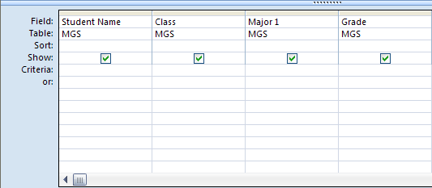
Who is a Jr or Sr and a (MG) major with a grade of A or B?

Slide 24
Who is a not a Freshman?

Slide 25
Who is a Fr, So or Jr?

Slide 26
Who is a Fr, So or Jr?

Slide 27
Advanced Query Topics

Slide 28
Unmatched Queries
Identifies records in one table that don’t exist in another
What products have never been ordered?
What students haven’t registered?

Slide 29
Parameterized Queries
The criteria is dynamic – every time a parameterized query is run, the user is prompted to enter the criteria value they want to use.

Slide 30
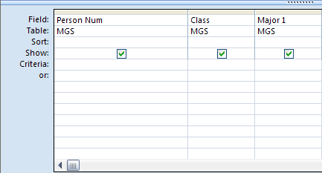
What is the class and major for a specific person number?

Slide 31
Concatenation
Can be used to combine multiple query fields together, or to add extra formatting in a query.
What expression will generate this output?
  Student name (Major)
  David Murray (MG)

Slide 32
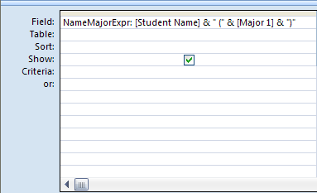
Concatenation Example
Ampersand symbol & is used to combine fields and text. All text should be enclosed in “double quotes”

Slide 33
HW3 - Ch 5 Applied Step 4
GPA: 3.7 – Grade: A
GPA:
Space
3.7
Space
– Grade:
Space
A
Space

Slide 34
IIF Expression
Use to conditionally evaluate data, and dynamically generate output based on it.
In other words…one single query expression can be created to do the following:
Display “Underclassman” for freshman and sophomore students and “Upperclassman” for junior and senior students

Slide 35
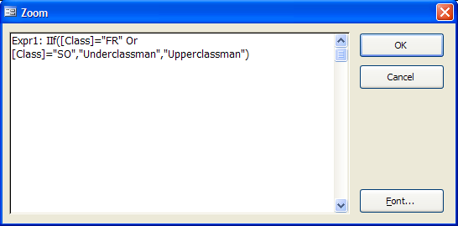
IIF Expression
IIF(logical expression, output if true, output if false)
IIF(Class field is equal to FR or SO, display Underclassman, otherwise display Upperclassman)

Slide 36
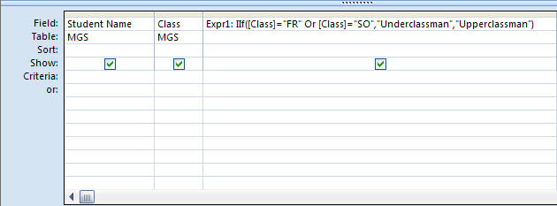
IIF Expression

Slide 37
Update Queries
Used to update specific records with data, based on the given criteria.
Update the Major 1 field in the database to “Management” where it currently is “MG”

Slide 38
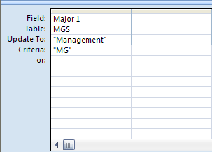
Update Query Example

Slide 39
IIF Expression and Update Query
Create one single query expression to do the following:
Update the performance field in the database for each student based on their course grade.
  Satisfactory [A, A-, B+, B, B-, C+, C]
  Marginal [C-, D]
  Unsatisfactory [F]

Slide 40
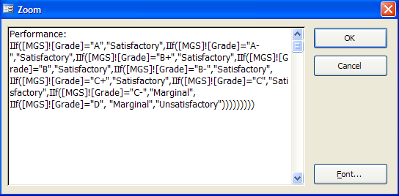
IIF Expression

Slide 41
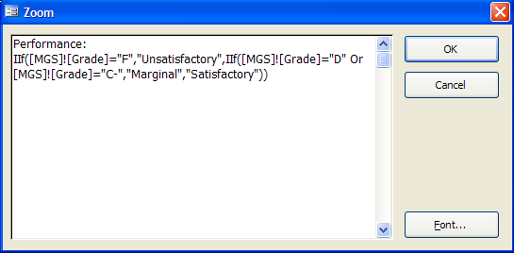
IIF Expression (Better Way)

Slide 42
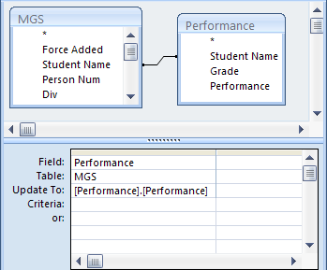
IIF Expression and Update Query
Separate Query with IIF Expression (Performance)
[TableName].[Fieldname] is the syntax used to refer to fields in other tables or queries

Slide 43
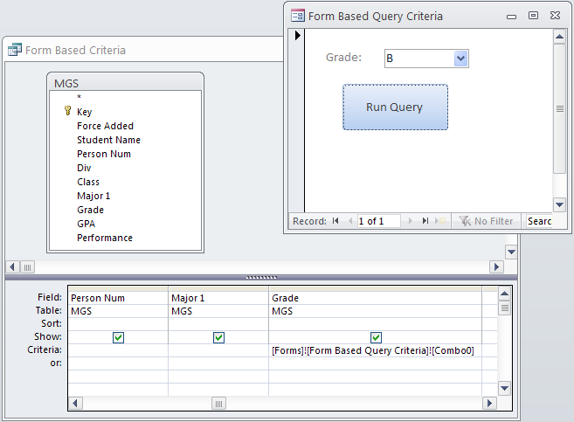
Form Based Criteria – Powerful and User Friendly!

Slide 44
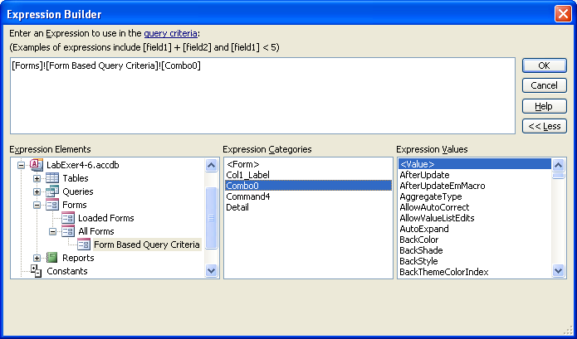
Form Based Criteria – Powerful and User Friendly!
Make sure to save the form first so that the control names show up in the expression builder.

Slide 45
Quick Review
The most common type of query is called a
a. Dynaset query
b. Select query
c. Query by Example query
d. Relational query

Slide 46
Quick Review
Which of the following criteria will return the record Anderson?
a. Like “Ander?”
b. Like “Ander*”
c. Both a and b
d. Neither a nor b

Slide 47
Quick Review
Which function can be used instead of the OR criteria?
a. Between
b. In
c. Not Null
d. IIF

Slide 48
Quick Review
All are valid functions for grouped queries except
a. Sum
b. Count
c. NPV
d. Min

Slide 49
Quick Review
If your balance is 10,000, what is the result of this expression?
IIF(Balance >= 10000, .035, .0275)

Slide 50
Quick Review
True / False
You can modify the query results, but the changes will not be reflected in the underlying table.

Slide 51
Homework 3
Chapter 4 Guided Exercise
Chapter 5 Guided Exercise
Chapter 5 Applied Exercise

