Slide 1
Intro to MIS - MGS351
Simplify Data Entry with Forms
Chapter 3

Slide 2
Chapter Overview
Designing Forms
Working with Forms
  Form, Layout and Design View
  Form Controls
Form Wizard Example
Form Controls and Properties

Slide 3
Forms
Forms are used for displaying data, entering data or used as part of a menu system
    Basic, Multiple Item and Split Forms
Built upon tables or queries

Slide 4
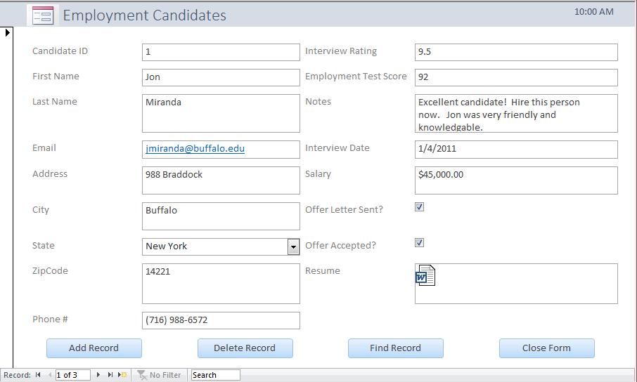
Form View

Slide 5
Form View
Displays data on the form and allows updates and edits of the form data. Cannot make updates to the form layout and design. Database end user uses this view.

Slide 6
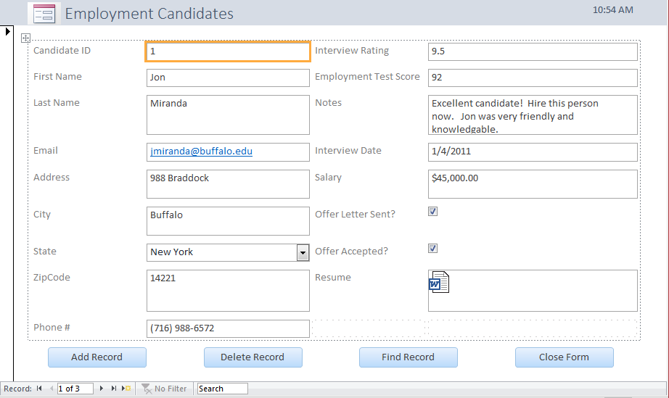
Layout View

Slide 7
Layout View
Most flexible way to work with and modify a form. Displays the data while allowing you to modify the form design. Cannot update form data.

Slide 8
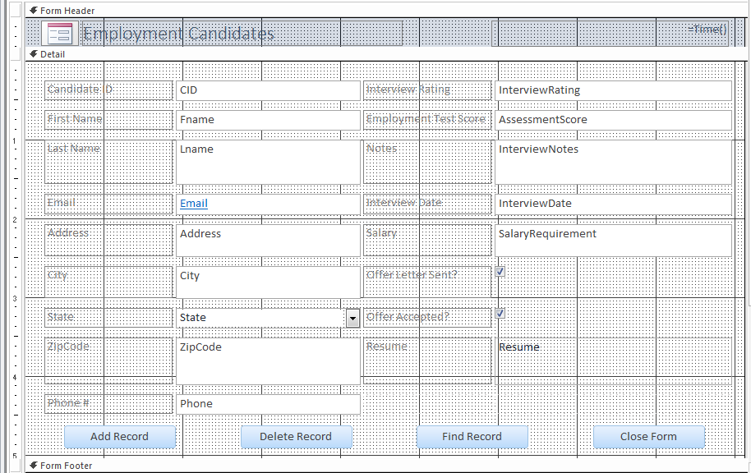
Design View

Slide 9
Design View
Most powerful view used to modify the layout, design and content of a form. Cannot view or edit data in this view.

Slide 10
Controls
Labels
Textboxes
Combo Box
Checkbox
Command Button

Slide 11
Controls
Labels
Textboxes
Combo Box
Checkbox
Command Button

Slide 12
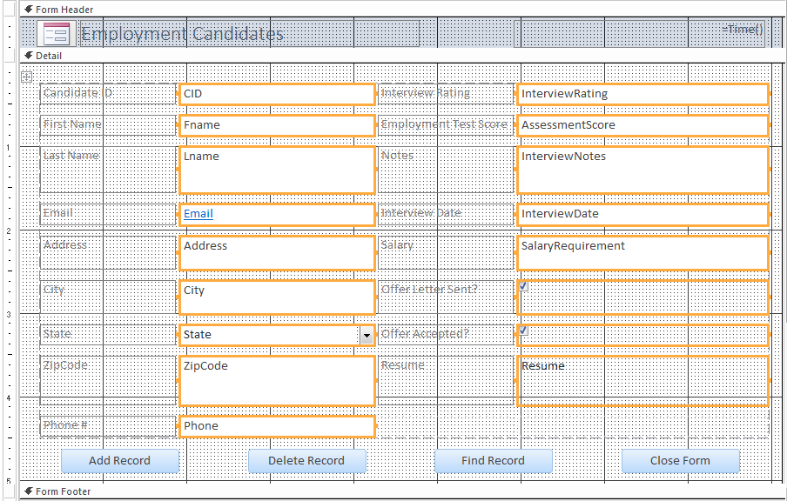
Bound Controls (Highlighted)

Slide 13
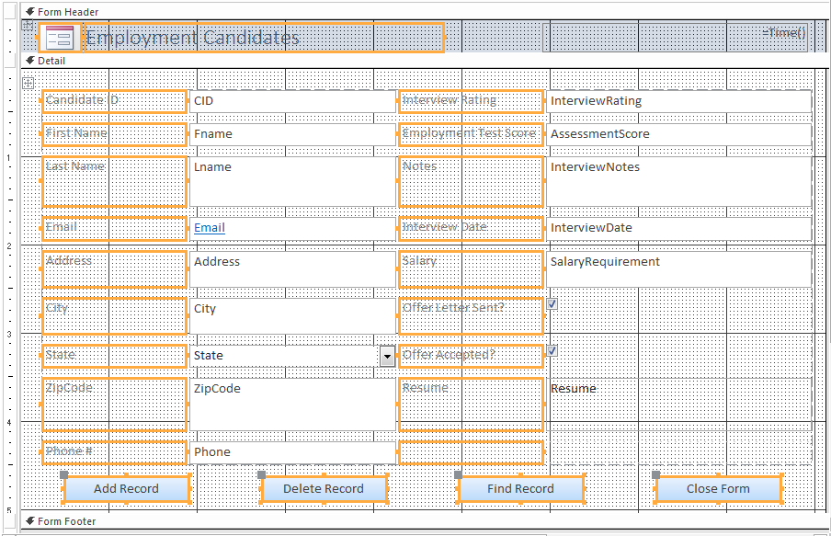
Unbound Controls

Slide 14
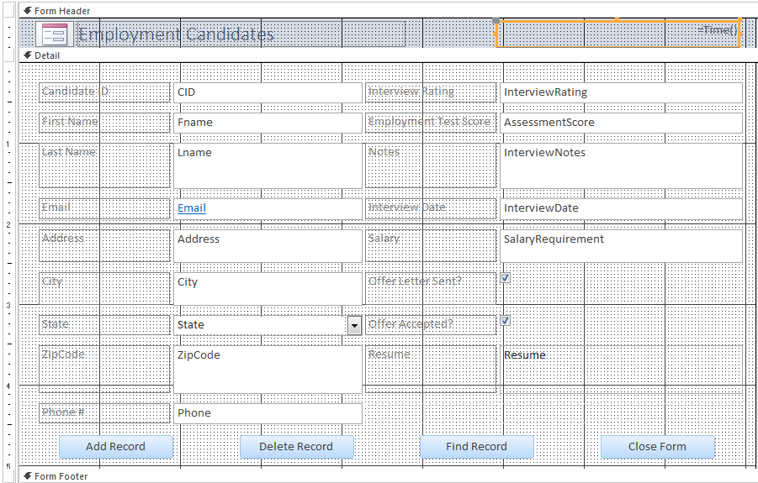
Calculated Controls

Slide 15
Form Wizard
Use it! Very useful as a starting point for building a form. Provides a framework you can customize and build upon.

Slide 16
Designing Forms
Consistent look and feel
Easy to read
Pleasant to look at
Displays all relevant information
Intuitive navigation

Slide 17
Form Wizard Example

Slide 18
Modifying Forms
Design View
    Field List, Property Sheet, Controls Tool Box
Adding Controls
Combo Boxes
Tab Stops

Slide 19
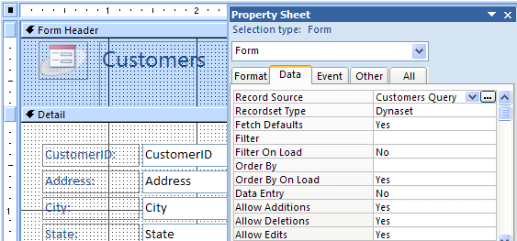
Identifying the Record Source
Click upper left corner to view properties for entire report. Record source property is in the Data tab. Click build button to view the report record source.

Slide 20
Formatting Forms
Selecting bound controls & labels
Sizing a control
Moving a control and its label
Changing properties of a control
Selecting multiple controls

Slide 21
Additional Form Controls
Drop down list boxes
Check Boxes
Option Groups
Command Buttons

Slide 22
Quick Review
A(n) ________ control on a form has an expression or formula as its data source.

Slide 23
Quick Review
Using the Lookup Wizard for a field in a table, will result in a ________ ________ displaying on a form based off of that field.

Slide 24
Quick Review
True / False
Updating form data will update the associated data record in the corresponding table.

Slide 25
Homework 2
Chapter 3 Guided Exercise
Chapter 3 Applied Exercise

