Slide 1
Intro to MIS - MGS351
Overview of
Microsoft Access Databases
Chapter 1

Slide 2
Chapter Overview
Introduction
Database Hierarchy
Database Objects
Tables, Queries, Forms, Reports, Macros and Modules
Relational Databases

Slide 3
We Remember….
10% of what we read
20% of what we hear
30% of what we see and hear
50% of what we see someone do while explaining it
90% of what we do ourselves

Slide 4
Learning Objectives
General Database Concepts
Microsoft Access
Application Development
Relational Database Design

Slide 5
Database Concepts
Data versus Information
Database hierarchy
Database (DBMS)
Table
Records (Rows)
Fields (Columns)

Slide 6
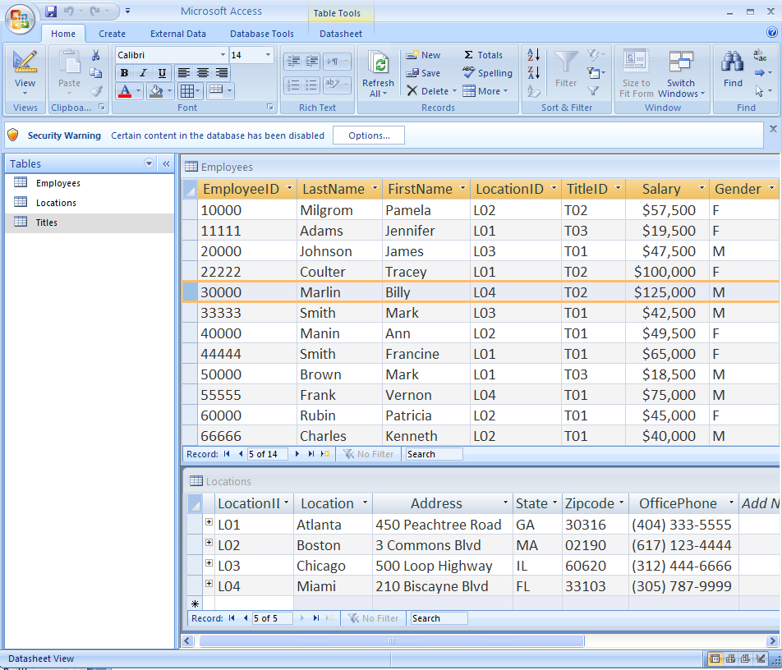

Slide 7
Commercial Systems
Oracle
Ingres
PostgreSQL
Informix
IBM DB2
Microsoft Access
Microsoft SQL Server
MySQL
MariaDB

Slide 8
Microsoft Access
Access 2007, 2010, 2013, 2016 and 2019 databases end with .accdb file extension – for example, sales.accdb
Databases made in older versions of Access have the file extension .mdb
NEVER remove a disk or flash drive until Access is completely shut down.
Access is only available for Windows

Slide 9
Access Database Objects
Tables – Ch. 2
Forms – Ch. 3
Queries – Ch. 4
Reports – Ch. 5
Macros – Ch. 7
Modules (VBA) – Not covered

Slide 10
Tables
Store the data in a database – similar to a spreadsheet, but more organized. Contains records (rows) and fields (columns).
Datasheet View and Design View
Field Properties – input mask, validation rule, data type, format, primary key, etc.

Slide 11
Queries
Allow you to ask questions (queries) about data in the database to extract information.
When have customers placed orders?
What products in inventory haven’t sold well?
Who is the most productive employee?

Slide 12
Forms
Forms are used for entering data, displaying data or for building a menu system.
Basic Forms, Split Forms, Multiple Item Forms, Subforms
Form, Layout and Design View

Slide 13
Reports
Used to format and present the data in a professional, logical and useful manner. Often intended for printing and distribution. Can be built from tables or queries.
Reports (output) in a system dictate what data must be stored in the database.
Report, Layout, Design and Print Preview

Slide 14
Macros
Small programs that can perform advanced operations, making the database more powerful and user-friendly.
Often used to open forms and reports or to automate portions of the database.
Macro saved with name Autoexec will run automatically when the database is opened.

Slide 15
Form and Report Wizards
Useful as a starting point for building reports and forms. Provides a framework that you can customize and build upon.

Slide 16
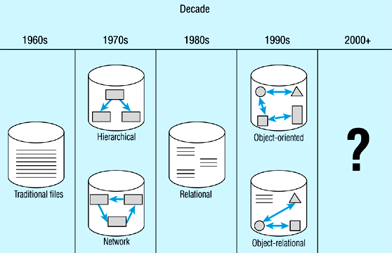
Evolution of Databases

Slide 17
Relational Databases
The real power of Access is derived from multiple tables and the relationships between those tables.

Slide 18
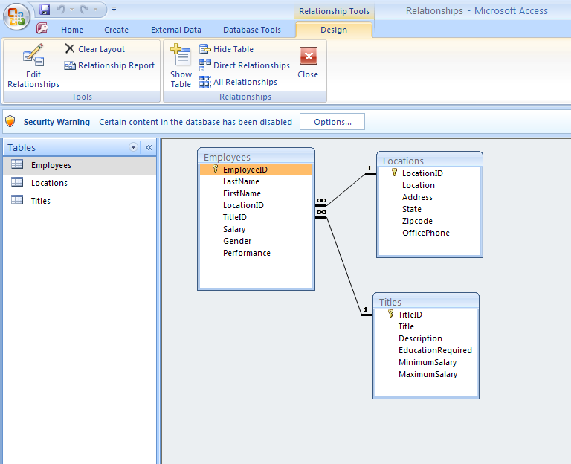

Slide 19
Quick Review
Which view is used to add, edit, and delete records in a table?
a. the Design view
b. the Datasheet view
c. Either (a) or (b)
d. Neither (a) or (b)

Slide 20
Quick Review
Which represents the hierarchy of terms from smallest to largest?
a. Database, table, record, field
b. Field, record, table, database
c. Record, field, table, database
d. Field, record, database, table

Slide 21
Quick Review
A __________ provides a convenient and attractive way to enter and display the data in a table.

Slide 22
Quick Review
Which form and report view allows you to immediately see the design changes you’re making?
a. Datasheet
b. Design
c. Print Preview
d. Layout

Slide 23
Homework 1
Chapter 1 Guided Exercise
Chapter 2 Guided Exercise
Chapter 2 Applied Exercise

