Slide 1
Intro to MIS - MGS351
Computer Crime and Forensics
Extended Learning Module H

Slide 2
Overview
Digital Forensics
Acquiring, Authenticating and Analyzing Evidence
Digital Forensic Challenges
Hidden Files, Passwords, Encryption, Steganography, Mobile Devices
Business Implications
Disposing of Old Computers

Slide 3
Digital Forensic Science (DFS)
“The use of scientifically derived and proven methods toward the preservation, collection, validation, identification, analysis, interpretation, documentation and presentation of digital evidence derived from digital sources for the purpose of facilitating or furthering the reconstruction of events found to be criminal, or helping to anticipate unauthorized actions shown to be disruptive to planned operations.”
Source: (2001). Digital Forensic Research Workshop (DFRWS)

Slide 4
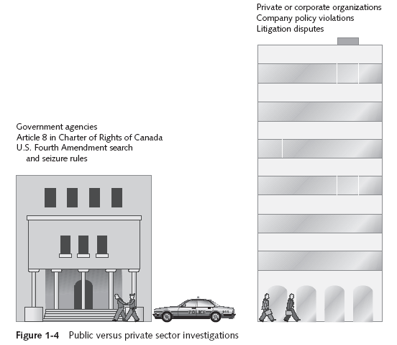
Public versus Private Investigations

Slide 5
Computer Forensics
“The collection, authentication, preservation, and examination of electronic information for presentation in court.”
Media Analysis
Examining physical media for evidence
Code Analysis
Review of software for malicious signatures. Analyze viruses and malware.
Network Analysis
Scrutinize network traffic and logs to identify and locate evidence

Slide 6
Digital Forensics
Acquire the evidence without altering or damaging the original
Authenticate the image (copy)
Analyze the data without modifying it
The chain of custody of the original evidence needs to be preserved throughout the entire investigation

Slide 7
Places to Look for Electronic Evidence
Floppy Disks
CDs
DVDs
Zip Disks
Backup Tapes
USB Storage
PDAs
Flash memory
Voice mail
Electronic Calendars
Scanner
Photocopier
Fax/Phone/Cell
IPods

Slide 8
Acquire the Evidence
If possible, hard disk is removed without turning computer on
Hardware write blockers are used to ensure that nothing is written to drive
Other techniques can be used to acquire volatile data (RAM, registers, etc.)
Forensic image copy – an exact copy or snapshot of all stored information

Slide 9
Authentication
Ensures no evidence was planted or destroyed
MD5 hash value - mathematically generated string of 32 letters and is unique for an individual storage medium at a specific point in time
Probability of two storage media having same MD5 hash value is 1 in 10³⁸, or
1 in 100,000,000,000,000,000,000,000,000,000,000,000,000

Slide 10
Authentication
This is the MD5 hash of this sentence
4b05c61d476b4e1059dbcf188d990441
Files, drives and images of drives can also be hashed to create a digital fingerprint.
Other hashing algorithms can be used too (SHA-1)

Slide 11
Analysis
Interpretation of information uncovered
Can pinpoint files location on disk, its creator, the creation date and many other facts about the file
Always work from an image of the evidence and never from the original
Make two backups of the evidence in most cases.
Analyze everything, you may need clues from something seemingly unrelated

Slide 12
File Hash Analysis
“De-Nisting” - Using database of known file hashes from NIST (3.3 GB), Encase can compare known systems files and programs and eliminate them from evidence.
Also used by law enforcement to find files of “interest”.

Slide 13
Files Can Be Recovered from
Email messages (deleted ones also)
Office files
Deleted files of all kinds
Files hidden in image and music files
Encrypted Files
Compressed Files
Temp Files
Spool Files
Registry
Web history-index.dat
Cache files
Cookies
Network Server files:
Backup e-mail files
Other backup and archived files
System history files
Web log files
Unallocated Space
Slack Space

Slide 14
Excerpts from NASA E-Mail
“…something could get screwed up enough…and then you are in a world of hurt…”
“I can only hope the folks…are listening…”
Pertaining to the Columbia Shuttle disaster

Slide 15
E-Mail from Bill Gates
“…do we have a clear plan on what we want Apple to do to undermine Sun…?”
From Bill Gates in an intraoffice e-mail about a competitor in the MS antitrust action

Slide 16
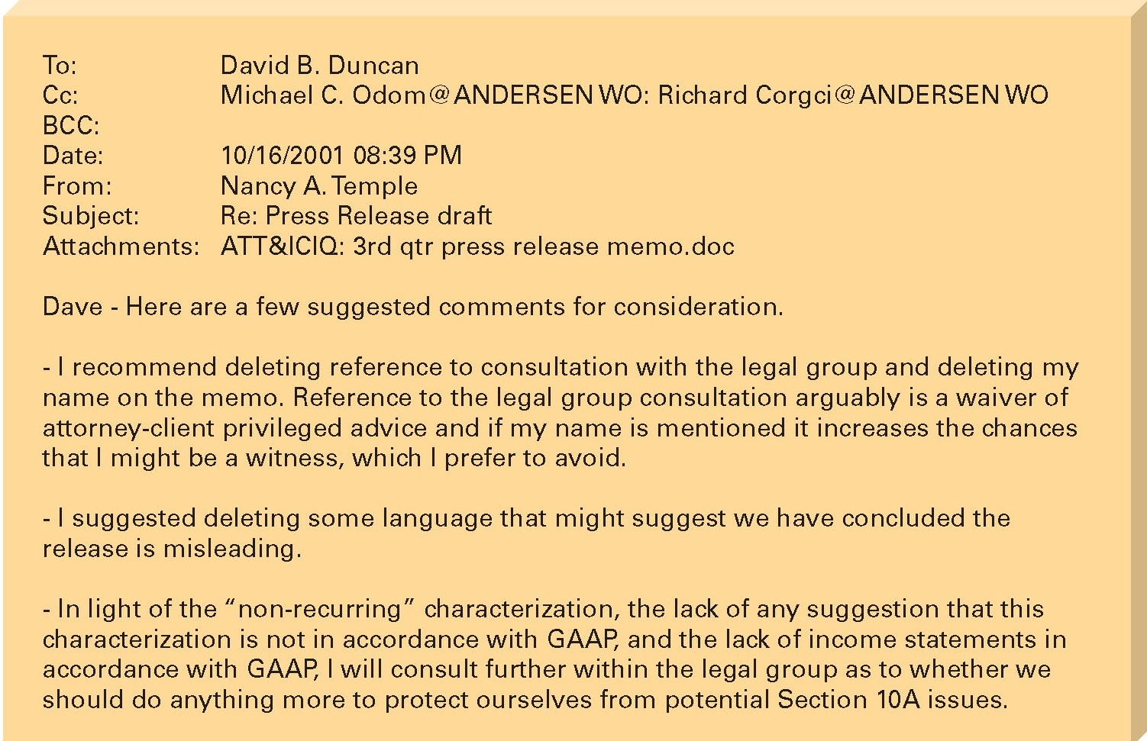
E-Mail between Enron and Andersen Consulting

Slide 17
What does this mean?
Deleted data really isn’t deleted!

Slide 18
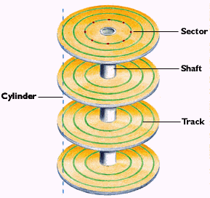
Data Storage
Tracks - Concentric rings
Sectors - Tracks divided radially into parts
Files storage
The minimum space occupied by any file is one sector.
Unused space in the sectors is known as slack space.

Slide 19
Storage Media Basics
Sector: 512 Bytes
Cluster (Block): 2 or more clusters (up to 64)
…
0
1
2
3
4
5
511
0
1
2
3
4
5
511
0
1
2
3
4
5
511

Slide 20
Slack Space
File Slack: Last cluster of file isn’t filled up completely, so data from the last use of that cluster isn’t overwritten.
File Slack = Disk Slack + RAM Slack
File Slack
RAM Slack
Disk Slack
0
1
2
3
4
5
511
0
1
2
3
4
5
511
EOF

Slide 21
Digital Forensic Challenges
“Hidden” files
Password protected files
Encryption
Steganography
Mobile Devices

Slide 22
Ways of Hiding Information
Rename the file or change file extension
Disk manipulation
Hidden partitions
Bad clusters
Set hidden property on file
Use Windows to hide files (ADS)
Most will be detected by forensic software

Slide 23
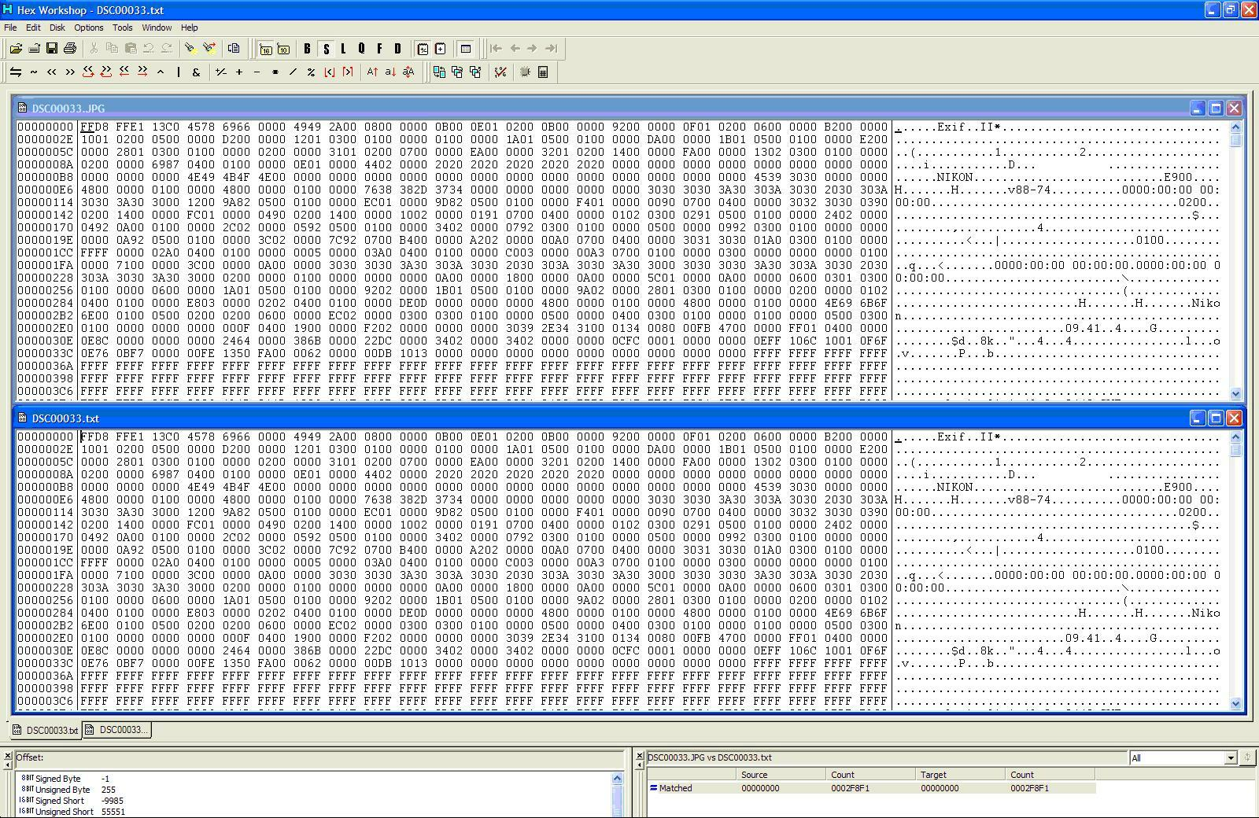
Changing file extensions

Slide 24
Recovering Passwords
Dictionary attack
Brute-force attack
Password guessing based on suspect’s profile

Slide 25
Examining Encrypted Files / Drives
Recovering data is difficult without encryption key
"I can tell you from the Department of Justice perspective, if that drive is encrypted, you're done. When conducting criminal investigations, if you pull the power on a drive that is whole-disk encrypted you have lost any chance of recovering that data."
- Ovie Carroll, Director of the cyber-crime lab at the Computer Crime and Intellectual Property Section in the Department of Justice

Slide 26
Steganography
Means “covered writing” or “hidden writing”
Hiding data in plain sight!
Invisible Ink is one example
Other types are letter, word and digital steganography.

Slide 27
Steganography Example
PRESIDENT'S EMBARGO RULING SHOULD HAVE IMMEDIATE NOTICE. GRAVE SITUATION AFFECTING INTERNATIONAL LAW. STATEMENT FORESHADOWS RUIN OF MANY NEUTRALS. YELLOW JOURNALS UNIFYING NATIONAL EXCITEMENT IMMENSELY.

Slide 28
Letter Steganography Example
PRESIDENT'S EMBARGO RULING SHOULD HAVE IMMEDIATE NOTICE. GRAVE SITUATION AFFECTING INTERNATIONAL LAW. STATEMENT FORESHADOWS RUIN OF MANY NEUTRALS. YELLOW JOURNALS UNIFYING NATIONAL EXCITEMENT IMMENSELY.
PERSHING SAILS FROM NY JUNE I

Slide 29
Steganography Example
Dear George,
Greetings to all at Oxford. Many thanks for your
letter and for the summer examination package.
All entry forms and fees forms should be ready
for final dispatch to the syndicate by Friday
20th or at the latest I am told by the 21st.
Admin has improved here though there is room
for improvement still; just give us all two or three
more years and we will really show you! Please
don’t let these wretched 16+ proposals destroy
your basic O and A pattern. Certainly this
sort of change, if implemented immediately,
would bring chaos.
Sincerely yours,

Slide 30
Word Steganography Example
Dear George,
Greetings to all at Oxford. Many thanks for your
letter and for the summer examination package.
All entry forms and fees forms should be ready
for final dispatch to the syndicate by Friday
20th or at the latest I am told by the 21st.
Admin has improved here though there is room
for improvement still; just give us all two or three
more years and we will really show you! Please
don’t let these wretched 16+ proposals destroy
your basic O and A pattern. Certainly this
sort of change, if implemented immediately,
would bring chaos.
Sincerely yours,

Slide 31
Other Steganography Approaches
Delliberate misspelling to mark words in the mesage
Use of small changes in spacing to indicate significant letters or words in a hidden message
Use of a slightly different font in a typeset message to indicate the hidden message

Slide 32
Digital Steganography
Message can be hidden inside of almost any type of file (image, audio, video).
Let’s see an example!

Slide 33


Which has the hidden data?

Slide 34
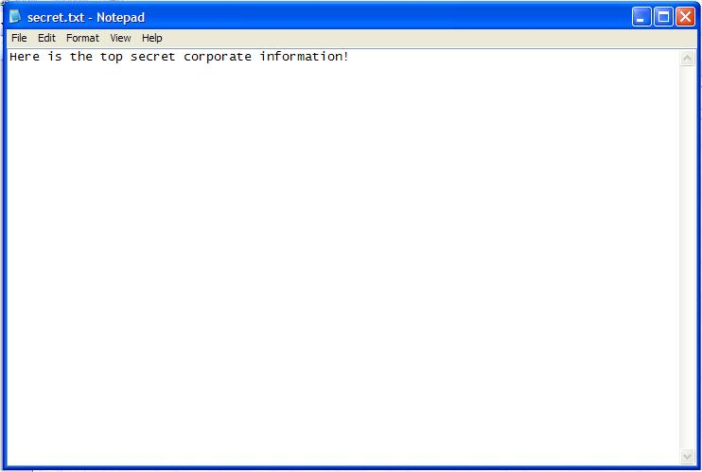
Which has the hidden data?

Slide 35
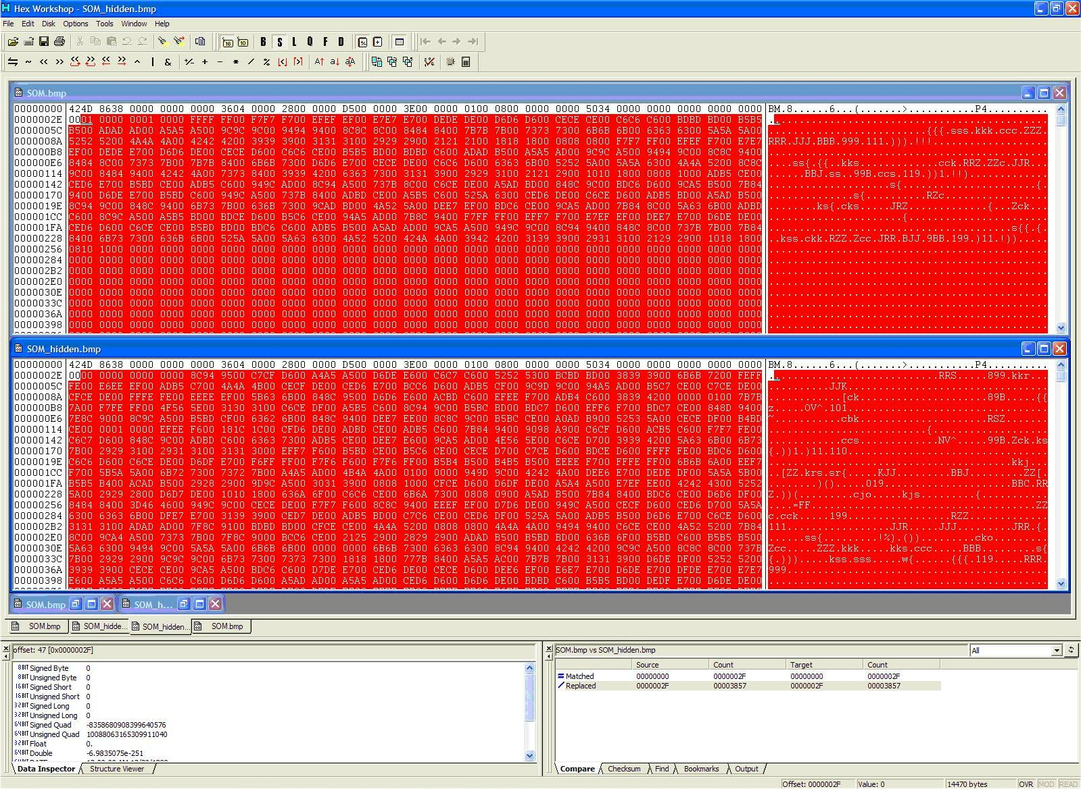
Hexadecimal file comparison

Slide 36
Steganography with Bitmapped image
Steganography is the mechanism to hide relatively small amount of data in other data files that are significantly larger.
Bitmap image (raster image) is representation of a digital image as a matrix of picture elements (pixels).
The color of each pixel is individually defined as images in the RGB color space, for instance, often consist of colored pixels defined by three bytes—one byte each for red, green and blue.

Slide 37
Forensic Challenges
Mobile Devices
“There are a lot of issues when it comes to extracting data from iOS devices. We have had many civil cases we have not been able to process ... for discovery because of encryption blocking us.“
- Amber Schroader, CEO of Paraben

Slide 38
Other Forensic Evidence Examples
EXIF Data
USB Registry Entries
Photocopiers

Slide 39
Business Implications
Internal Investigations
Incident Response
Establishing Policies

Slide 40
Internal Corporate Investigations
Business must continue with minimal interruption from your investigation
Corporate computer crimes:
E-mail harassment, Gender and age discrimination, Data falsification, Embezzlement, Sabotage and Industrial espionage
Encouraged by Sarbanes-Oxley Act as a way to promptly investigate allegations
Regulatory & Compliance driven monitoring and response

Slide 41
Fit with Incident Response
Computer Forensics is part of the incident response (IR) capability
Proper evidence management and handling
IR is an integral part of Information Assurance

Slide 42
Establishing Company Policies
Company policies may help avoid litigation
No expectation of privacy
Rules for using company computers and networks
Line of authority for internal investigations
Data retention and disposal guidelines

Slide 43
Disposing of Old Computers
What happens to your old computers?
Specifically, what happens to the data on your old computers?

Slide 44
“Remembrance of Data Passed Study”
Researcher Simson Garfinkel purchased 235 used hard drives between November 2000 and January 2003
eBay, Computer stores, Swap fests
Spending less than $1000 and working part time, he was able to collect:
Thousands of credit card numbers
Detailed financial records on hundreds of people
Confidential corporate files

Slide 45
Disk #6: Biotech Startup
Memos & Documents from 1996
Business was acquired Nov. 2000
Company shut down; PCs disposed of without thought to contents.

Slide 46
Disk #44: Bay Area Computer Magazine
Personal email and internal documents
Many machines stripped and sold after a 70% reduction in force in summer 2000
No formal policy in place for sanitizing disks

Slide 47
Disks #73, #74, #75, #77 Community College (WA)
Exams, student grades, correspondence, etc.
Protected information under Family Educational Rights and Privacy Act!
School did not have a procedure in place for wiping information from systems before sale, “but we have one now!”

Slide 48
Disk #134: Chicago Bank
Drive removed from an ATM machine.
One year’s worth of transactions; 3000+ card numbers
Bank hired contractor to upgrade machines; contractor had hired a subcontractor.
Bank and contractor assumed disks would be properly sanitized, but procedures were not specified in the contract.

Slide 49
Main Sources of Failure
Failing or Defunct Companies
Nobody charged with data destruction
Trade-ins and PC upgrades
Assumed that service provider would sanitize
Failure to supervise contract employees
Sanitization was never verified

Slide 50
How can we sanitize hard disks?
Disk scrubbing
Overwriting the entire drive with zeroes and random characters
Degaussing
Physical Destruction
Disintegration, Incineration, Pulverizing, Shredding or Melting
FORMAT and FDISK do NOT WORK

Slide 51
Free Hard Disk Scrubbers
Active@Kill Disk – bootable floppy
http://www.killdisk.com/
Darik’s Boot and Nuke – bootable CD, DVD, floppy or USB
http://dban.sourceforge.net/

Slide 52
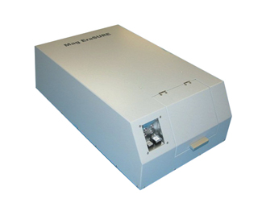
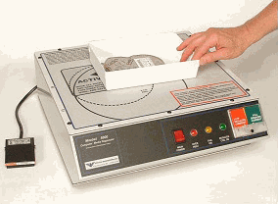
$3,000 - $10,000 Degaussing Solution
Drive will not work after degaussing

Slide 53
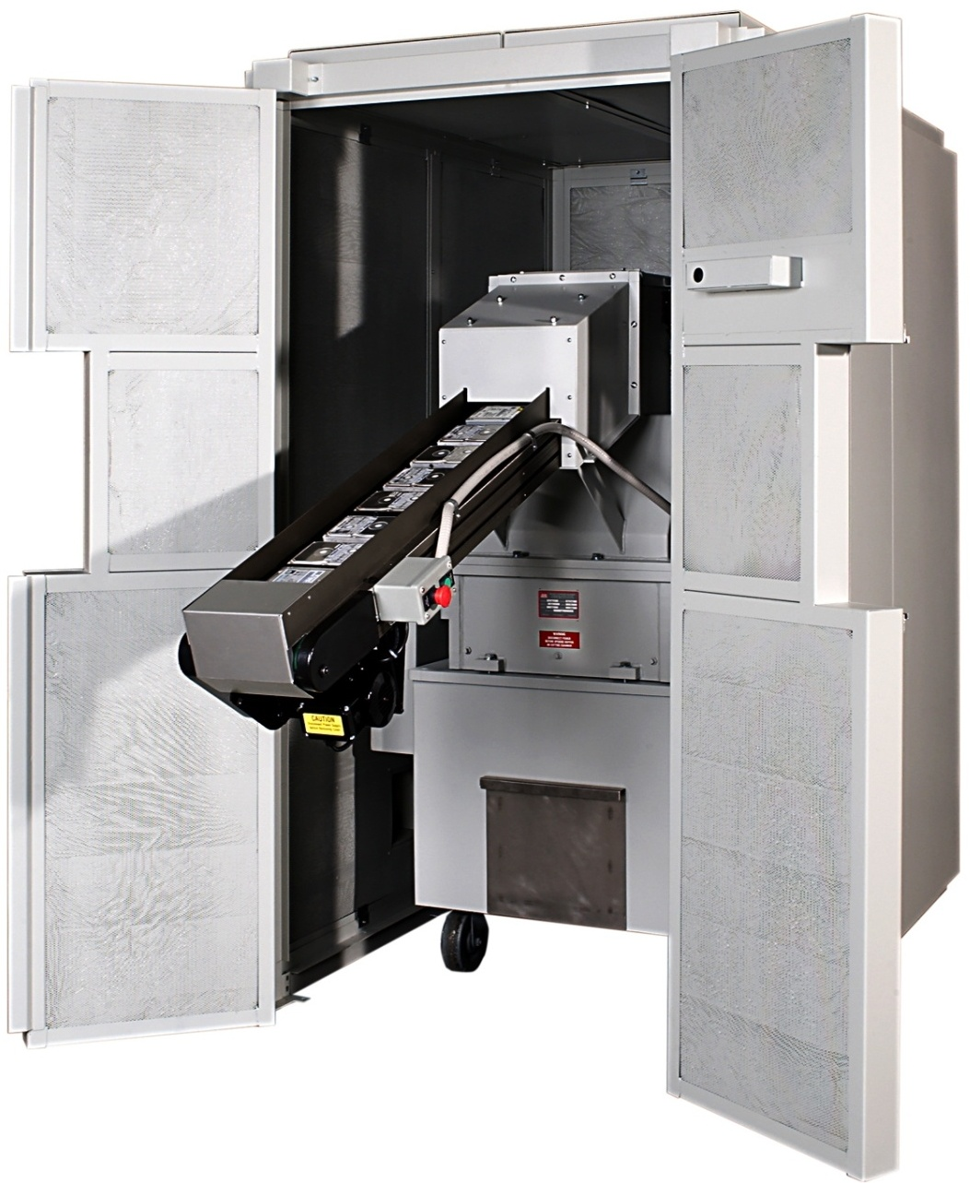
$60,000 Disk Shredder Solution

Slide 54
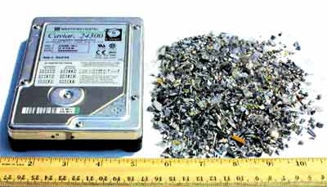
Disk Shredder Solution

Slide 55
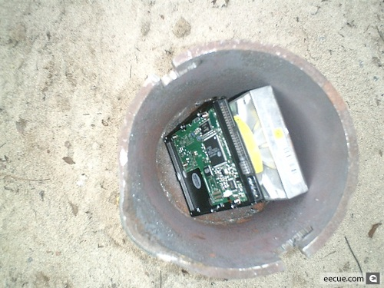
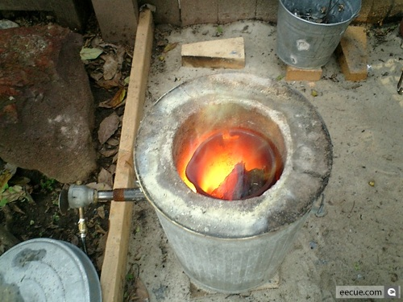
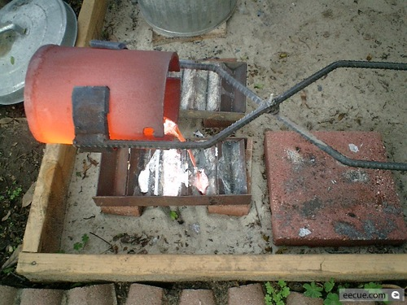
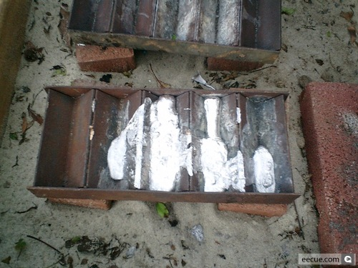
Good luck recovering from this!

Slide 56
A Computer Forensics Expert Must
Know a lot about computers and how they work (hardware, software, OS, file systems, storage media, etc.)
Always keep learning
Have infinite patience
“No such thing as point and click forensics.”
Be detail-oriented
Be good at explaining how computers work

