Slide 1
Intro to MIS - MGS351
Building a Webpage
Extended Learning Module F

Slide 2
Overview
The World Wide Web
Web servers, Web browsers and Web pages
HTML Introduction
Using HTML Tags
HTML5 Best Practices
HTML5 Webpage Structure
Cascading Style Sheets (CSS)
UB Web Environment

Slide 3
Web Pages
Viewing a web page involves using a web browser (Chrome, IE, Firefox) to connect to a networked machine running web server software (IIS, Apache). This action loads an HTML file from the web server and sends it to your computer across the Internet using the HTTP and TCP/IP protocols, and the file is displayed by your web browser software as a web page.

Slide 4
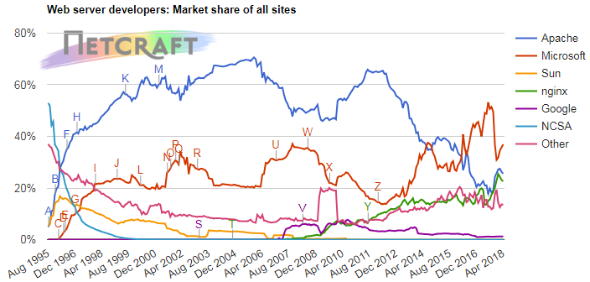
Web Server Stats
Notes:
https://news.netcraft.com/archives/category/web-server-survey/

Slide 5
Default Web pages
Default page appears when visiting a website without specifying the file name in the URL.
mgs351.com displays mgs351.com/index.html
Default pages are usually either index.htm, index.html, index.asp, default.htm, default.html or default.asp. These options are configured in the web server.

Slide 6
HTML Introduction
HTML (Hypertext Markup Language) is the code used to build web pages. Web pages are text files with HTML code.
You can view the HTML code on any webpage by clicking on Source from the View menu in a web browser.
HTML files usually have either .htm or .html file extension

Slide 7
W3C – www.w3.org
World Wide Web Consortium - founded in 1994
Creates specifications and guidelines that are intended to promote the web’s evolution and ensure that web technologies work well together
Specifications for: HTML, CSS, XML, XHTML, DOM, etc…

Slide 8
W3C Standards
HTML5 released at a faster pace
HTML 4.01 approved on 12/24/1999
HTML 5 approved on 10/28/2014
HTML 5.1 approved on 11/1/2016
HTML 5.2 approved on 12/14/2017

Slide 9
Using HTML Tags
Most HTML tags have an opening and corresponding closing tag indicated by a slash /.
<pre>…</pre>
<b>…</b>
Anything between the tags, denoted by the “…” above, will be modified according to the behavior described by the tag.

Slide 10
HTML Caveats
Extra spaces (beyond one) in the code and any line breaks are ignored by the browser when rendering the HTML page.
&nbsp; is a special symbol that can be used to insert extra spaces.
<br> or <p> can be used to create necessary line breaks.

Slide 11
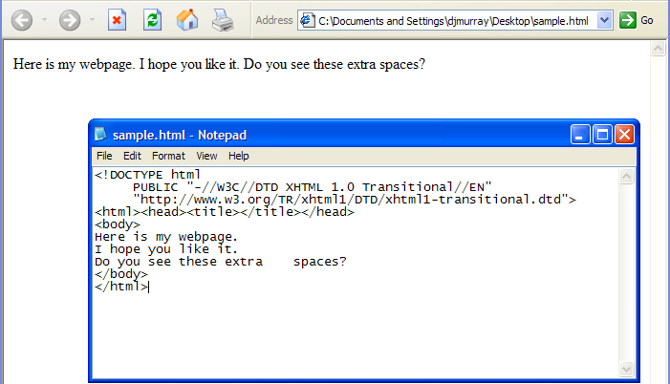
HTML Caveats

Slide 12
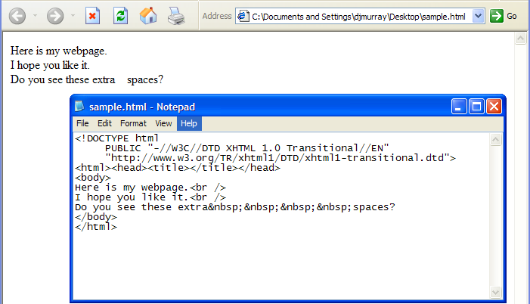
HTML Caveats

Slide 13
HTML5 Best Practices
All tags should be closed - including tags like <br/>
All tags should be in lowercase except for the DOCTYPE tag
All tag attributes values should be quoted and exist
CSS are used for page formatting

Slide 14
HTML5 Webpage Structure
<!DOCTYPE html>
<html lang="en">
<head>
<meta charset="utf-8">
<title> ... </title>
</head>
<body> ... </body>
</html>

Slide 15
Design with Cascading Style Sheets
Presentation languages (CSS) format the web page, controlling the typography, placement, color, etc…
Due to the separation of structure from presentation you can easily change one without affecting the other
CSS is implemented with inline, internal or external style sheets
Large sites may reduce bandwidth costs too

Slide 16
Cleaner Code with CSS
WITHOUT CSS
<p><font color=“#000000” size=“10px”><b>heading of an article</b></font></p> WITH CSS <p class=“articleheading”>heading of an article</p>

Slide 17
CSS Example - Inline Stylesheet
<!DOCTYPE html>
<html lang="en">
<head><meta charset="utf-8">
</head>
<body style="background-color:lightgray">
<h1 style="color:red; text-align:center">
This is a heading</h1>
<p style="color:blue; font-style: italic">
This is a paragraph.</p>
</body>
</html>

Slide 18
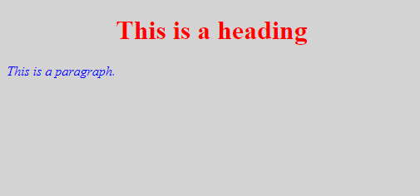
Inline Stylesheet Output

Slide 19
CSS Example - Internal Stylesheet
<!DOCTYPE html>
<html lang="en">
<head><meta charset="utf-8">
<style> body {background-color:lightgray} h1 {color:red; text-align:center} p {color:blue; font-style: italic} </style>
</head>
<body> <h1>This is a heading</h1> <p>This is a paragraph.</p>
</body>
</html>

Slide 20
Internal Stylesheet Output

Slide 21
CSS Example - External Stylesheet
<!DOCTYPE html>
<html lang="en">
<head><meta charset="utf-8">
<link rel="stylesheet" type="text/css" href="style.css" />
</head>
<body> <h1>This is a heading</h1> <p>This is a paragraph.</p>
</body>
</html>

Slide 22
CSS Example - External Stylesheet (style.css)
body {background-color:lightgray} h1 {color:red; text-align:center} p {color:blue; font-style: italic}

Slide 23
External Stylesheet Output

Slide 24
UB Web Environment
UB provides web space for each student on the UBUNIX servers which run the Apache webserver. Your webpage can be viewed in any of the two locations.
www.buffalo.edu/~djmurray
www.acsu.buffalo.edu/~djmurray

Slide 25
UB Web Environment
URLs and files are case sensitive because the UNIX OS is case sensitive.
www.buffalo.edu/~djmurray/INDEX.html - error!
www.buffalo.edu/~djmurray/index.html - works!
Windows servers running IIS are not case sensitive. Both work properly.
http://mediastream.buffalo.edu/Content/courses/
http://mediastream.buffalo.edu/CONTENT/COURSES/

Slide 26
UB Web Environment
Remember that a webpage is simply a file stored on a webserver in a particular location.
Your UB homepage is stored in the public_html directory of your S: drive. Anything in that directory is technically on the web.

Slide 27
UB Web Environment
It’s easiest to work from a lab computer since they have direct access to the S: drive folders.
Enable your homepage first.
https://www.acsu.buffalo.edu/cgi-bin/ubfs_activatepersonalwebsite.cgi
Use Windows Notepad or Notepad++ to edit the index.html file in your public_html folder.

Slide 28
UB Web Environment
If you are using a computer on the UB network (Resnet, wireless, VPN), you can map a network drive and create your own S: drive as explained at this website.
http://www.buffalo.edu/ubit/service-guides/file-storage-and-sharing/accessing-myfiles-from-anywhere/getting-started-by-accessing-ubfs.html

Slide 29
UB Web Environment
Another option is using FTP software (Filezilla or Fetch) to upload files to your UB web space using these settings. VPN also required when using from off campus.
Host: ubunix.buffalo.edu
Server Type: SFTP – SSH File Transfer Protocol
Login Type: Ask for password

Slide 30
Next Steps
The hard part is often understanding how the web environment works and where to save the HTML files so they appear on the web!
Now its time to try some HTML tags.

