Slide 1
Intro to MIS - MGS351
Network Basics
Extended Learning Module E

Slide 2
Overview
Telecommunications
Channels, Protocols and Media
Computer Networks
Networking Components
Network Classifications
Network Topologies

Slide 3
Telecommunications
The transmission of different forms of data (such as text, audio, video, images, graphics) from one set of electronic devices over media to another set of geographically separated electronic devices.

Slide 4
Basic Components of Communications
Sender: Person or device sending the message
Receiver: Person or device receiving the message
Medium: What carries the message from sender to receiver

Slide 5
Face-to-face Communications
Message
Voice
Channel/Medium
A short distance of air
Sender Person
Receiver Person

Slide 6
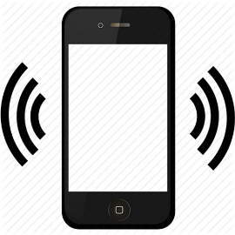

Telecommunications
Message Voice, Data Video, etc.
Sender Telephone, Computer, Video Conferencing
Receiver Telephone, Computer, Video Conferencing
Channel/Medium Various Types of Electronic Media

Slide 7
Characteristics of Channels
Characteristics
Description
Transmission rate
Rate at which channel carries data from one computer to another (bps, kbps, Mbps, Gbps)
Volume or capacity of data that a channel can carry.
Ways by which data are transmitted. Two ways include asynchronous (one byte at a time) and synchronous (blocks of bytes).
Three directions for transmitting data include simplex, half duplex, and full duplex.
Information travels as analog or digital signals.
Bandwidth
Transmission mode
Transmission direction
Transmission signals

Slide 8

Transmission Signals

Slide 9
Telecommunication Protocols
Rules and formats that ensure efficient and error-free electronic communications between computers.
TCP/IP, IPv6, 802.11g, 802.11b
Vary on reliability, speed and ease of use

Slide 10
Telecommunication Protocols
A set of characters that mean the same thing to both the sender and the receiver
A set of rules for timing and sequencing messages
A set of methods for detecting and correcting errors

Slide 11
Telecommunications Media
Communications media - the paths, or physical channels, in a network over which information travels.
Wired communications media - transmit information over a closed, connected path.
Wireless communications media - transmit information through the air.

Slide 12
Telecommunications Media
Bounded (wired)
twisted-pair (telephone, Ethernet)
coaxial cable (cable TV)
fiber-optic cable (DWDM)
Unbounded (wireless)
microwave radio (Bluetooth, WiFi)
communication satellites
infrared
high-frequency radios

Slide 13
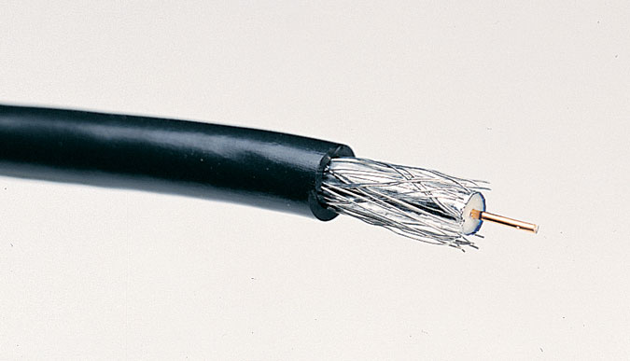
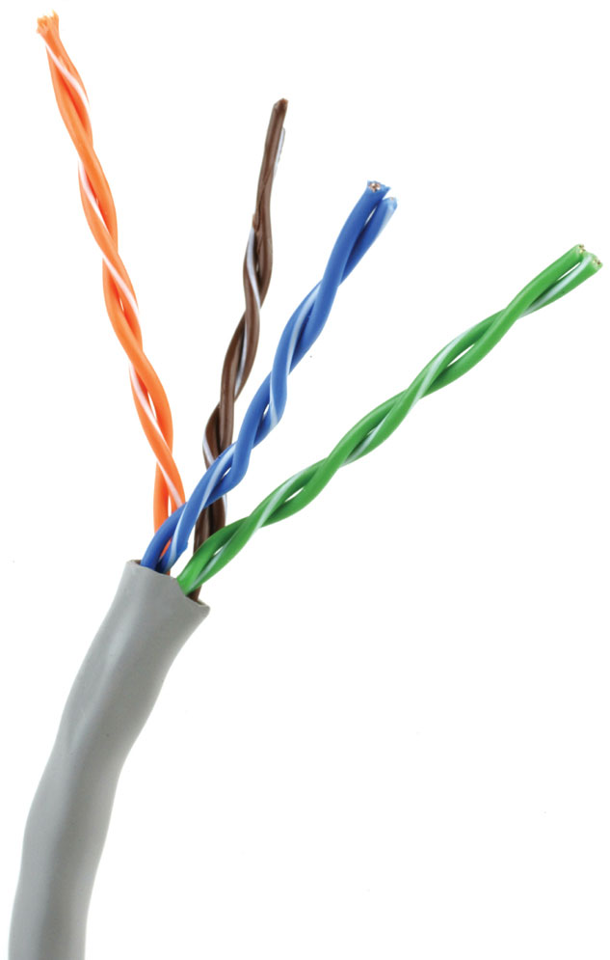
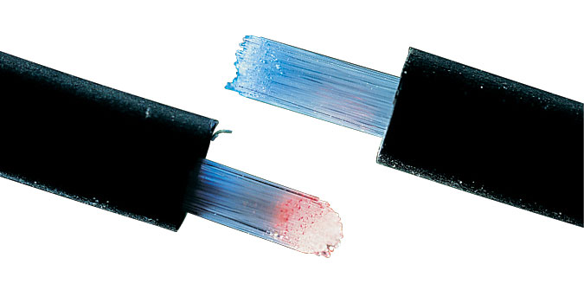
Telecommunications Media

Slide 14
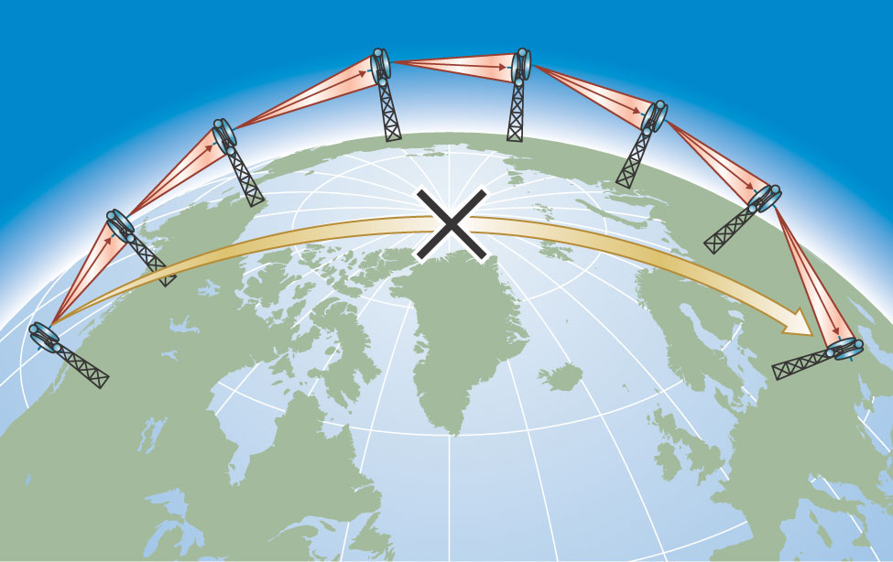
Unbound Media – Medium Distance
Repeater - a device that receives a radio signal, strengthens it and sends it on.

Slide 15
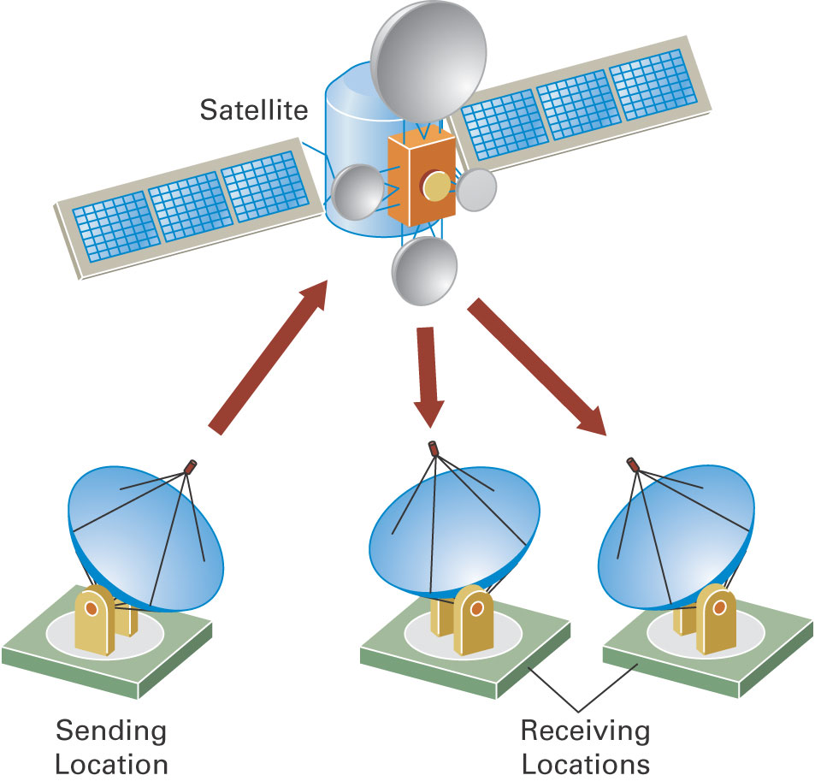
Unbound Media – Long Distance
Communications satellites - microwave repeaters in space.

Slide 16
Computer Networks
Two or more computers connected so that they can communicate with each other and share information, software, peripheral devices, and/or processing power.

Slide 17
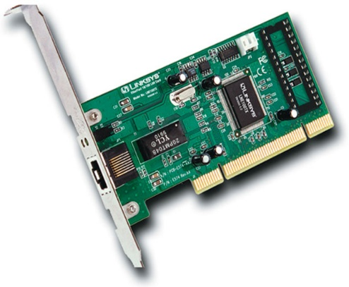
Networking Components
Network interface card (NIC) - an expansion card or a PC Card that connects your computer to a network and provides the doorway for information to flow in and out.
Ethernet card - the most common type of network interface card.

Slide 18
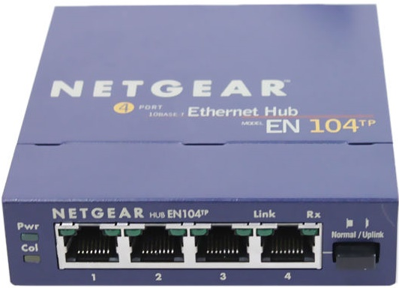
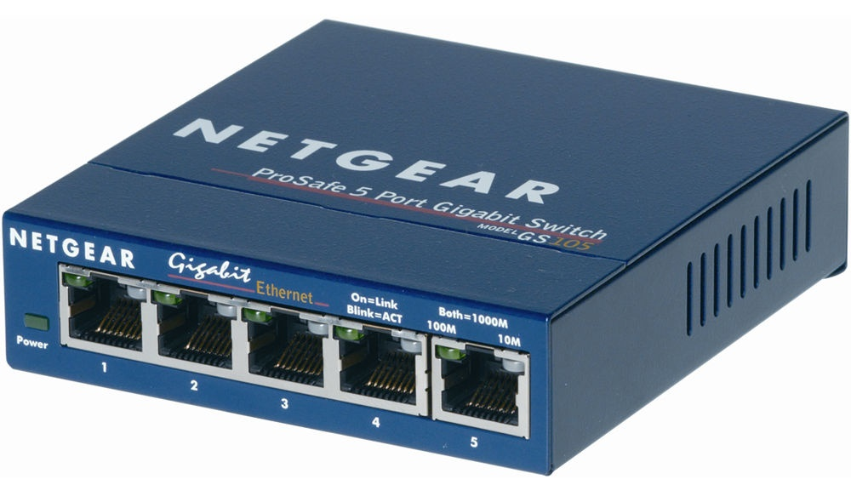
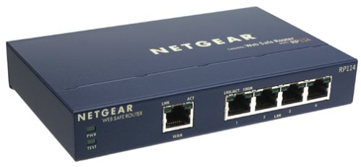
Networking Components

Slide 19
Networking Components
Network hub - a device that connects multiple computers into a network.
Switch - a device that connects multiple computers into a network in which multiple communications links can be in operation simultaneously.
Router - a device that acts as a smart hub connecting computers into a network, and it also separates your network from any other network it’s connected to.

Slide 20
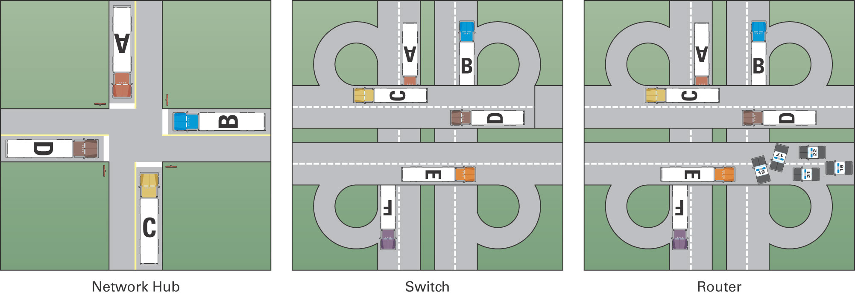
Networking Components

Slide 21
Networking Components
Firewall - software and/or hardware that protects a computer or network from intruders.
Cat 5, Cat 5e or Cat 6 cable - a better-constructed version of the phone twisted-pair cable.
Wireless network access point or wireless access point - a device that allows computers to access a wired network using radio waves. (WiFi, IEEE 802.11 (a,b,g,n,a/c), or Bluetooth)

Slide 22
Wireless Security Issues
Your wireless signal reaches beyond your walls
Many wireless networks are vulnerable to eavesdropping (sniffing)
Not all security methods are robust
Unauthorized internal access points
Laptops may automatically connect to networks they previously connected to
Rogue (evil twin) access points nearby

Slide 23
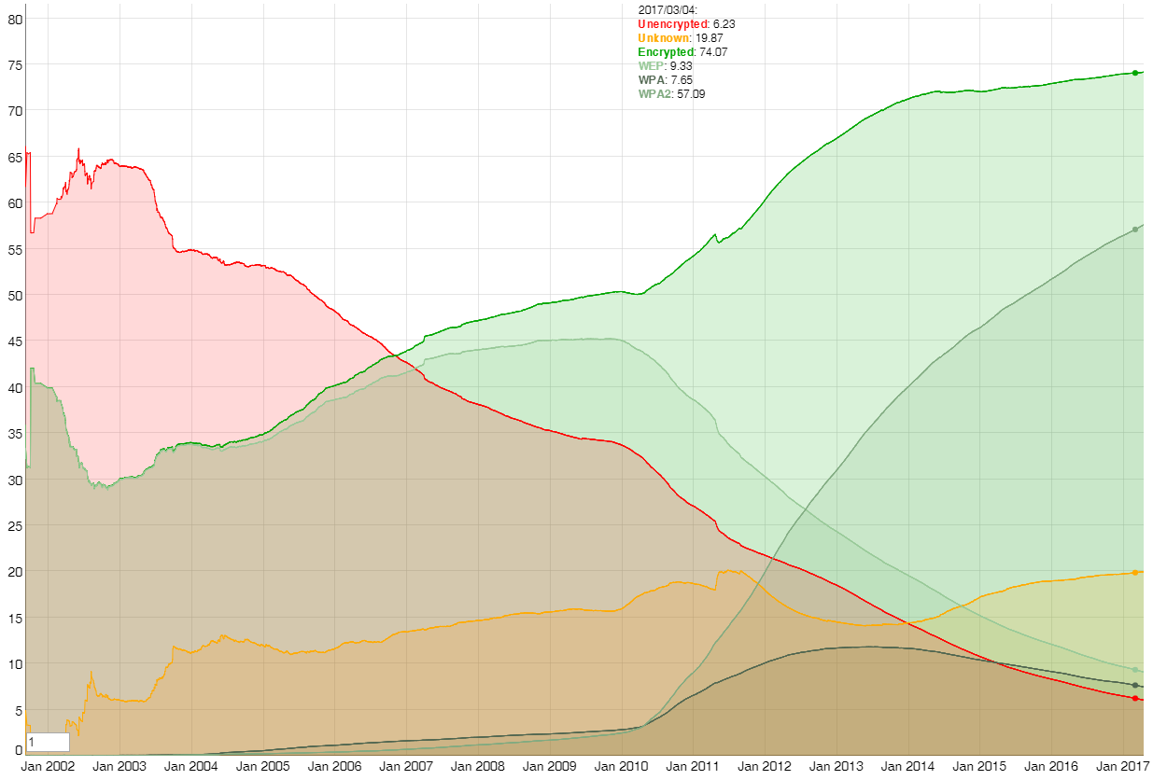
wigle.net data
Notes:
https://wigle.net/stats

Slide 24
Home and Business Networks
Peer-to-peer network – most often a home network where a small number of computers share hardware, software and/or information.
Client/Server Network – this configuration is most commonly used in businesses. One or more computers are servers which provide various services to the other networked computers which are called clients.

Slide 25
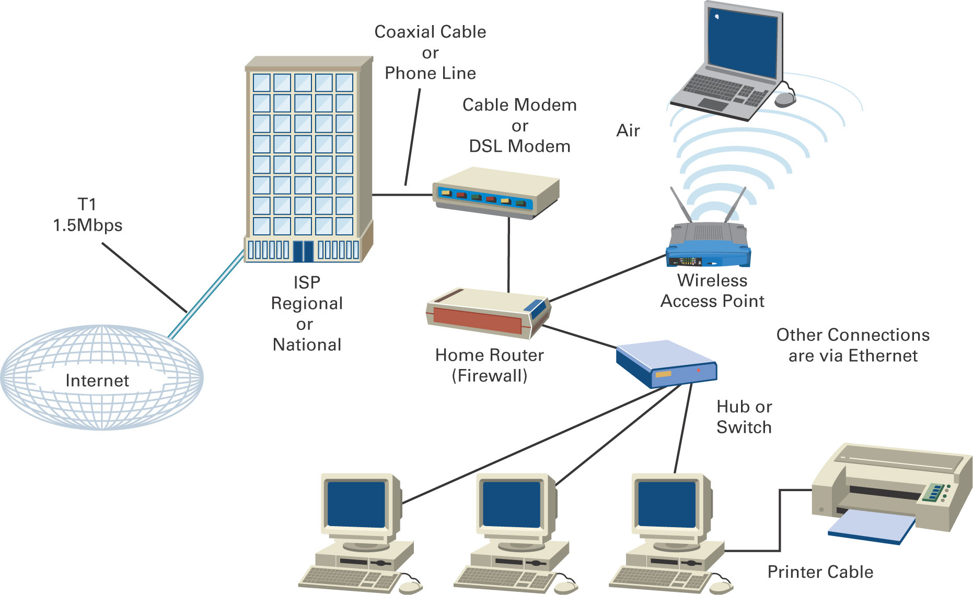
Peer-to-Peer Network

Slide 26
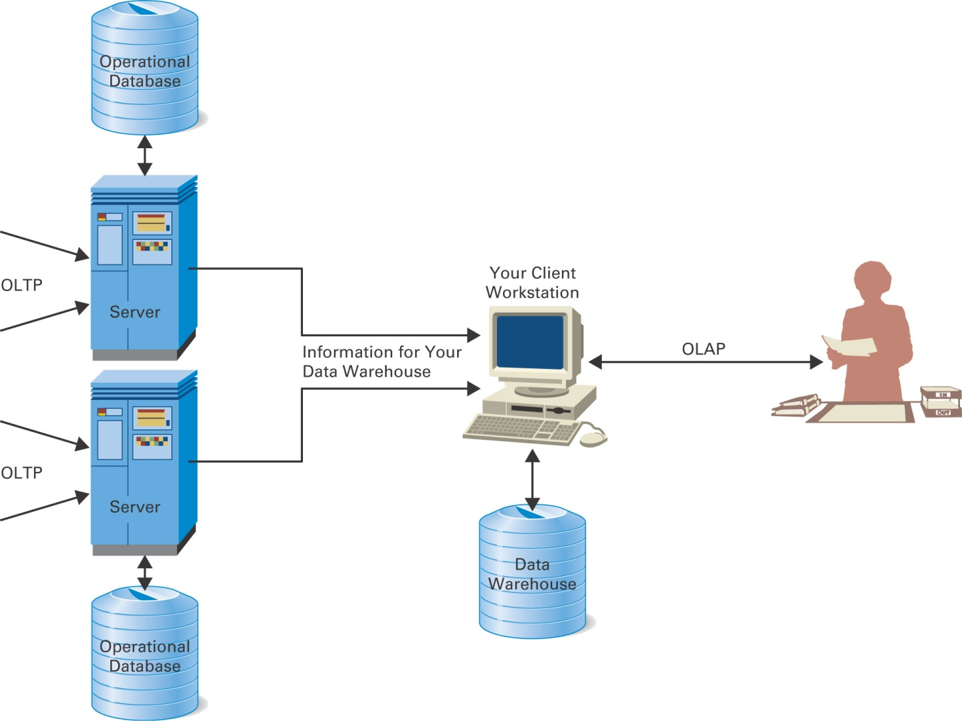
Client/Server Network

Slide 27
Network Classifications
Local area network (LAN) - covers a limited geographic distance, such as an office, building, or a group of buildings in close proximity to each other.
Municipal area network (MAN) - covers a metropolitan area.
Wide area network (WAN) - covers large geographic distances, such as a state, a country, or even the entire world.

Slide 28
Bus Topology
A network configuration in which all computers on the network are connected through a single circuit, such as twisted-pair cable. Messages are transmitted to all computers on the network, although only the targeted device responds to the message.

Slide 29

Bus Topology

Slide 30
Ring Topology
A network configuration in which computers are arranged in the form of a ring using twisted-wire, coaxial cable, or fiber optics. Messages are transmitted in one direction to all devices between the sending node and the receiving node.

Slide 31
Ring Topology

Slide 32
Star Topology
A topology in which a central host computer receives all messages and then forwards the message to the appropriate computer on the network.

Slide 33
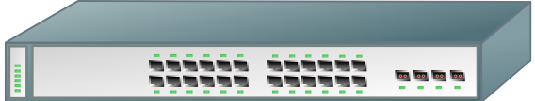
Star Topology

Slide 34
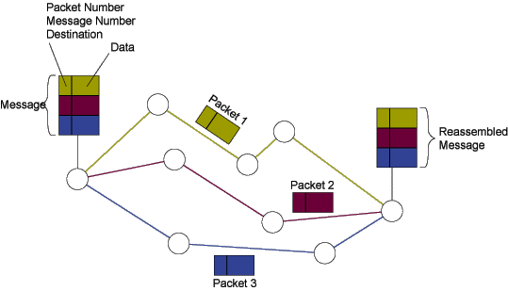
Packet Switching

