Slide 1
Intro to MIS - MGS351
Build User-Friendly
Information Systems
Chapter 6

Slide 2
Chapter Overview
Implementing ERDs
Creating Objects & Record Names
Adding Relationships
Creating Apps
Custom Navigation
Custom Home Page
Global Actions

Slide 3
Implementing ERDs
Create an object for each entity
Salesforce automatically creates a hidden primary key for you
The Record Name is used as a lookup for related foreign keys
Auto Number or text

Slide 4
Relationships
Add a relationship to create a foreign key field
Always done on child object which is the many side of a relationship
Lookup
Master-Detail (value is required)
External Lookup

Slide 5
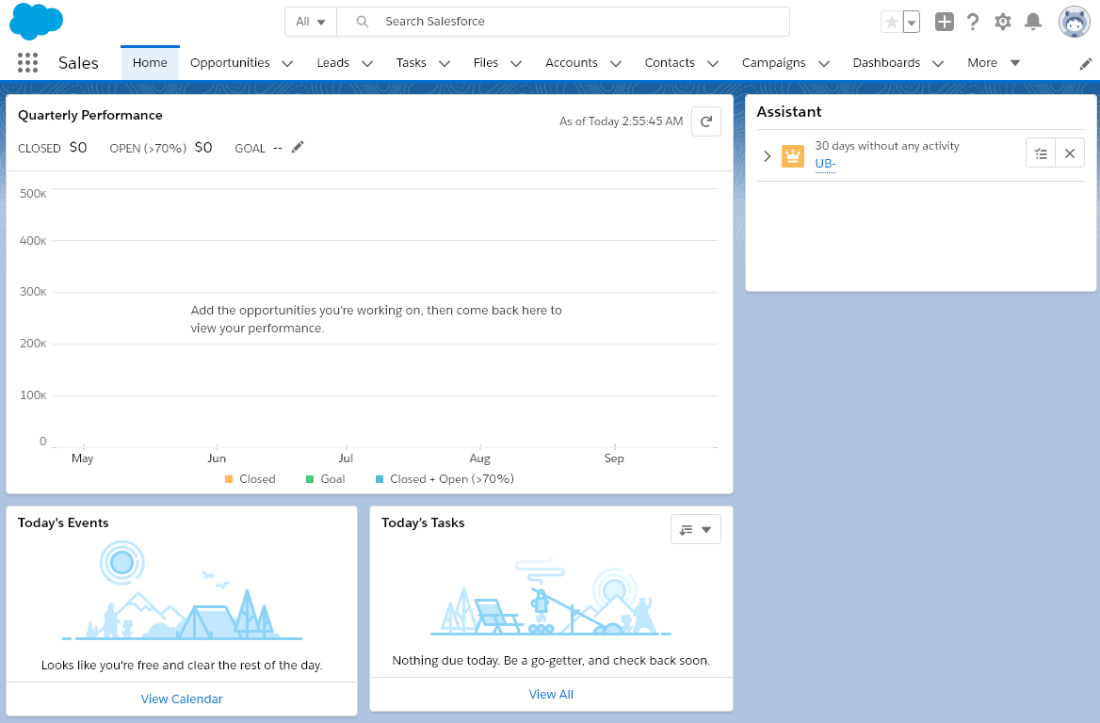
Creating Apps - Navigation and Home Page
Sales App Navigation

Slide 6
Creating and Customizing an App
using the App Manager

Slide 7
Global Action Example

