Slide 1
Homework 5 Hints

Slide 2
Read!
Please Read pages 68-70 before completing Homework #5!!

Slide 3
Chapter 7 Guided Exercise
Orders Database
Step 4
Add TA record
Expand in datasheet view and add an order record
Step 5
If you do not remember what a primary key is see chapter 6
Step 7
Remember to only add Customers ID from the MANY side

Slide 4
Ch 7 GE
Step 8
is all done in datasheet view after the query is ran
Step 10
First Highlight “CustomerOrders” Query
THEN Select “Create” and “Form” to automatically create a form based on the “CustomersOrders” Query
Add a new form record (click over past last record) – must be in Form view
Do not add anything to “OrderID” ONLY add “1” to “CustomerID” Field in the form.
Now you can change the Location to Amherst (this updates ALL of CustomerID=1’s information for ALL orders.

Slide 5
Ch 7 GE
Step 12
You cannot skip this step.
BEFORE CONTINUING please read:
Pages 68-70 of chapter 7
Step 14
You are editing the “Switchboard (Default)”
Step 15
Do not make any changes in the second part of step #15

Slide 6
Ch 7 GE
Step 16-21
SEE Step 21 for end result
Step 22
Check to make sure your switchboard works
Step 23-24
This is how to create Navigation Forms (an alternative to a switchboard)
DO NOT USE NAVIGATION FORMS FOR THE APPLIED EXERCISE

Slide 7
Ch 7 GE
Step 25-42
Intro to creating MACROS and applying them
Step 29
If an action (like closing a form) is going to be executed by a macro, the action must be reasonable (the form would have to be open BEFORE you try to execute the macro to close the form)
Step 30
Reports do not automatically use button wizards (you must manually adjust the actions)

Slide 8
Ch 7 GE
Step 31
To adjust button name to “Close Report” go to:
Format tab, “Caption” field
**To edit a macro mistake:
Go to the navigation pane and right click on the macro.
Select “Design View”

Slide 9
Ch 7 GE
Step 36
See Steps 13-21 if you get confused
Step 37
Close Switchboard manager
Open “Swtichboard” form in Form view and check to make sure buttons are working properly
Steps 38 & 39
These are 2 commands in the SAME MACRO
The ORDER of Macros actions MATTERS
The macro carries out the actions in order of how actions are listed in Macro design view
Step 41
Adding macros to buttons in FORMS (not Reports)

Slide 10
Chapter 7 Applied Exercise
Step 1:
See CH 7GE Steps 6-11
Very similar to “CustomerOrders” Query
REMEMBER TO ADD your new “ProductOrders” Query as a subform to “CustomerOrders” FORM
CH6 GE Steps 34-39
PAY ATTENTION to HIDING “OrderID” field in Subform
See hint in step: be sure to drag the control width to zero in FORM VIEW

Slide 11
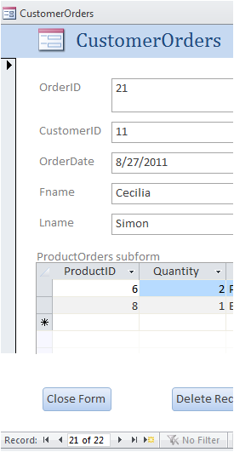
Ch 7 AE
Step 2:
Scroll over using record navigation
Buttons at bottom left of screen to
TA’s record
Insert details IN SUBFORM
Step 3:
Scroll over to YOUR Student record
Insert next set of details in YOUR
STUDENT record

Slide 12
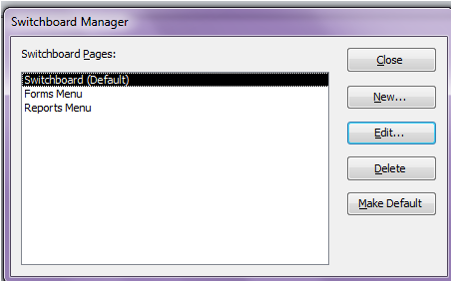
Ch 7 AE
Step 4: Completely Re-Designing Switchboard
You will use this for your final database project.
You will NOT use a Navigation Form/Forms for this step (they will be removed).
Search “Switchboard Manager” in the search bar
Add additional NEW menus: Forms Menu and Reports Menu
Double Click on
“Forms Menu”

Slide 13
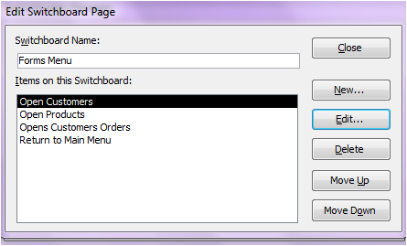
Ch 7 AE
Step 4 cont.
Add “NEW” Items
-See CH 7 GE Steps #13-22
Make sure to give the proper commands to open the proper forms/ return to the main (default switchboard)
“Close” and go back to Main Switchboard Manager”

Slide 14
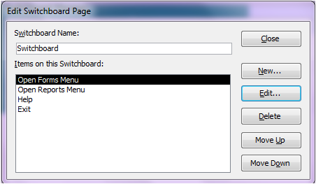
Ch 7 AE
Step 4 cont:
Do the same for the “Reports Menu” but with report commands listed in the textbook
Click on the “Switchboard (Default)” and add the appropriate items:
Make sure to give
Proper commands for
Each item (hint for open
Forms & reports menus:
“go to switchboard”
Command is used

Slide 15
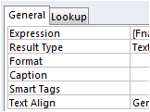
Ch 7 AE
Step 5
Go to “Customers” Table in “Design View”
Add a new field, select “calculated data type”
Use concatenated code in “Expression” row:

Slide 16
Ch 7 AE
Step 5 cont.
Quotations= “text”
Brackets= [Field reference]
Step 6 MACROS
CH 7 GE Steps 25-40
Macro Should (all actions in a single Macro):
OpenForm (customerorders)
MaximizeWindow
GoToRecord(new)
GoToControl(CustomerID)
Go to “Switchboard Manager”
Forms Menu
Edit “Opens Customers Orders” Item
Change “command” to “Run Macro”

Slide 17
Ch 7 AE
Step 7
Create another new macro
CloseWindow(Products Report)
Go to Design View of “Products Report”
Add button & manually run macro when button is clicked
CH7 GE Steps #30 & 31

Slide 18
Ch 7 AE
Step 8
New Macro
RunMenuCommand (CloseDatabase)
OR Quit Access
Step 9
READ PAGES 68-70 ANSWER IS IN THE READING
AutoExec= name a macro this and the macro will automatically carry out when database first starts up
OpenForm(Switchboard)
MaximizeWindow
MessageBox
Hide Navigation Pane See page 70 “Other Database Settings”

Slide 19
Ch 7 AE
In General:
READ PAGES 68-70 of Chapter 7
Take notice of Page 69 “Switchboard Troubleshooting”
If your Switchboard is not working:
Compact and Repair Database
If it is still not working, Go through Steps in “Switchboard Troubleshooting”

