Slide 1
Homework 4 Hints

Slide 2
Chapter 6 Guided Exercise
Make sure to enforce Referential Integrity and Cascade Update when prompted
Step 4
Make sure to add a record for your TA.
Step 5
Primary key is indicated by a KEY next to the field
Remember ERD rules for this homework (what are foreign keys?)

Slide 3
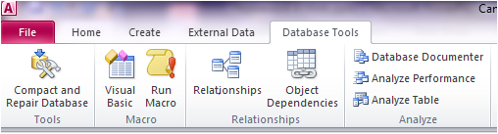

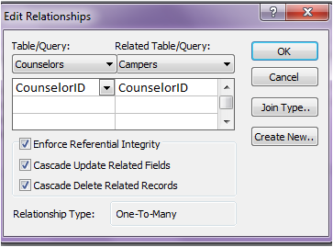
Chapter 6 GE
Step 8:
Step 9-13:
REMEMBER TO SET RELATIONSHIPS between tables!
Step 15-19:
REMEMBER TO:
Set “ENFORCE REFERENTIAL INTEGRITY” and “CASCADE UPDATE” ALL RELATIONSHIPS for the rest of the homework!
Do this by right clicking on the relationship and “edit relationship”

Slide 4
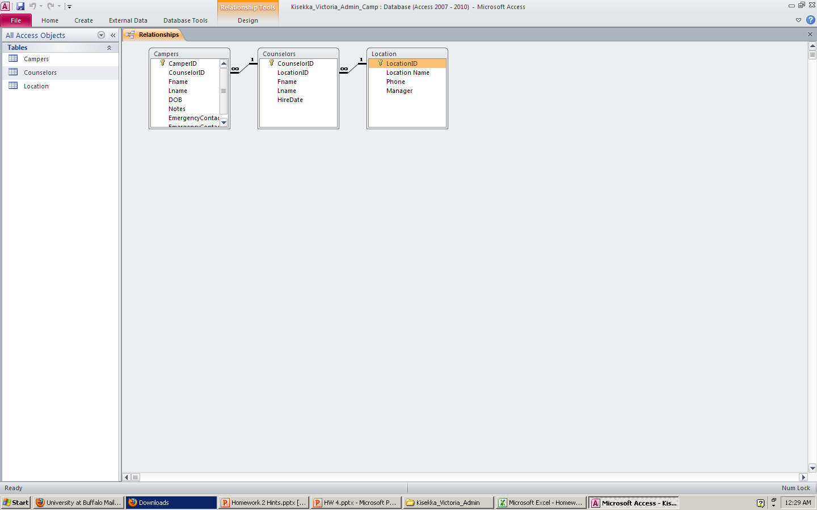
Chapter 6 GE
Step 23:
2. Related table on the many side of the relationship can be a subform
1. Table on the one side of a relationship can be a main form

Slide 5
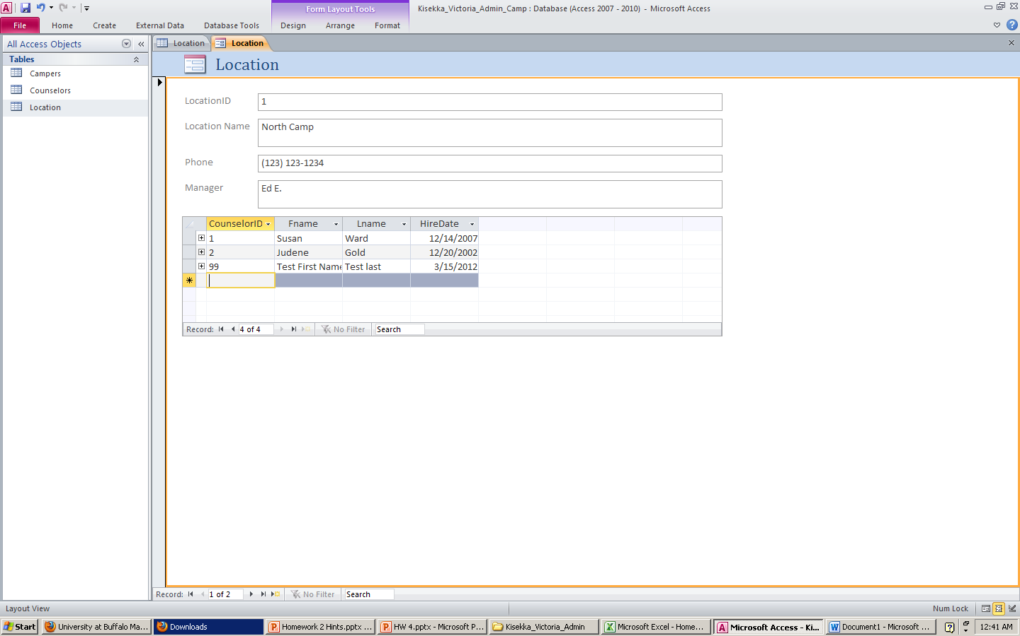
Chapter 6 GE
Step 25 and 26: Updating a subform automatically updates the tables too. (Remember to SAVE)
Navigate through records in the subform (Counselor)
Navigate through records in the main Form (Location)

Slide 6
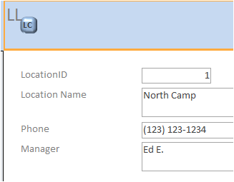
CHAPTER 6 GE
Step #28-40
This is how you will link your tables to your forms and create subforms
This will be used in your final project
Please make sure you understand these steps
Step #31 bug:

Slide 7
Chapter 6 GE
Step 34
The Subform/Subreport button is under the Design ribbon
This is where the subform/subreport control is located

Slide 8
Chapter 6 GE
Step 36:
Formatting!
REMEMBER TO RESIZE THE DETAILS SECTION
Step 39
Remember to switch the Counselors Sub form from “Data Sheet” View to “Single Form” View in the property sheet!
SAVE and close form after changes are made
Step 40
Re-open the form to make sure changes were made properly (see in form view)

Slide 9

Chapter 6 Applied Exercise
Step 1:
Create table in DESIGN VIEW AND SET DATATYPES
Step 2:
Set Primary key by highlighting field (in design view) and clicking on
Add “LocationID” to same table in design view

Slide 10
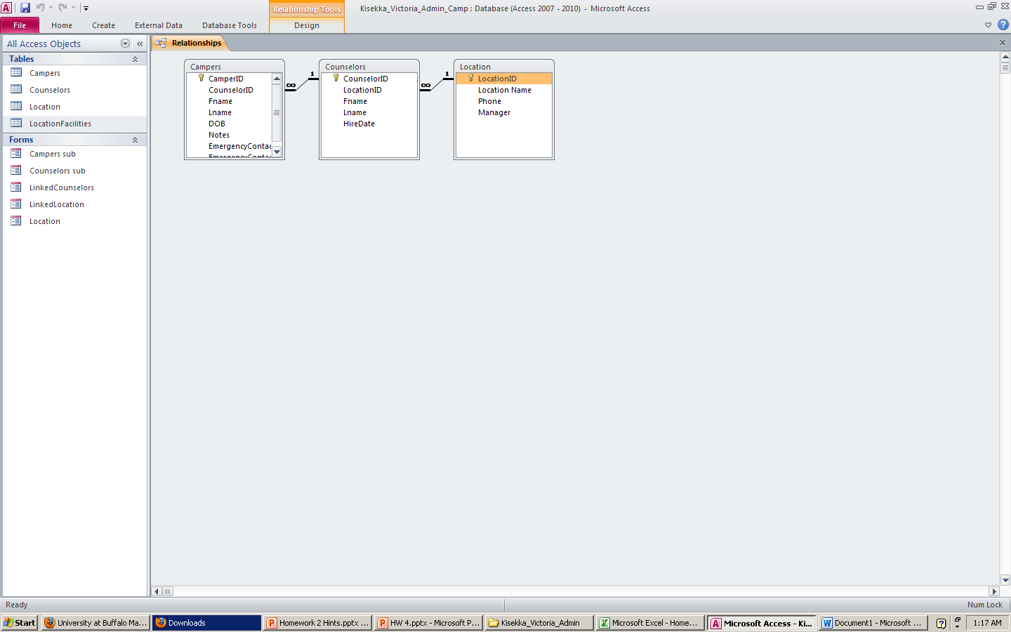
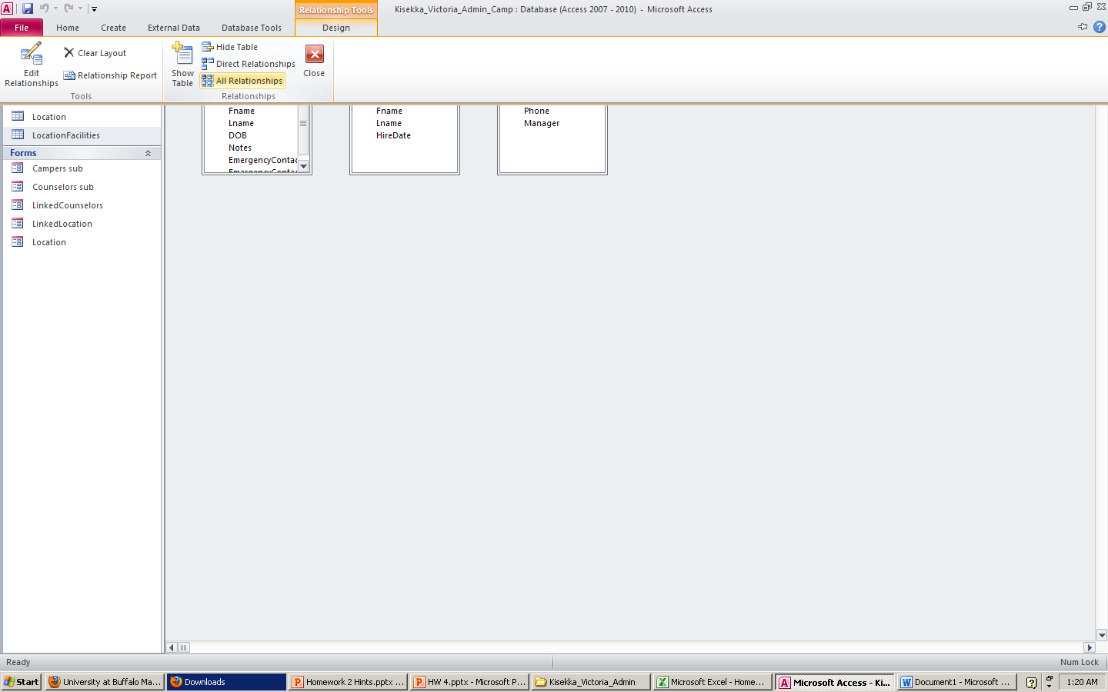
Chapter 6 Applied Exercise
Step 3
See GE Step #8
Click on Design, then click on Show Table
See GE Step #’s 9-14 to create a relationship

Slide 11
Ch 6 AE
Step 3 continued
ADD Location Facilities to Relationships window
Drag and Drop
“Location ID” from the Location Table to the LocationFacilities table
Continue as learned in step #’s 9-14 in GE

Slide 12
Chapter 6 Applied Exercise
Step 4
Make sure to add data to the LocationFacilities table as instructed
It's very similar to what you do for Steps 34&35 in the Guided Exercise, EXCEPT that, instead of choosing the Counselors Table you choose the LocationFacilities Table.
When the SubForm Wizard pops up choose "Use existing Tables and Queries", click "Next", then select "Table: Location Facilities" from the drop down menu, then click the double right arrow, and finally "Finish".

Slide 13
Chapter 6 Applied Exercise
Step #4 continued
Remember: “Location 2” is the 2nd Record in the Locations Complete Form
Add these directly in the SUBFORM for LOCATION 2 ONLY! (DO NOT PUT ANYTHING IN LOCATION 1 SUBFORM!)
This is indicating that Archery Range, Craft Hall, etc are located at Location #2 only and NOT Location #1

Slide 14
Chapter 6 Applied Exercise
Step 5
Again, very similar to Steps 34 & 35 of GE, but instead of selecting "Use existing Tables and Queries" choose "Use an existing form" and select the "Counselors Sub" form created in GE Step #’s 34-37.
Nested subform = a subform inside of a subform
*Add the Counselors Subform in the Locations Complete form
Campers nested subform is already within the Counselors subform
You should end up with the Location Complete form that has:
Location Facilities subform
Counselors subform with the campers nested subform
Window and edit that relationship
Reference the GE #’s 14-18

Slide 15
Chapter 6 Applied Exercise
Step 6
Pay attention, Change only Counselors subform to DATASHEET (not single form, see step #39 of GE)
Step 7
Go to Relationships in the Database Tools Ribbon

Slide 16
REMEMBER!
CHECK YOUR FORMATTING!
Go to the Form view and check ALL your forms for:
Make sure no fields/ names/ words are being cut-off
Make sure you can see ALL your subforms
Avoid unnecessary spaces/ gaps between controls/fields/subforms

