Slide 1
Intro to MIS - MGS351
Decision Support and
Artificial Intelligence
Chapter 4

Slide 2
Overview
Types of Decisions
Decision Support
Decision Support Systems (DSS)
Collaboration Systems
Geographic Information Systems (GIS)
Artificial Intelligence (AI)
Expert Systems
Neural Networks
Genetic Algorithms
Intelligent Agents

Slide 3
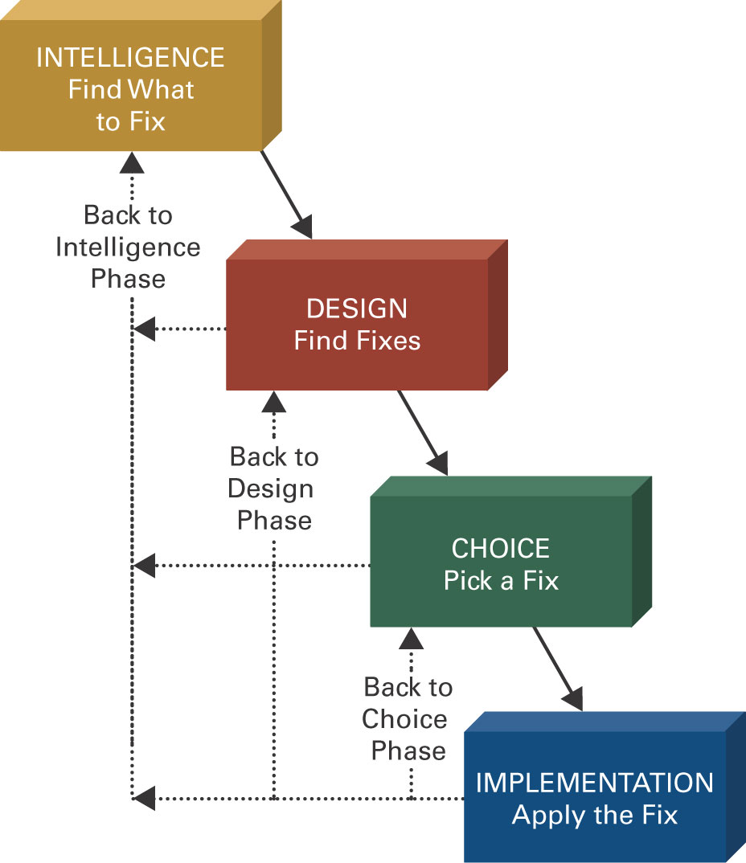
Four Phases of Decision Making

Slide 4
Types of Decisions
Structured
Semi-structured
Unstructured
Recurring vs. ad-hoc

Slide 5
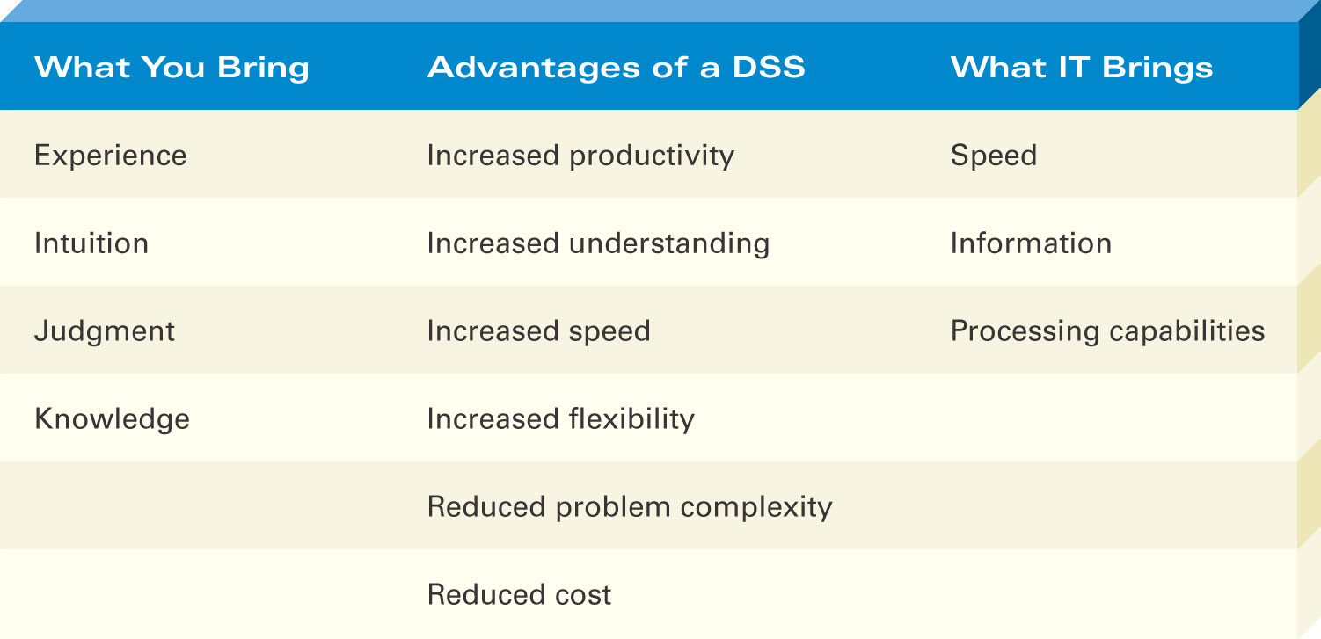
Decision Support Systems (DSS)
Highly flexible and interactive IT system designed to support unstructured and semi-structured decision making.

Slide 6
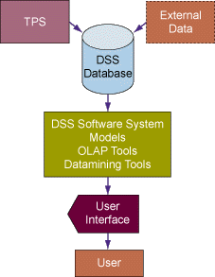
DSS Components

Slide 7
DSS Components
Model management - consists of both the DSS models and the DSS model management system.
Data management - performs the function of storing and maintaining the information that you want your DSS to use.
User interface management - allows you to communicate with the DSS.

Slide 8
DSS Capabilities
Sensitivity Analysis
Study of the effect that changes in one or more parts of a model have on other parts of the model
What-if Analysis
Checks the impact of a change in the assumptions or other input data on the proposed solution
Goal-seeking Analysis
Finds the value of the inputs necessary to achieve a desired level of output

Slide 9
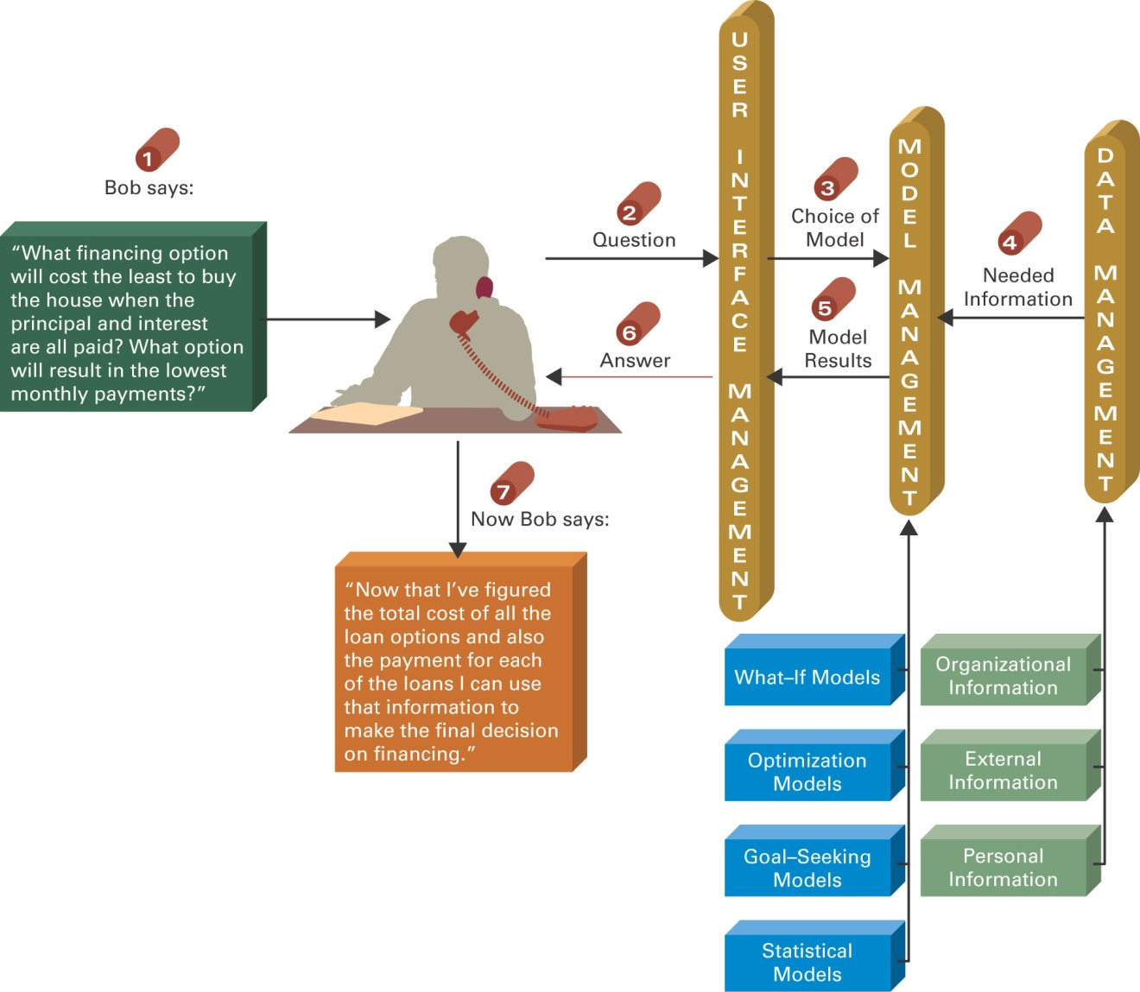
DSS Process

Slide 10
DSS Examples
General Accident Insurance: Customer buying patterns and fraud detection
Bank of America: Customer profiles
Frito-Lay: Price, advertising, promotion selection
Burlington Coat Factory: Store location and inventory mix
Keycorp: Targeting direct mail marketing customers
National Gypsum: Corporate planning & forecasting
Southern Railway: Train dispatching and routing
Texas Oil & Gas: Evaluation of potential drilling sites
United Airlines: Flight scheduling, passenger demand forecasting

Slide 11
Collaboration Systems
Interactive computer-based system that facilitates the solution of semi structured and unstructured problems by a group of decision makers.
Tools include - Electronic questionnaires, Electronic brainstorming tools, Idea organizers, Questionnaire tools

Slide 12
Collaboration System Benefits
Improved preplanning
Increased participation
Open, collaborative meeting atmosphere
Criticism-free idea generation
Evaluation objectivity
Idea organization and evaluation
Setting priorities and making decisions
Documentation of meetings
Access to external information

Slide 13
Geographic Information Systems (GIS)
Computer system with software that can analyze and display data using digitized maps. Enables display and analysis of spatial information.
Examples – Location analysis, law enforcement, identifying efficient delivery routes

Slide 14
Artificial Intelligence Systems
Artificial Intelligence (AI)
Branch of computer science that deals with ways of representing knowledge, using symbols rather than numbers, and heuristics, or rules of thumb, rather than algorithms for processing information
Objectives:
Make machines smarter
Understand what intelligence is
Make machines more useful

Slide 15
Commercial AI Systems
Expert systems (ESs)
Neural Networks
Genetic Algorithms
Intelligent Agents
Natural language technology
Speech (voice) understanding
Computer vision and scene recognition
Intelligent computer-aided instruction
Handwriting recognizers

Slide 16
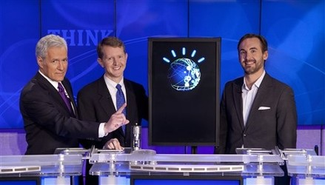
IBM Watson
90 IBM POWER 750 Servers on 10 racks
Each server has 4 processors
Each processor has 8 cores (2880 total cores)
16 Terabytes of RAM and 4 Terabytes of Clustered Storage
A single CPU machine would take 2 hours to answer a single question
Notes:
An offline copy of all of Wikipedia’s articles, as of the last full data-dump, is about 6.5GB compressed, 30GB uncompressed – that’s 1/500th Watson’s RAM

Slide 17
Expert Systems
AI based Information System that applies reasoning capabilities to solve very specific problems. These systems utilize expert knowledge and can replace an expert in the decision making process.
Good for diagnostic (what’s wrong?) and prescriptive (what to do?) problems

Slide 18
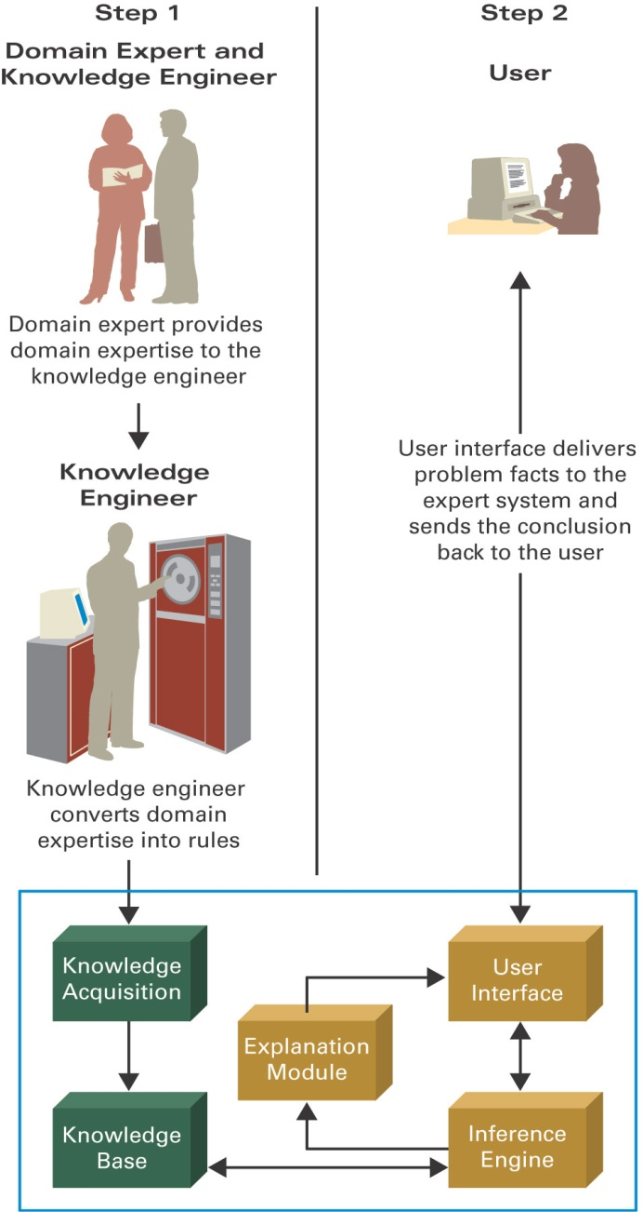
Expert Systems Process

Slide 19
Expert Systems Components
Knowledge base
Knowledge acquisition
Inference engine
User interface
Explanation module

Slide 20
Inference Engine

Slide 21
Expert Systems People
Domain expert - provides the domain expertise in the form of problem-solving strategies.
Knowledge engineer - IT specialist who formulates the domain expertise into an expert system.
Knowledge worker or user - that’s you.

Slide 22
Expert Systems
An expert system can:
Reduce errors
Improve customer service
Reduce costs
An expert system can’t:
Use common sense
Automate all processes

Slide 23
Artificial Neural Network (ANN)
Emulates a biological neural network
Receives information from other neurons or from external sources, transform the information, and pass it on to other neurons or as external outputs
Useful for pattern recognition, learning, and the interpretation of incomplete inputs

Slide 24
Neural Networks
Self-organizing neural network - finds patterns and relationships in vast amounts of data by itself
Back-propagation neural network - a neural network trained by someone

Slide 25
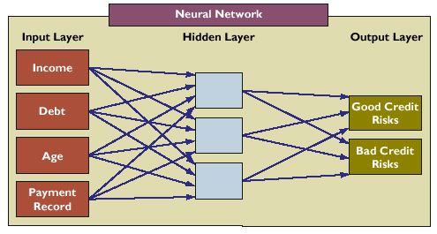
Neural Networks

Slide 26
Genetic Algorithms
AI based system that mimics the evolutionary, survival-of-the-fittest process to generate increasingly better solutions to a problem.
Selection - survival of the fittest.
Crossover - combining portions of good outcomes in the hope of creating an even better outcome.
Mutation - randomly trying combinations and evaluating the success (or failure) of the outcome.

Slide 27
Intelligent Agents (IA)
Software that assists you, or acts on your behalf, in performing repetitive computer-related tasks.
Four types of intelligent agents include:
Buyer agents or shopping bots
User or personal agents
Monitoring-and-surveillance or predictive agents
Data-mining agents

Slide 28
Intelligent Agents (IA)
Autonomy - act without your telling them every step to take.
Adaptivity - discovering, learning, and taking action independently.
Sociability - conferring with other agents.

