Slide 1
Intro to MIS - MGS351
Design and Implement Powerful Relational Databases
Chapter 6

Slide 2
Chapter Overview
Database Relationships
Referential Integrity
Cascade Update and Delete
Subforms
Helpful Access Utilities

Slide 3
Database Relationships
Tables should be related on primary and foreign keys with similar data and compatible data types.
Set relationships BEFORE entering data in the tables.
Click Database Tools Ribbon, click Relationships button

Slide 4
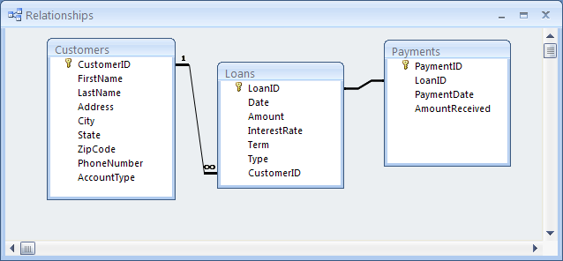
Relationships Window

Slide 5
Compatible Data Types
Primary Key Foreign Key
Short Text 1---∞ __________
Number 1---∞ __________
Date 1---∞ __________
AutoNumber 1---∞ __________

Slide 6
Errors in Relationships
Caused by one of three things:
1) Primary and/or foreign keys aren’t set properly in the table design
2) Data already exists in table(s) that violates referential integrity
3) Data types of related fields are incompatible or incorrect

Slide 7
Relationship Options
Referential Integrity - Ensures that related records in a database are consistent. Generally a good idea to enforce this option. When enforced, relationship line indicates 1 and ∞.
Cascade Update & Cascade Delete

Slide 8
Relationships Example

Slide 9
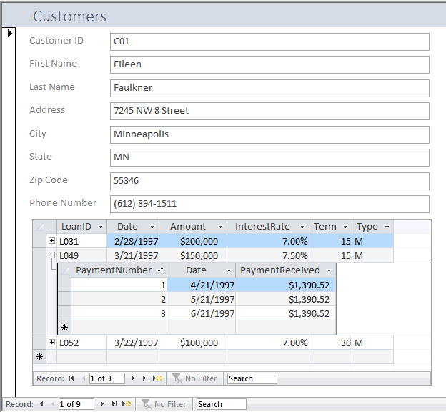
Subforms

Slide 10
Subforms
A form within a form
Displays data on one form from related tables
Can have subforms within subforms (nested) and multiple subforms on a single form

Slide 11
Subforms Example

Slide 12
Access Utilities
Compact & Repair Database – shrinks size of database. Access database files NEVER decrease in size unless compacted. Should do this before emailing a database file.
Click File Menu, Compact & Repair Database Button

Slide 13
External Data
Can be used to import data from other files (Excel, text) or link existing database tables.
ODBC link allows you to connect to non-Access databases such as Oracle.

Slide 14
Quick Review
Which is the appropriate pairing for setting relationships?
a. Short Text PK – Hyperlink FK
b. AutoNumber PK – Number FK
c. Date PK – Short Text FK
d. None of the above

Slide 15
Quick Review
A 1---∞ relationship exists between Physicians and Patients. Which is True?
a. Physician ID will appear in the Patients table
b. Patient ID will appear in the Physicians table
c. Both (a) or (b)
d. Neither (a) or (b)

Slide 16
Quick Review
Which of the following will remove the relationship between tables?
a. Click the join line connecting the two tables and press the Del key
b. Double click the join line
c. Click the join field and press Del
d. All of the above

Slide 17
Quick Review
Every table in an Access database
a. Must be related to every other table
b. Must have one or more foreign keys
c. Both (a) and (b)
d. Neither (a) nor (b)

Slide 18
Quick Review
Which of the following is true?
a. A main form may contain multiple subforms
b. A subform may contain another subform
c. Both (a) and (b)
d. Neither (a) nor (b)

Slide 19
Quick Review
True / False
When creating relationships between tables in Access, you must relate the tables on fields with the same data types.

Slide 20
Homework 4
Chapter 6 Guided Exercise
Chapter 6 Applied Exercise

