Slide 1
Intro to MIS - MGS351
Create Professional Quality
Output with Reports
Chapter 5

Slide 2
Chapter Overview
Using Reports in Access
Working With Reports
Identifying the Record Source
Report Example
Report Sections
Grouping, Sorting and Totaling

Slide 3
Reports
Used to format and present the database data in a professional, logical and useful manner. Often intended for printing and distribution. Can be built from tables or queries.

Slide 4
Reports
The reports (output) for a system dictate what data must be stored in the database.
Columnar
Tabular
Justified

Slide 5
Working with Reports – 4 views
Print Preview – Displays report as it appears when printed. Cannot modify design in this view.
Design View – Most powerful method to modify the layout, design and content of a report. Cannot view data in this view.

Slide 6
Working with Reports – 4 views
Report View – Displays data on report and enables temporary modifications to report design.
Layout View – Most flexible way to work with and modify a report. Displays the data while allowing you to modify the report design.

Slide 7
Report Wizard
Use it! Very useful as a starting point for building a report. Provides a framework you can customize and build upon.

Slide 8
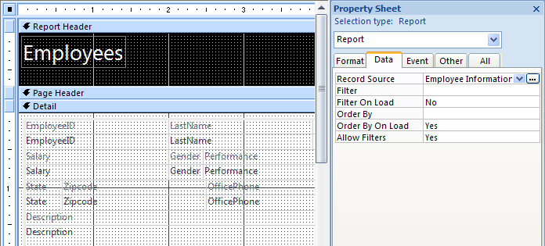
Identifying the Record Source
Click upper left corner to view properties for entire report. Record source property is in the Data tab. Click build button to view the report record source.

Slide 9
Report Example

Slide 10
Quick Review
A report may be based on
a. a table but not a query
b. a query but not a table
c. Either a table or query
d. Neither a table nor a query

Slide 11
Quick Review
Which enables you to edit the report design while also viewing the report data?
a. Design View
b. Datasheet View
c. Report View
d. Layout View

Slide 12
Quick Review
Which area of a report displays the record data and any other objects for each record?
a. Detail Section
b. Report Header Section
c. Page Header
d. Report Footer Section

Slide 13
Quick Review
An expression or formula would be used in a(n):
a. Bound Control
b. Unbound Control
c. Calculated Control
d. None of the above

Slide 14
Quick Review
A(n) ________ header appears at the top of each page in a report.

